Slide 1
Proposed set-up of EPSO APAC Working Group
23 Sep 2019
(For discussion)

Slide 2
Aim of EPSO APAC Working Group (WG)
Impetus for regulators to have more global outreach due to:
Porosity of healthcare services across boundaries
Increasing commonalities in new services and regulatory issues (digitalisation, new technologies, etc) amongst countries
The WG will serve as a regional network to encourage regulatory collaboration and exchange of best practices (a) across APAC members, and (b) between APAC and European countries

Slide 3
Example of global collaborations amongst regulators on other fronts…
International Coalition of Medicines Regulatory Authorities (ICMRA) is an international executive-level coalition of key medicine regulators from every region in the world.

Slide 4
What joining the APAC WG will encompass (for discussion)
Participate in annual/bi-annual meeting(s) in APAC region, to discuss identified topics of mutual interest
Participate in APAC WG sessions in EPSO Conference* (optional)
Countries to take up rotating 1-year term as secretariat to organise the APAC regional meetings
1
2
3
*Countries may need to become an EPSO member to join the EPSO conference

Slide 5
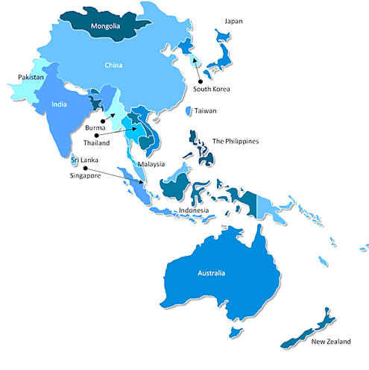
We intend for the WG to start off covering the countries/ regions in red
China
Hong Kong
Thailand
Malaysia
Singapore
Indonesia
Any others to propose?
Australia
New Zealand

Slide 6
Potential topics of interest (for discussion)
Digital Health regulations (including Cybersecurity, Data Privacy & Data Protection)
New Sensing and Regulatory Oversight on new technologies (e.g. Telemedicine, Genetic Testing Services and Artificial Intelligence)
Approach towards Outcome-Based Regulations
Regulations for Aged Care Facilities for Medical and Social Care
Any other topics to propose?

Slide 7
What next?
SG offers to be secy for 2020
To reach out to other APAC countries and confirm members
Once members are confirmed, SG to organise 1st EPSO APAC WG meeting tentatively in mid-2020

