Slide 1
Minister of Health, Labor and Social Protection from Republic of Moldova
National Agency for Public Health
Moldovan delegation
Vaile GUSTIUC - Deputy director, National Public Health Agency
Speaker : Alexandru VOLOC –
Secretary of State,Ministry
of Health,Labour and
Social Protection in Moldova
Cristian Niguleanu - Main inspector,
National Public Health Agency
28th Conference &Working groups
23-25th September 2019 Malmö, Sweden

Slide 2
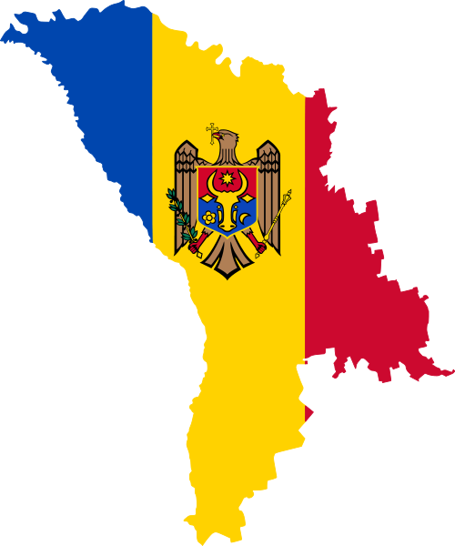
Country profile - Republic of Moldova
Background
of the state service
on public health surveillance
An independent
Republic from 1991
Inherited Semashko system with an extensive infrastructure of sanitary-epidemiological stations
Area: 33,800 sq km
Life expectancy:
75.7 years for women
and 67.6 years for men
First structural reform in 1993 followed by 2 administrative reforms of the PH service (1998 and 2001) and one structural adjustment (2009)
Inhabitants : 4.0 mil, 3.5 mil. (without Transnistria)
Total 1531 settlements
48.1% of men and 51.9% of women
NCDs account for
89.0% of deaths
Predominantly rural population (58.6%)
The gross domestic product per capita – US$ 3,300
GDP index increased to 100% from 2000.
Law on State Surveillance of Public Health (No. 10-XVI, 3 February 2009)
Notes:
Data of the National Bureau of Statistics show that the population of the Republic of Moldova in 2010 was 3 563 695, comprising 51.9% women and 48.1% men. The population has declined since 1989 due to high emigration and a low birth rate. According to data from the National Bureau of Statistics, nominal GDP in 2011 was 8 billion lei (around US$ 7 billion).
Both public finance and external trade indicators have improved in recent years, but inflation persists and is highly influenced by external factors such as food, gas and energy price increases.
Urbanization is lower than in Europe generally.
Each of 35 districts and two municipalities has a territorial Centre of Public Health that provides services across all subordinated territory.

Slide 3
Public Health Reforms
Undertaken steps
State Sanitary – Epidemiological Service
Affordability Ensuring that the patients, healthcare providers and governments can afford the product
Quality/Acceptability
Ensuring that the product works as intended, is efficacious and safe
State Surveillance Service of Public Health
2012 – Analysis of public health operations, services and activities
2014 – National Public Health Strategy (2014 - 2020)
National Scientific and Practical Center of Preventive Medicine
National Centre of Public Health
2016 – Regionalization of PH laboratories, from 36 district laboratories to 10 regional
2017, May – the concept of PH Reform was approved by the Government
2017, December – the statute of the National Agency for Public Health was endorsed by the Government
2018 – started to implement the PH reform

Slide 4
Institutions involved in the reform of the PH service
Inspectorate of pharmaceuticals and medical devices*
(4 staff positions)
National Center for Health Management
(135 staff positions)
National Council for Assessment and Accreditation in Health Care
(15 staff positions)
National Public Health Agency
(1665 staff)
Municipal Centres for Public Health
(624 staff positions)
District Centres for Public Health
1699 staff positions
National Centre for Public Health
(379 staff positions)
* From Medicines and Medical Devices Agency

Slide 5
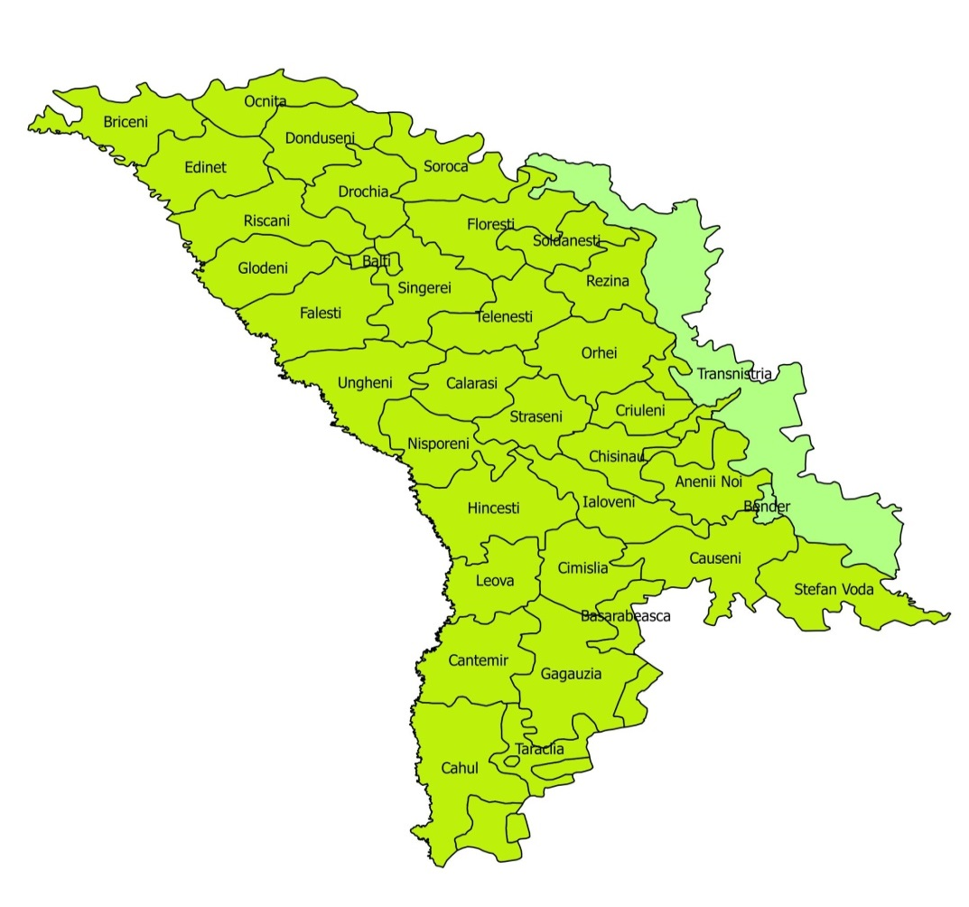
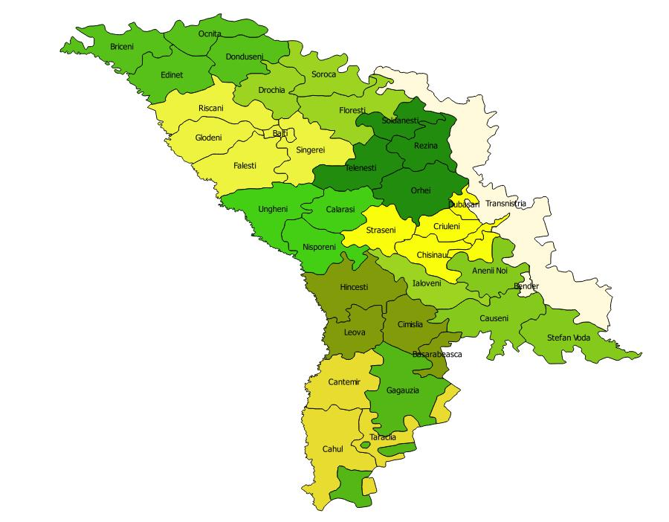
Territorial distribution of the institutions before and after reform
2009 – November,
- 2017
From December,
2017
Notes:
On this page we can visualize the location of public health centers until the reform, and after

Slide 6
Key challenges and premises of PH service reform
The large network of PH centres. The limited capacity of the MoH to coordinate PH activities and subordinated institutions
Unbalanced distribution of functions within PH service. Core public health functions represent a small part of the activities. Duplications of functions with other services
Reform of the Government structures
Governance and organization
Limited financing of public health institutions
Low and uncompetitive salaries of the PH servants
PH institutions deliver market-oriented activities
Financing
PH workforce
A lack of the well-trained workforce within PH system determined by uncompetitive salary and fragmented governance

Slide 7
The main Responsibilitie of the National Agency for Public Health
Disease surveillance
Science and Research in Public Health
Health Promotion and NCD prevention and Control
Response support
Public health alerts monitoring division
Risk assessment
Laboratory coordination division (quality control, equipment maintenance)
Preparedness and capacity strengthening training
Communication

Slide 8
Organizational structure of the National Public Health Agency
Coordination Council
Administration
Dispute Resolution Council
NCD Department
Department of Communicable Diseases
Health Care Accreditation Department
Health Inspectorate
Health Promotion
Department
Department of
PH Emergency
Management
Quality
Health Services
Support Services
Health Protection
Department
PH Laboratories
Health
Statistics
10 regional branches
Research Directorate
Human Resources
Notes:
The activity of the Supervisory is coordinated directly by the NAPH Deputy Director.

Slide 9
Distribution of human resources
1%
Data monitoring and analysis/Surveillance of population health
4%
Public Health Service, 2016
National Public Health Agency, 2018
24%
Laboratory Service
27%
15%
Control of communicable diseases
16%
13%
Health Protection
12%
Research in Public Health -
209 staff position
16%
Health Inspection
7%
Control of NCDs and health promotion
10%
3%
IT Service
21%
Management and support
31%

Slide 10
Finanțare

Slide 11
Organizational structure of the Inspectorate
186
state units
23
state units
Directorate of state control in health (HQ)
Total
209
state units
Sections of state health control in 10 territorial HPCs
11,0%
89,0%
Notes:
In order to carry out the basic tasks and functions of the Inspectorate, according to the approved personnel state, the personnel number constitutes 209 state units, including 23 units are distributed within the sections of the State Health Control Directorate (central level) the other 186 units are distributed to the 10 territorial Public Health Centers, which are uniformly distributed in all administrative territories of the Republic of Moldova.

Slide 12
Directorate of state control in Health ( INSPECTORATE )
The main goal of the reform of the State Public Health Surveillance Service was to separate the functions of state control from the functions of supervision, monitoring and health assessment, by creating in the National Agency for Public Health the Directorate of state control in health, which aims to:
assessments of the way in which natural or legal person comply with the legislation in the field of public health.
granting of the advisory aid and methodological of the natural or legal persons in identify avenues for effective enforcement of the legislation and measures to prevent infringements, as well as the liquidation of violations in case of their finding
ascertain and sanction of violations of the current legislation in accordance with the competence.
Notes:
Number of inspections/supervisions : For example, in the Schedule of controls planned for 2019 there are 5004 entities with a wide range of services. In addition unannounced controls may also occur based on complains, for example in the first quarter 2190 controls were performed from which 1197 unannounced, including 826 (69%) of them for the purpose of issuing permissive acts and 371 (31%) for the purpose of examining the various complains and notifications received.
Number of hospitals or health institutions under supervision - 61 hospitals under supervision for 2019 and 526 health institutions.

Slide 13
The directorate of state control in Health is vested by legislation with the task of state control in the following areas:
1
Overseeing compliance with legislation in the field of public health – by Any form of verification, review, audit, evaluation and / or analysis exercised in order to ascertain compliance with the law and to verify certain facts relevant to the field of control, on the spot and / or by direct request from the person under review of the documentation and other information by mail, including by electronic mail, or by telephone, information which, by virtue of law, it is not obliged to offer.

Slide 14
The Occupational safety department is responsible for the proper outgoing work
2
By coordinating primary, secondary and tertiary prevention activities; organizing and conducting consultancy visits in order to familiarize economic operators and consumers with the requirements of consumer legislation to take precautions and implement measures to prevent accidents or incidents .

Slide 15
The circulation of medicinal products, para-pharmaceutical products, control of medical devices, including their radiological and nuclear safety, and services provided by medical institutions, pharmaceutical activity, carried on the business by pharmaceutical undertakings and their subsidiaries active in the wholesale and retail distribution;
3
among other things NAPH have the scope to supervision circulation of narcotic drugs, psychotropic substances and precursors;
4

Slide 16
The consumer protection in the field of medicinal products, pharmaceutical and para pharmaceutical services provided by medical and pharmaceutical institutions and for other products and services available to consumers of pharmaceutical and medical enterprises and institutions;
5

Slide 17
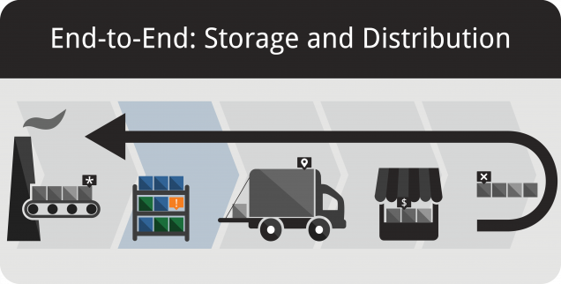
Directorate of state control in Health ( INSPECTORATE )
The market surveillance on non-food products in the areas governed, including materials in contact with food.
6
The transplant activity with quality control and testing of all donation, procurement, testing, storage and distribution activities to ensure the quality and safety of organs, tissues and cells used for transplantation
7

Slide 18
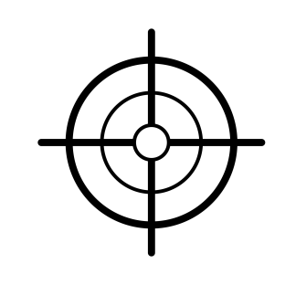
Strengths and Weaknesses of the new PH Agency
Strengths
Connecting limited public health workforce into one network
Pooling the supportive services (legal, finances)
Better coordination of activities within the PH service
Reduce some unnecessary costs
Weaknesses
Many domains of activity that would be difficult to coordinate and accomplish
Vertical structure that have to identify appropriate mechanisms for horizontal coordination of activities
Inspection and service delivery in one institution (conflict of interests)
Aims
Development of the Road – Map for implementation of the institutional reform of PH service
Define the human resource action plan and empower workers to identify their opportunities in the new Agency
Define and implement appropriate changes (legislation, statutes, internal coordination mechanisms)
Monitor, evaluate and apply corrective actions
Notes:
INTERESTING ONGOING DEVELOPMENTS IN OUR COUNTRY:
NAPH is enabled to enforce implementation of the National legislation in tobacco control, which is in line with Framework Convention on tobacco control main areas of interventions: Total ban of Tabaco smoking in enclose environments, in public institutions territories especially health care and educational facilities; Enforcing applications of pictorial health warnings on tobacco packs; Enforcing restrictions on trade of tobacco products, location of selling points, total ban on using vending machines and selling to minors

