Slide 1
Administration for Inspection Affairs of Montenegro
10 – 12 April 2019 in Porto, Portugal

Slide 2
About us - reminder
Administration for Inspection Affairs (AIA) was established in June, 2012
It consists of six departments and two services. Inspection sectors belong to four different departments.
282 employees – 220 inspectors within 22 inspection sectors
28 health and sanitary inspectors
4 inspectors for social and child protection
One budget for all inspection sectors.

Slide 3
Inspection offices around Montenegro

Slide 4
Principles and methods of control
Transparency
Efficacy
Prevention
Sameness of rules and procedures
Non-discrimination on any ground
Public interest protection

Slide 5
Inspections – priorities and indicators
All inspection sectors carry out inspection according to an annual plan, upon the order of director, deputy director or chief inspector, upon initiatives of health institutions, legal or natural entities, upon citizens’ complaints and in order to check whether the subject has removed previously identified irregularities.
Inspectors always give priorities to complaints over the regular inspections.

Slide 6
Health and Sanitary Inspection
According to the Law on Health Protection, this inspection controls the following types of health care institutions:
Infirmaries
Laboratories
Pharmacies
Polyclinics
Health centres
Hospitals
Health retreats and healing resorts
Clinics
Clinical and hospital centre
Public Health Institute

Slide 7
Health and Sanitary Inspection – indicators used
All types of health care institutions are obliged to fulfill the requirements related to premises, staff and equipment, prescribed by the Ministry of Health.
Minor violation indicator: Minor violations may not endanger people’s lives. Such violations are lack of documentation; non-display of working hours etc.
Serious violation indicator: Serious violation may have a negative (direct or indirect) effect on people’s lives. The examples of such violations are:
A doctor is not in a infirmary
A pharmacist is not in a pharmacy
Opening a health centre without a permit
Lack of important health records
Etc.
The Administration for Inspection Affairs regularly informs the Ministry of Health in a written form as well as on meetings.

Slide 8
Inspection of Social and Child Protection
In Montenegro there are both public and private institutions of social and child protection. These institutions can be organised as business entities, NGOs, etc.
According to Law on Social and Child Protection, Inspection of Social and Child Protection controls the following types of institutions:
Social Work Centre
Orphanages
Elderly Home Care Institutions
Daily Centres for Children with Disabilities

Slide 9
Inspection of Social and Child Protection- priorities
This inspection sector gives priority to:
Complaints of beneficiaries of social and child protection,
Citizens’ initiatives,
Initiatives of legal entities,
Initiatives of state bodies.
In addition, this inspection gives priority to those institutions that were facing difficulties during previous years.

Slide 10
Inspection of Social and Child Protection- indicators used
In accordance with the Law on Social and Child Protection and the Law on Inspection, inspectors control whether institutions fulfill legal requirements for functioning and set standards. In relations to this, violations may be minor and serious ones.
Minor violation indicators: Minor violations are those that may not endanger beneficiaries' health and life, such as lack of certain equipment in the space in which they live.

Slide 11
Inspection of Social and Child Protection- indicators used
Serious violation indicators: Serious violations are those which may (directly or indirectly) endanger beneficiaries' health and life. The examples of such violations are:
Bad living conditions
Extremely poor standards of hygiene
Work of a social or child protection institution without a permit
A change in standards after obtaining a work permit
Providing social and child protection without having concluded an agreement with a beneficiary
Lack of expert staff in social and child protection institutions

Slide 12
Inspection of Social and Child Protection- measures taken
In cases of minor violations, inspectors take a measure of indication. If a subject of control does not act upon this measure within the given timeframe, inspectors impose fines.
In case of serious violations, inspectors forbid further work of the institution.
Inspection of Social and Child Protection informs the line ministry in issues related to control of expert service providing and in situations in which inspectors identify improper implementation of set procedures.

Slide 13
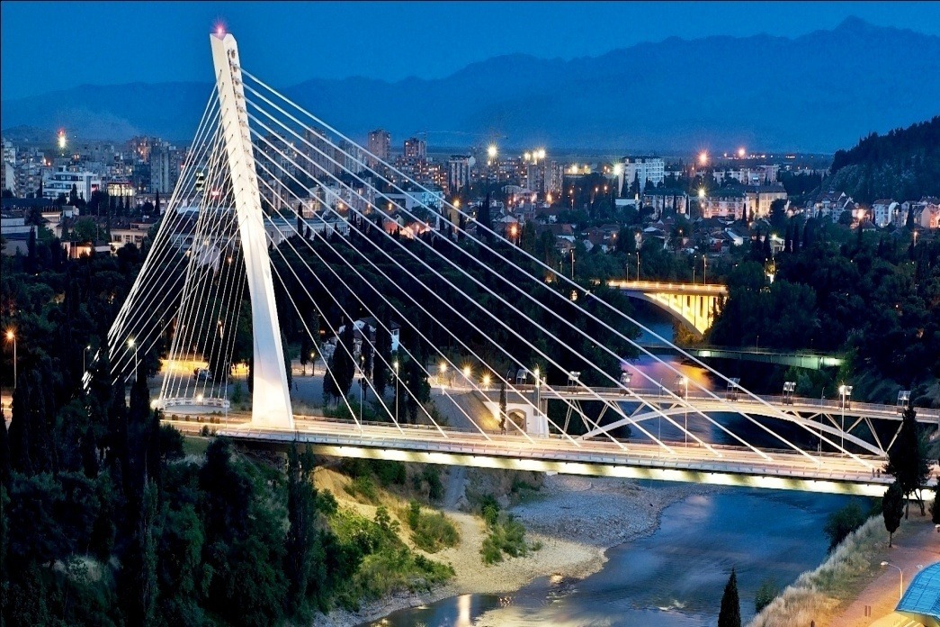
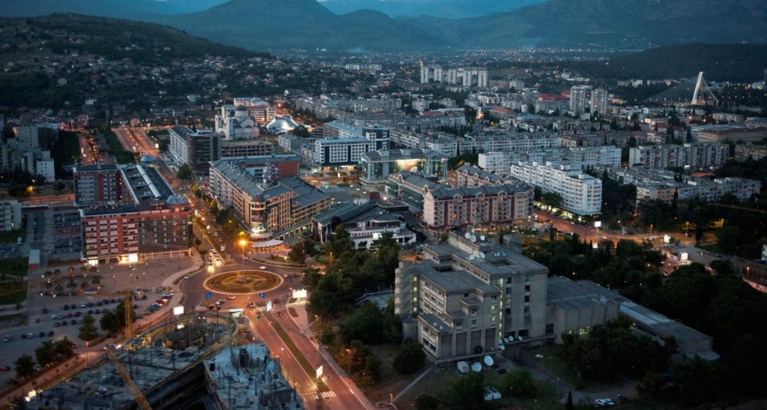
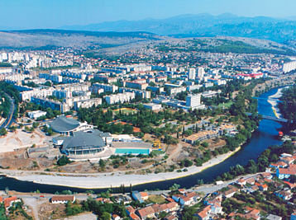
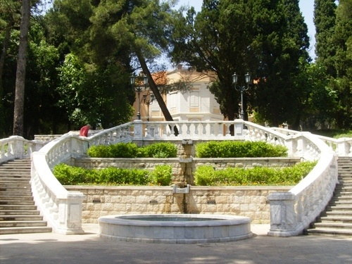
PODGORICA- THE CAPITAL

Slide 14
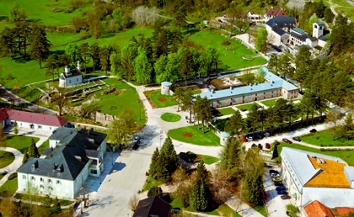
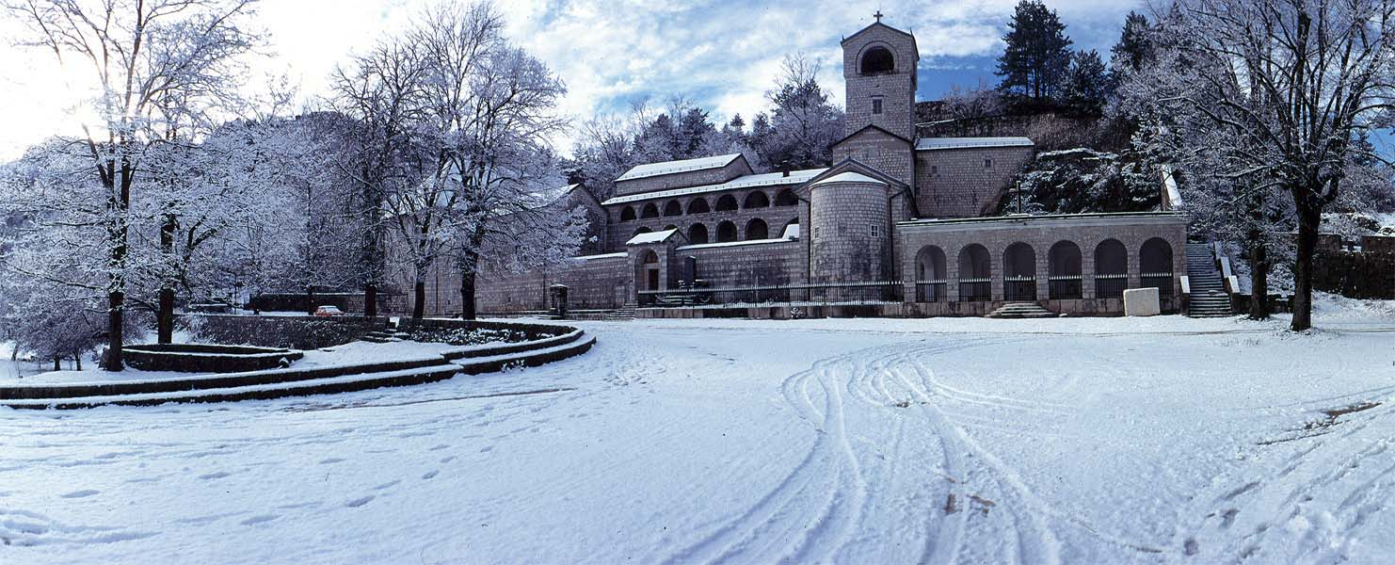
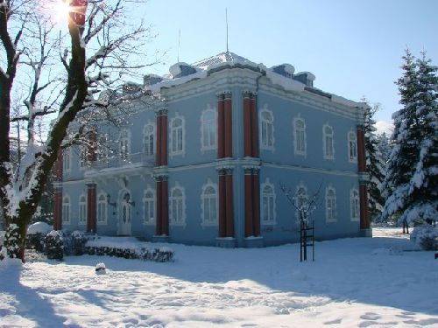
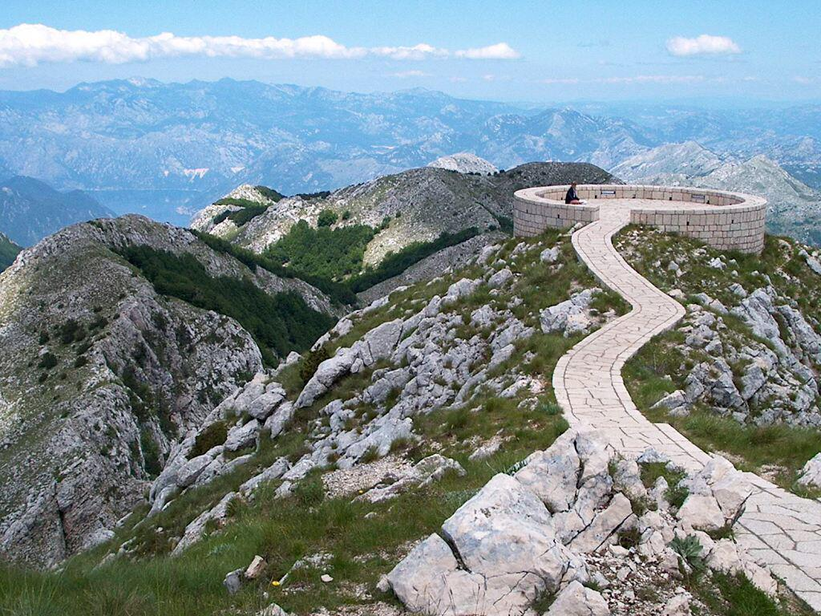
CETINJE – THE OLD ROYAL CAPITAL

Slide 15
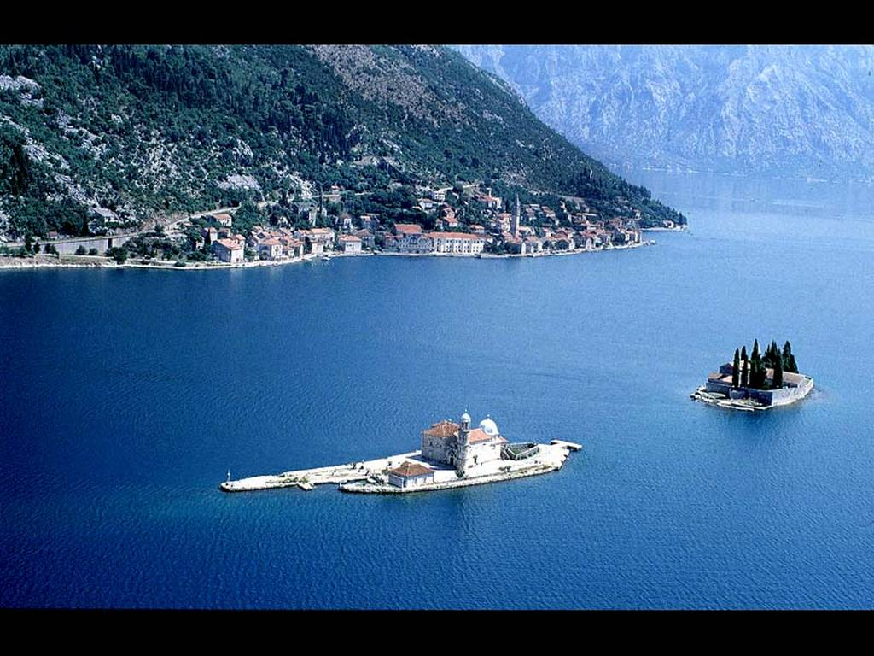
Bay of Kotor

Slide 16
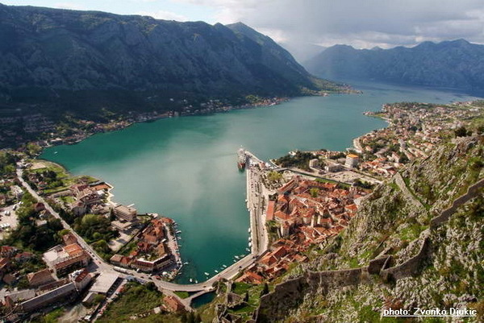
KOTOR

Slide 17
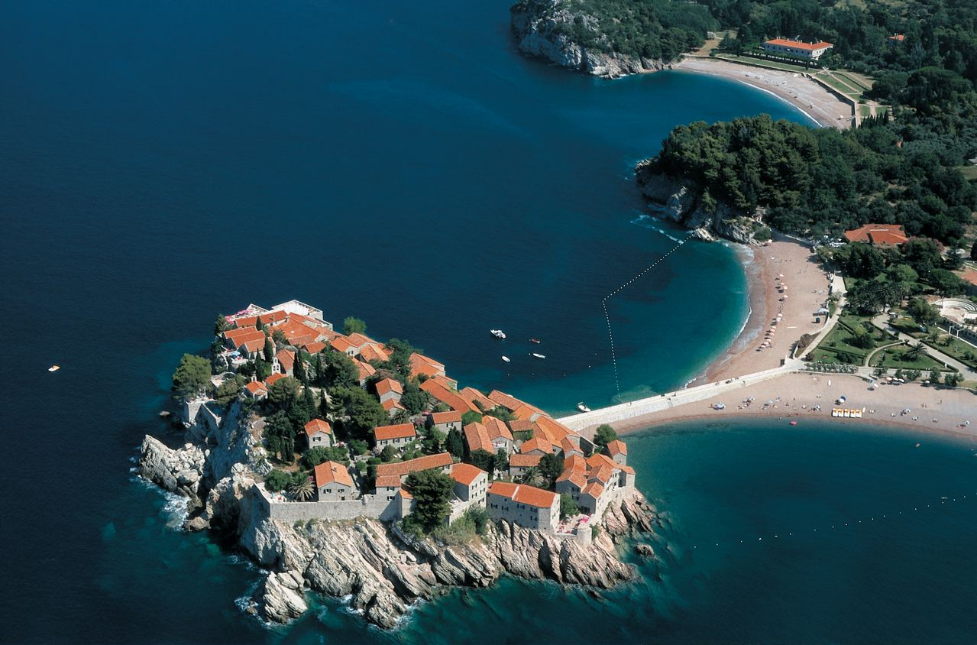
SVETI STEFAN

Slide 18
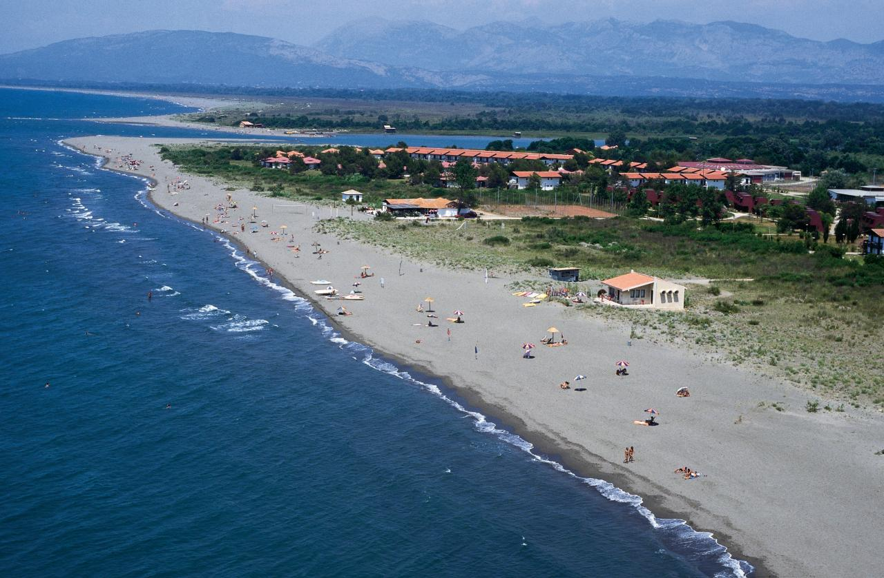
Long beach - Ulcinj

Slide 19
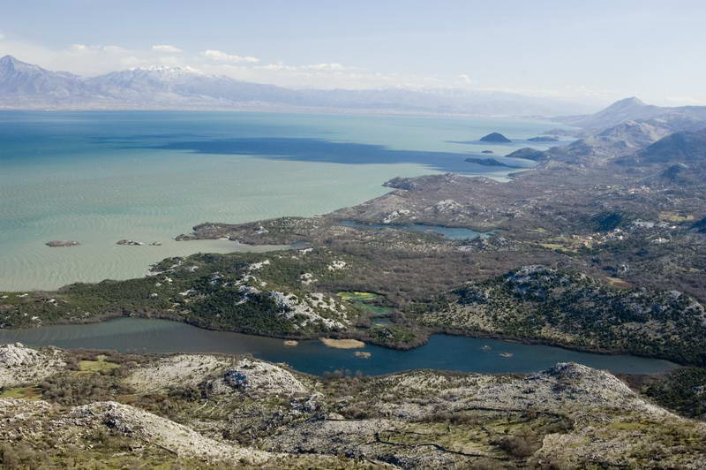
SKADAR LAKE

Slide 20
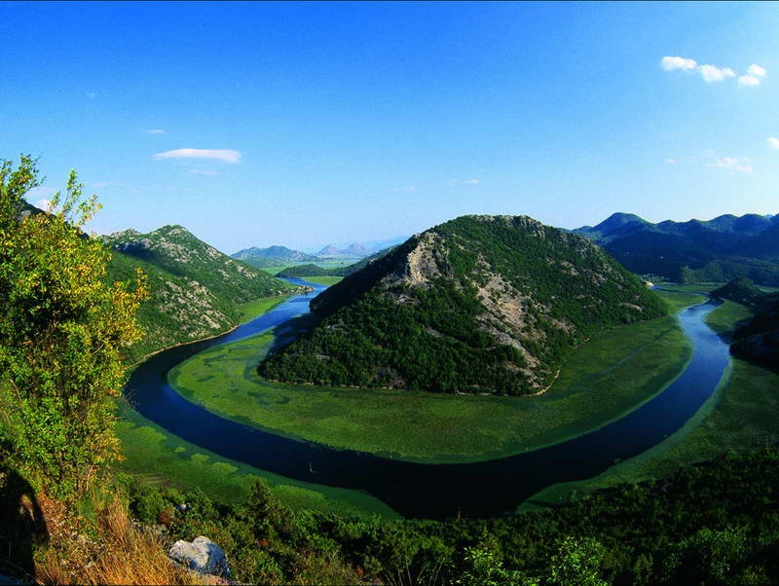
RIJEKA CRNOJEVICA

Slide 21
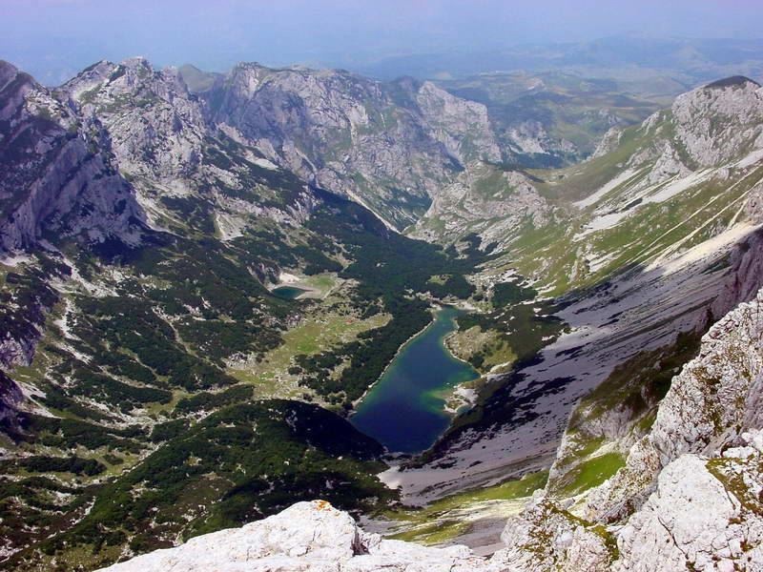
DURMITOR

Slide 22
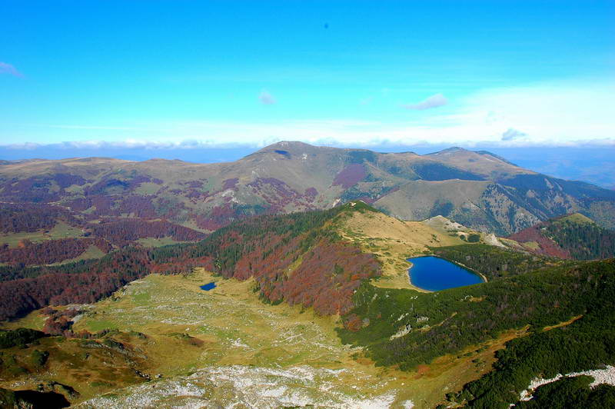
BIOGRADSKA GORA

Slide 23
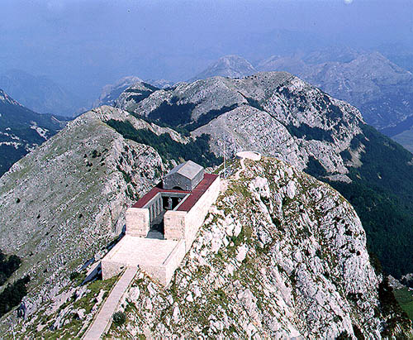
LOVCEN

Slide 24
THE TARA RIVER

Slide 25
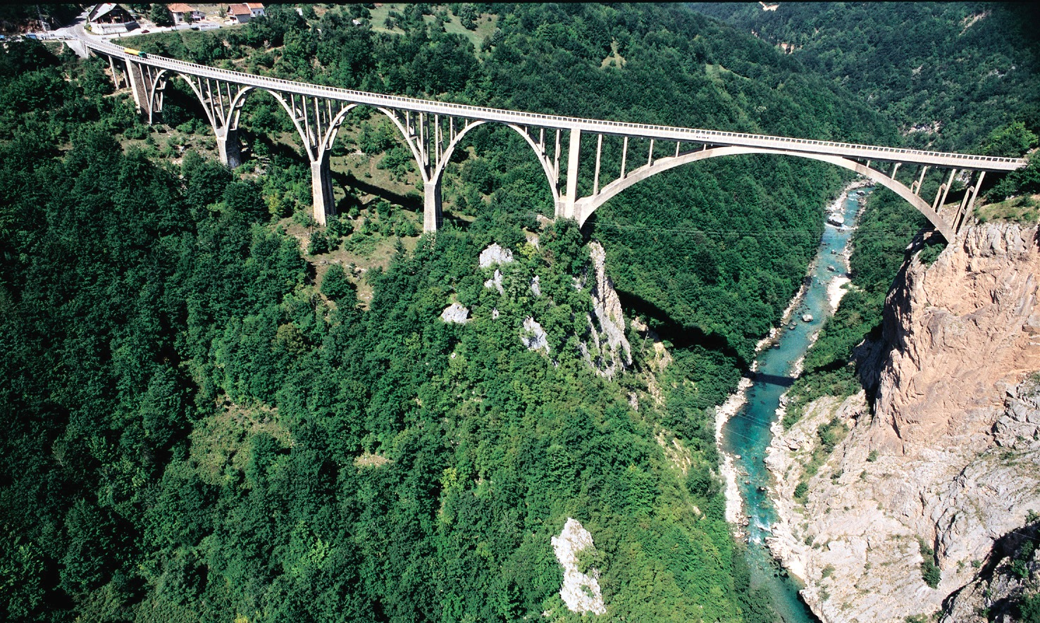
THE TARA RIVER

Slide 26
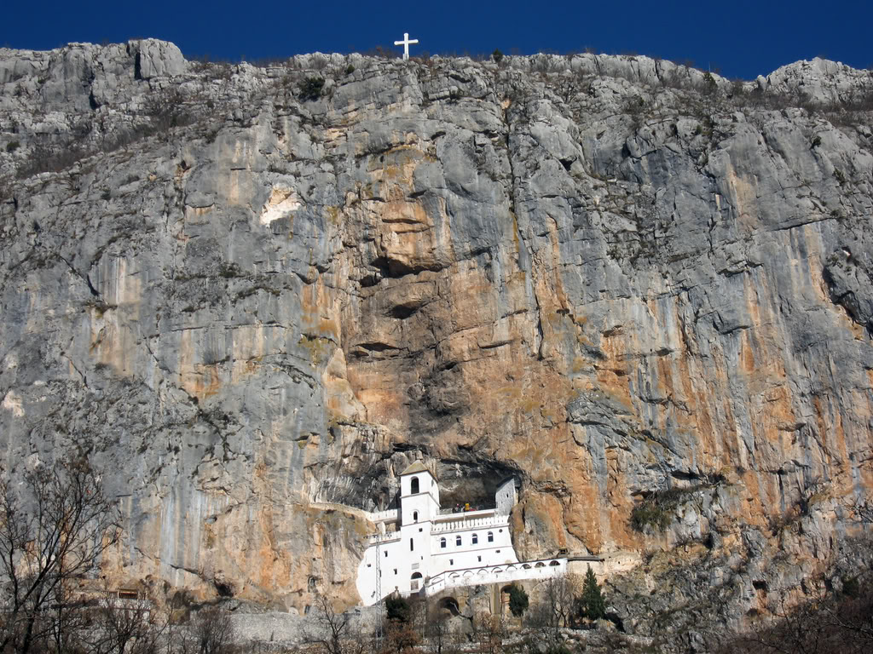
OSTROG MONASTERY

Slide 27
