Slide 1

Inspecting Care at Home (Domiciliary Care) in Scotland
EPSO Conference – Porto, Portugal
12 April 2019
Kevin Mitchell
Executive Director of Scrutiny & Assurance

Slide 2

The Care Inspectorate
Public body funded by Scottish Government
630 staff
£37.5M budget
Core Purpose:
Scrutiny and assurance that supports improvement in achieving world class care for the people of Scotland

Slide 3

13,230 Registered Care Services
Early learning and childcare
Services for older people
Children’s services
Community justice & social work criminal justice
Services for adults

Slide 4
Care at Home (Domiciliary Care)
(registered as support service )
‘... a service which provides support, assistance, advice or counselling to a vulnerable person to enable a person to live in their own home or in the community… It does not include a care home service or service providing overnight accommodation….

Slide 5
Care at Home Provided by :
Health Board
5 (0.5%)
Local Authorities
127 (12.4%)
Private
390 (38%)
Voluntary / 3rd Sector
505 (49%)
Total Number of Services
1,027

Slide 6
Complaints
We receive about 400 complaints each month
50% of those are about care homes
18% are about care at home
Most reported by friend, relative or visitor
Complaints about staffing are increasing

Slide 7
92% inspections show good, very good or excellent care
86% inspections show good, very good or excellent management leadership

Slide 8
Good Quality Care
Relationship based practice – interaction a person receiving the support has with the staff who support them
…linked to how well recruited, trained, supervised , supported and resourced these staff are to fulfil their role…
… contingent on the effectiveness of the service provider’s back-office arrangements in terms of co-ordination, communication, continuity and contingency ….
... which can be impacted by how the provider’s services are contracted and commissioned….

Slide 9


The new Health and Care Standards

Slide 10

How are the new standards different?
Human rights and wellbeing
Person-led
Outcome focused
Decoupled
from settings
Outcome focused

Slide 11
Five general standards
I experience high quality care and support that is right for me.
I am fully involved in all decisions about my care and support.
I have confidence in the people who support and care for me.
I have confidence in the organisation providing my care and support.
I experience a high quality environment if the organisation provides the premises.

Slide 12

New Care Standards
1.17 I can choose from as wide a range of services and providers as possible, which have been planned, commissioned and procured to meet my needs.
3.8 I can build a trusting relationship with the person supporting and caring for me in a way that we both feel comfortable with.
3.11 I know who provides my care and support on a day to day basis and what they are expected to do. If possible, I can have a say on who provides my care and support.
4.15 I experience stability in my care and support from people who know my needs, choices and wishes, even if there are changes in the service or organisation.
3.15 My needs are met by the right number of people.
4.16 I am supported and cared for by people I know so that I experience consistency and continuity
3.16 People have time to support and care for me and to speak with me.
3.19 My care and support is consistent and stable because people work together well.
-v- Time and Task / What providers are funded/contracted to do
-v- late, short or missed ‘visits’ & consistency and continuity of care
.

Slide 13
Quality Framework
1.4 People are getting the right service for them ?

Slide 14

‘Above and Beyond’ – The experience from Wales
How do local councils commission domiciliary care services?
What is working well and what could be improved?
How do domiciliary care services organise the care they provide?
What quality of care do people receive?
What are care workers pay and conditions like and what challenges do they face?
What quality assurance systems are in place?

Slide 15
Opportunities for ‘Above and Beyond’ in Scotland?
New Inspection Methodology
New Quality Framework
New Care Standards
Joint Inspections of Strategic Commissioning
Thematic Inspections of Key Policy Arears

Slide 16
Opportunities for ‘Above and Beyond’ in Scotland?
New Inspection Methodology
Application of New Health and Care Standards
Develop a New (Service Specific) Quality Framework
Link to Strategic Scrutiny of Integration Authorities
Thematic Scrutiny of Policy Areas
Greater emphasis on self-evaluation
The intention is to develop this model and
test this approach in 2019/20

Slide 17
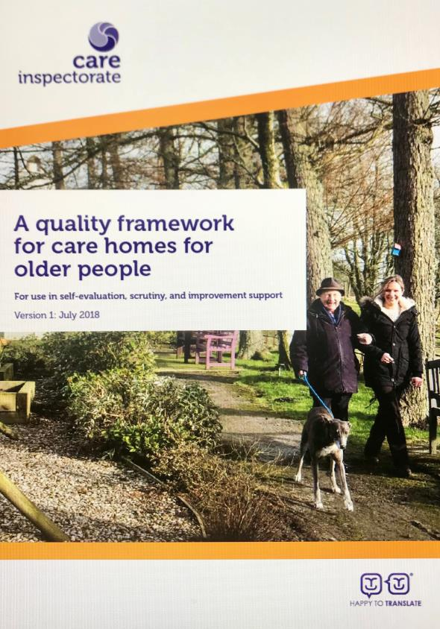

Slide 18
Inspecting Care at Home (Domiciliary Care) in Scotland
EPSO Conference – Porto, Portugal
Thank You
Kevin Mitchell
Executive Director of Scrutiny & Assurance
kevin.mitchell@careinspectorate.gov.scot

