Slide 1
The developing quality concept: recent developments in the Netherlands
Prof. dr. Henk Nies
Vilans, Centre of Expertise for Long-term Care, Utrecht
Vrije Universiteit, Amsterdam
Quality Council, National Health Care Institute
24 September2019
Malmö
www.vilans.org

Slide 2
This presentation
Developments in conceptualising ‘quality’
National Quality Council’s view
Quality of care and quality management
Principles of quality management
Use of data
What is key in health?
The example of the nursing homes framework
Dilemmas

Slide 3
Developments in conceptualising ‘quality’
Input:
sources of knwoledge
Practice
Output
‘Old’ quality
Implicit
Protectionistic
Practice variation
Current quality
Explicit
Reductionistic
Uniformity
‘New’ quality
Explicit and impliciet
Learning
Pluriformity

Slide 4
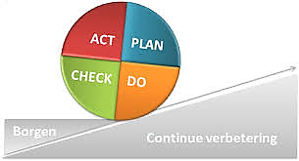
Quality is…
A normative concept and is:
Personal, shared with others ánd collective
Pluriform and reflects multiple perspectives and interests
Contextual in settings and time
Only to a certain extent objective and collective
Not the average; everyone is a deviation of the average
A moral concept reflecting a ‘good’ life from the person’s perspective
Self-direction, being connected, meaningful life
Within a framework that is defined by society: quality in relation to access, sustainability and pluralism in care

Slide 5
Quality of care…
Increases capabilities and enhances opportunities to realize a ‘good’ life as defined by the person; health is a precondition
Balances interests of users, relatives, informal carers, professionals, care providing organisations, the (health and social) care system and society
Can only be partially objectified
Connects knowledge based on measurable data, users experience and practice experience of professional carers
Emerges in the interaction of users and professional carers; it is their endeavour to come to shared objectives and decisions
Contributes to learning and improving, less to accountability
Grounded in intrinsic motivation: desire instead of obligation

Slide 6
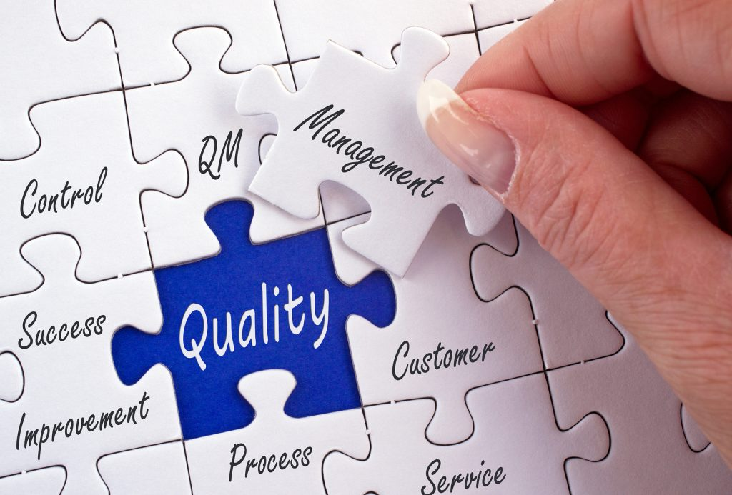
Principles of quality management
Contributes to learning and improving
Accountability and commissioning criteria are secondary
Grounded in intrinsic motivation: desire instead of obligation
Based on trust and openness
Assisted by instruments and processes such as indicators, dialogues about values, learning networks, user experiences as inputs, joint prioritising, quality systems
Instruments and processes are means,
not ends!

Slide 7
Use of data
Various sources and kinds of data
Quality, safety, conditions
Primary care process
Experiences of users and informal and formal carers
Purposefully collected
Scientific (quantitative and qualitative), eclectic
Local and individual
Big data (?)
Aiming at improvement and risk reduction
National comparisons: not as a standard

Slide 8
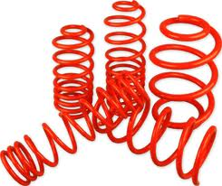
What is key in health? (Machteld Huber, 2011; 2017)
WHO definition (1948)
a state of complete physical, mental and social wellbeing and not merely the absence of disease or infirmity
New concept (Huber et al., 2011)
health as the ability to adapt and self manage, in the face of social, physical and emotional challenges

Slide 9
Health is a multi-facated concept (Machteld Huber, 2011; 2017)

Slide 11
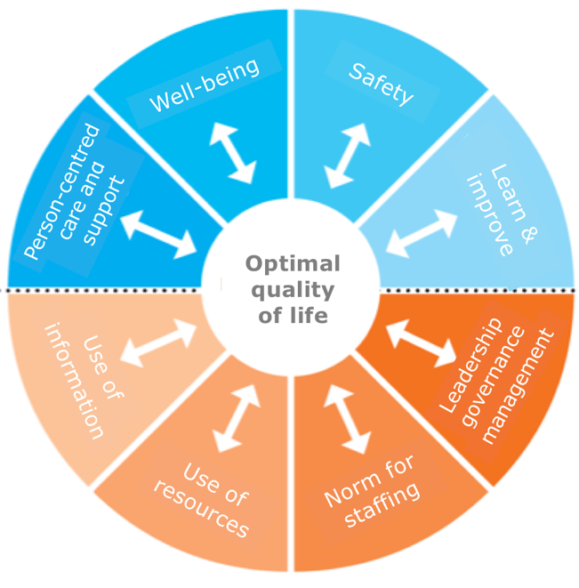
The structure of the quality standard for nursing homes
Quality & Safety
Person-centered care & support
Life & well-being
Safety
Learn & improve
Conditions
Leadership & governance
Norm for staffing
Use of resources
Use of information

Slide 12
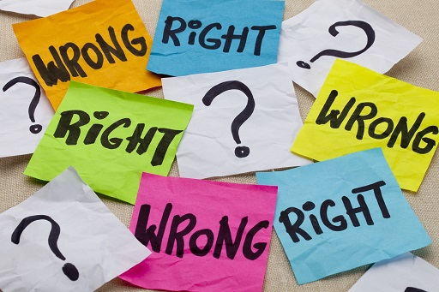
Dilemmas
Accountability to users, relatives and staff, and/or to external parties?
Learning and improving from colleagues, at organisational and team level: time, organisation, competition
Less emphasis on regulation, inspection, accreditation, or other types of regulation, inspection, accreditation?
Is trust always justified?
Reduced or other transparency and bureaucracy: unachievable goals?
The inspector facilitating or monitoring learning and improvement?
Quality to any price?
Quality or quantity?
Labour market and funding: sufficient time, staff and money?

Slide 13
Key question
Should quality rely on trust as a key value?

Slide 14
Thank you for your attention!
Prof. dr. Henk Nies
Vilans, Utrecht
Vrije Universiteit Amsterdam
h.nies@vilans.nl
+31307892308
+31622498862
www.vilans.org

