Slide 1
New initiatives for health care quality improvement in Latvia EPSO 28th Conference
Evija Palčeja
Head of Strategic Planning and Development Department
25.10.2019.

Slide 2
Health Inspectorate - basic information
Subordinated to the Ministry of Health;
Supervision of healthcare (incl. distribution of medical devices and register of HC institutions and medical practitioners), public health and pharmaceutical market;
Employees – 210;
Budget 4 244 645 EUR (remuneration – 3 524 849 EUR);
Healthcare sector:
4024 healthcare institutions;
19 health inspectors; 17 physicians-experts
~900 on-site controls/year;
~800-900 considered complaints/year;
~200 claims for Medical Risk Fund.

Slide 3
Recommendations of the EURINSPECT team
1. Re-position the HI as more independent, transparent and accountable entity.
2. Move to more of a learning culture (including thematic review of common and systemic problems).
3. Empower the staff (continuous education, fostering an integrated culture).
4. Improve the image of the inspectorate.
5. Focus on improving the quality and safety of healthcare.
6. Move from compliance to more co-operative methods.
7. Introduce self-assessment as part of the review framework.
8. Introduce better risk-based profiling and better use of indicators.
9. Redesign the complaints procedure e.g. consider introducing a triage process, categorisation and a mediation step into the process.
10. Improve engagement with health institutions and groups.
11. Externalise the Medical Risk Fund (MRF) function from the Inspectorate.
12. Separate the (expert) function of determining if an MRF case should receive a pay-out from the assessment of the amount to be paid-out.
25.05.2019.
Riga

Slide 4
Strategy 2019-2021
Why
We believe that everyone in Latvia has to receive quality and safe health services and products, live in a safe and healthy environment, and we contribute to this
Vision
How
By implementing consistent and effective supervision, we identify and mitigate health risks, promote the quality and safety of health and healthcare services, and thus contribute to meeting these individual and societal needs
Mission
What
We will achieve improvements in the health sector through a proactive approach, risk-based monitoring, high professionalism and collaboration with stakeholders
Strategy
Notes:
Moving from compliance to

Slide 5
Self-assessment
“Improvements without pain and stress which rise HC providers responsibility”
New regulatory requirements for medical institutions;
As part of themed (clinical) audit;
In future – general self-assessment, for new medical institutions as well;
Proactive system;
Effective;
Learning.
SA
25.10.2019.
EPSO 28th Conference

Slide 6
Design Principles
Choice of area for self-assessment.
Self-assessment criteria and a self-assessment questionnaire.
Information for HC institutions.
Training (depending on specificity, subject matter, complexity).
Sending (electronically) self-assessment form to HI, deadline control/ re-invitation.
Evaluation of each individual self-assessment and identification of good practices, weaknesses, and HI and topics for on-site audit (control).
Feedback to each applicant and invitation to share good practice.
Summarizing the results of the on-site audit (control).
Data analysis.
Presentation of self-evaluation data, workshop with stakeholders, discussion on improvements at national level.

Slide 7
Data analysis of pilot project (from 56 hospitals)
Requirement No. | Requirement
3 | Patient identification
4.1. | Timely communication of critical diagnostic results
4.2. | Completed medical records and effective communication
5 | Risk mitigation measures for high risk patients
6 | Safe administration of medicines
7 | Risk reduction measures for healthcare associated infections
8 | Patients' complaints analysis
9 | Indicators and outcome analysis
10 | Patient surveys
25.10.2019.
EPSO 28th Conference

Slide 8
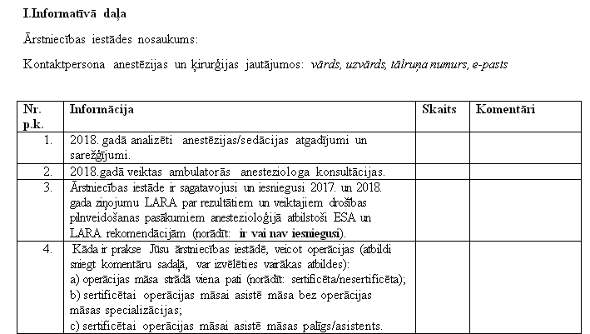
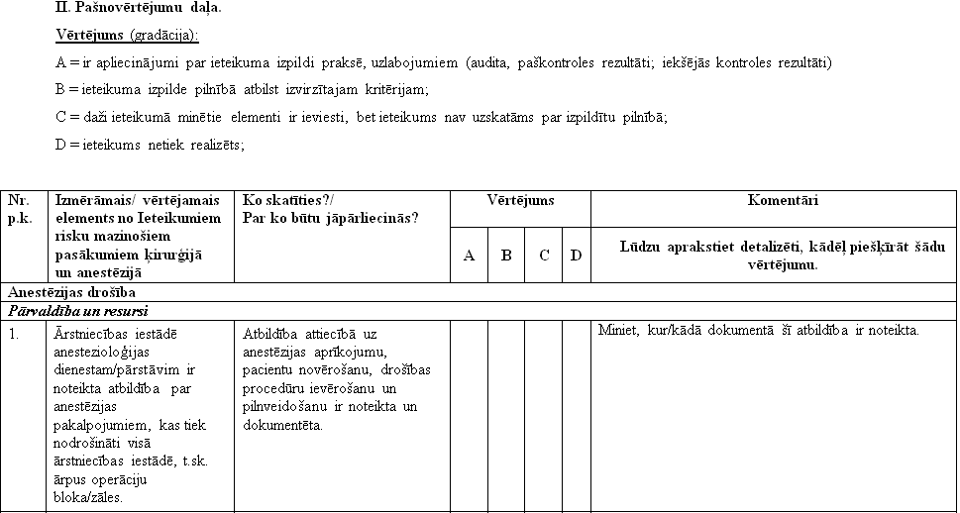

Slide 9
Evaluation criteria and feedback
Provided comments on criteria (0-3 points);
Content and relevance of the comments (0-3 points);
Improvement activities (0-3 points);
Good practices;
Problems for discussions or topics for on-site control.

Slide 10
Risk based supervision in 2019 (Thematic control – clinical audit)
Screening mammography service providers quality audit
controlled 10 mammography providers based on risk assessment
audit team: National Health Service, Health Inspectorate, Latvian Association of Radiologists, Radiation Safety Center
control criteria:
- staff competence
- service management
- quality management system
- technical parameters of medical devices
- mammography image quality
- medical records, diagnosis
25.10.2019.
EPSO 28th Conference

Slide 11
Risk based supervision in 2019 (Thematic control – clinical audit)
HI proposals for improving the quality of screening mammography
High quality contrast image - training and specialization of radiological assistants
Qualitative description of the image - postgraduate training in mammography
Double-blind evaluation of image
Image description to build after BIRADS system - a unified structured description, common terminology and clear follow-up
For screening mammography use only digital mammographs
Improve patient information about the results
25.10.2019.
EPSO 28th Conference

Slide 12
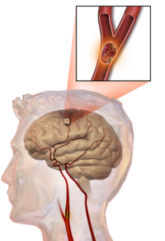
Risk based supervision in 2019 (Thematic controls)
Assessment of causes of stroke mortality
I. Stroke patients treatment in hospitals
Stroke unit controls in 9 hospitals;
Controls in 6 hospitals that do not have a stroke unit;
Analysis of medical records;
Cooperation partner - Latvian Neurological Society
II. Stroke prevention
80 general practitioners controls - oral anticoagulation therapy prescription for patients with atrial fibrillation
III. Control criteria:
Clinical Guidelines for Pre-hospitalization, Diagnosis and Acute Treatment of Cerebral Infarction (Latvian National Guidelines)
25.10.2019.
EPSO 28th Conference

Slide 13
Complaints management – aims and challenges
Implementing triage and a single (united) classification of complaints
Developing learning methods and competences
Systemic causes and factors for improvements on national level
Using complains and TRF claims as a part of risk based supervision
Developing Just Culture
25.10.2019.
EPSO 28th Conference

Slide 14
Complaints about health care - triage
828 (6 month)
High Medium
severity
Low severity
63
765
The first steps
Health Care Institution (HCI)
Health
Inspectorate (HI)
Why?
To improve health care quality and safety!
New pain points:
HI: How many from 63 are back? how many high, medium severity? about what? what harm? what «opinion» we expect from HCI?
HCI: It is your job! Why do you forward to us?
Patients: We did complain to you, not to HCI!
Patients rights?
25.10.2019.
EPSO 28th Conference

Slide 15
Classification of complaints – methodology
Domain (clinical, management, relationship)
Category (quality, safety, environment, processes, communication and patients rights)
Severity (0-3)
The level of harm (1-5)
Stages of care
Healthcare Complaints Analysis Tool. London School of Economics and Political Science, version 3, 2015
25.10.2019.
EPSO 28th Conference

Slide 16
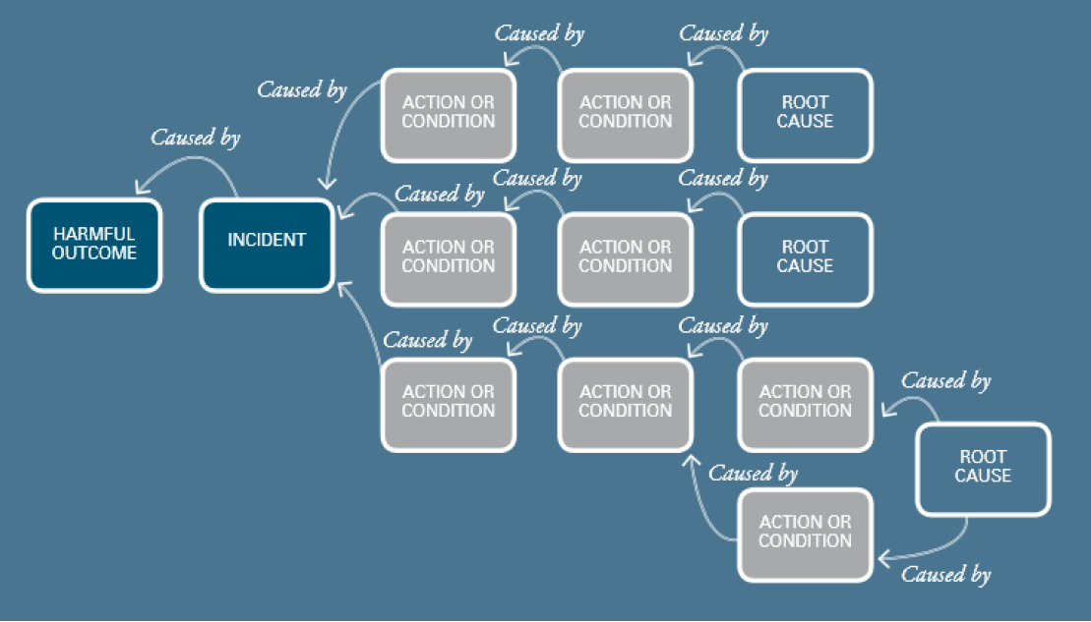
Causal Analysis
Understand What Happened
Determine How and Why It Happened
Develop Recommended
Actions to Improvement
Disclosure to the patient
Evaluate the Effect of the Actions for Improvement
25.10.2019.
EPSO 28th Conference

Slide 17
Learning from incidents in healthcare: the journey, not the arrival, matters
Evaluation of learning process
Process of investigation (team, staff involved)
Reconstruction of the event
Analysis and methodology used (Why?)
Conclusions on causes and contributing factors
Recommendations
Aftercare
Leistikow I, Mulder S, Vesseur J, et al.BMJ Qual Saf; doi:10.1136/bmjqs-2015-004853
25.10.2019.
EPSO 28th Conference

Slide 18
What we are going to achieve!
Improved learning quality
Quality score of learning from high severity complaints and adverse events reach at least 70% in 5 years
Improved patient experience
100% of low and 90% of medium severity complaints are solved at the service provider level
100% of MRF conclusions are on time
Identified and managed risks
Agregated data analysis has rised number of iniciatives, benchmarkings and recommendations at the national level
Improved quality of supervision
Customer perception index rises from 88 till 98
25.10.2019.
EPSO 28th Conference

Slide 19
Timeframe
2021-2022
Risk calculation
RCA in practice
Risk based supervision
Measure outcomes and drive improvements
IT solution
2019-2020
Triage improvements
Methodology development
Collaboration with HCI
Trainings
IT testing
Pilots
Changes in legislation
Until now
Triage of complaints
Tested IT system to understand limitations
Reviewed literature
Choosed methodologies
RCA for Health Inspectorate use
The first trainings
Feasibility
challenges
25.10.2019.
EPSO 28th Conference

Slide 20
Redesigning the complaints procedure
25.10.2019.
EPSO 28th Conference

Slide 21
Thank you!
Any questions?
evija.palceja@vi.gov.lv
25.10.2019.
EPSO 28th Conference

