Slide 1
EPSO Updates by Jooske Vos (chair of the EPSO-Board)
EPSO European Partnership for Supervisory Organisations in Health Services and Social Care
Notes:
Introduction
Mr. Chairman, Ladies and Gentlemen , welcome to this working group
Before starting this presentation I want to thank the Dutch presidency and in particular the Dutch Inspectieraad (the co-operative inspectorates) for organizing this interesting conference and bringing us together so many professionals who are interested in co-operation, partnership and enforcement in a Europe without borders.
As we all know, we live in an era in which new borders tend to behave like ‘pop-up stores’: yesterday there was nothing and today the boundaries and fences are there.
Therefore this might be an excellent timing to discuss our many positive experiences and good practices of co-operation and the EPSO experience of working towards a Europe without borders in the field of inspectorates regulators and monitoring organisations.
It might be good to keep in mind that is only a decade ago (to be more exact 12 years) that we all started talking about co-operation between various kind of inspectorates and regulators. In fact it all started with the report of Sir “Philip Hampton in 2005 on ‘Reducing administrative burdens: effective inspection and enforcement’ and the following discussions on Better Regulation.
In a way this was also the start for our EPSO co-operation although this was not primarily focused on better regulation and enforcement but on cooperation between likewise inspectorates in healthcare and social care.

Slide 2
Overview Presentation
EPSO UPDATES Overview presentation
EPSO Survey
Why
Procedure
What we expect from you ?
Why support the Survey procedure
Link to Survey and hard-copy
EPSO Board
EPSO Board task and legal position
Vacancy per 1-1-2020
Selection procedure for new board candidates
Board candidate qualifications
Candidate Indra Dreika – cv and photo
EPSO Advisory Network – short update and call for new members

Slide 3
EPSO Survey- Why ?
Why an EPSO Survey ?
The EPSO Board decided to look more documented and in co-operation with our partners to our EPSO future for the next 10 years to get input from:
Active EPSO partners and supporters of EPSO;
Not active supporters of EPSO;
Potential supporters of EPSO;
Those who have been active in the past but are not any longer participating or not any longer active.

Slide 4
EPSO Survey- Procedure
Procedure:
After Porto conference: EPSO Survey made in cooperation with SIRA Consulting – August 2019
Sent out to a broad range of EPSO partners & contacts – September 2019
Follow up planned: additional mailing and reminder after Malmö conference – October 2019
SIRA consulting: analyses and report anonymously to EPSO Board – November 2019
EPSO Board: decide on follow up action – December/ Jan 2019/20
Results: presented in Malta conference – May 2020

Slide 5
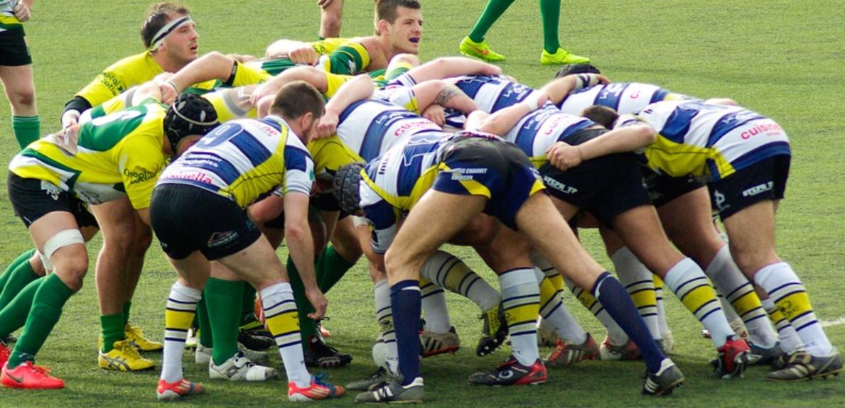
EPSO Survey- What do we expect from you ?
Lets make a team, get on the ball and bring EPSO’s future further !
(and please also include your colleagues)

Slide 6
Why support the EPSO Survey ?
Why Support the EPSO Survey and help us get more answers ?
First of all as the former picture showed: you have to co-operate to get on the ball ! and EPSO is cooperation.
EPSO means :
Learn from peers and colleagues;
Get in a professional debate
Share your holy grail: good practise;
Improve your skills in healthcare supervision;
Enjoy good partnership;
Enjoy cooperation with the EPSO Joint Office if you have questions;
Travel all over Europe from Iceland to Malta for our conferences.

Slide 7
Link to EPSO Survey and hard copy
AND
For those who have missed the EPSO survey…..☹ The link is on our website ☺
A hard copy of the survey is available at the entrance of the conference room
LINK TO EPSO SURVEY https://nl.surveymonkey.com/r/W2TFWMW
This anonymous survey is
About the future of EPSO
To gather information about the expectations of the EPSO partners,
Possibilities for partners to get involved in EPSO activities and
Recommendations to EPSO.
Results of the survey will be used by EPSO to set its goals for the years to come.

Slide 8
EPSO Board- task and legal position 1
EPSO is a Not for profit – Foundation according to Dutch law
The foundation has :
A Management board of 3-5 members (the EPSO Board),
An advisory board (EPSO advisory network),
The EPSO Joint Office
The EPSO Board members are Jooske Vos; Alvaro Moreira da Silva and a vacancy per 1-1-2020;
the EPSO board is unpaid and meets once a year.

Slide 9
EPSO Board- task and legal position 2
The responsibilities of the EPSO Board are:
Financial and organisational responsibility for Foundation EPSO in accordance with the Dutch law and based on the Statutes of Foundation EPSO;
Administrative responsibility for the administrative obligations of foundation EPSO in accordance with the Dutch law;
Management responsibilities for foundation EPSO.
The Board members are not primarily responsible for the tasks of the EPSO Joint Office
The tasks of the EPSO Joint Office are:
organising conferences, working groups and management of EPSO contacts including the EPSO advisory network, knowledge exchange, public relations and acquisition of potential associated EPSO partners and support to the EPSO management board).

Slide 10
EPSO Board vacancy per 1-1-2020
EPSO board has a Vacancy per 1-1-2020
Since Anette Lykke Petri of the Danish Patient Safety Authority left the EPSO board , there will be a vacancy in the EPSO Board per 1-1-2020.
Therefore the EPSO board has followed the procedure for new EPSO Board members and has been looking for a successor.

Slide 11
Procedure for new EPSO Board members
Procedure for vacancies in the EPSO Board
In case of a vacancy in the EPSO board the EPSO Joint Office will start a.s.a.p. the procedure to find and select a candidate to be appointed as new EPSO management board member.
This procedure includes exploratory talks with potential candidates.
If a candidate is found the candidate will be presented to the EPSO partners.
If within one month after the presentation no objections are received or other candidates are named the candidate will be appointed by the EPSO Board.
If objections are received or other candidates are named the EPSO Joint office will organise elections

Slide 12
EPSO Board candidate qualifications
EPSO Board job requirements :
Enthusiastic about and supportive to the aims of Foundation E.P.S.O.
Willing to represent and promote EPSO as EPSO Board member;
Experienced in the field of management of a supervisory , monitoring or regulatory organization preferably at a senior management position;
Access to a broad network in the field of supervisory monitoring or regulatory practice;
Communicative and network skills;
Fluently or at least relatively good in the English;
Available for consultation and to support the EPSO activities if necessary;
Active experience within the EPSO network for at least 2 years;
Availability of at least 2 hours per month.

Slide 13
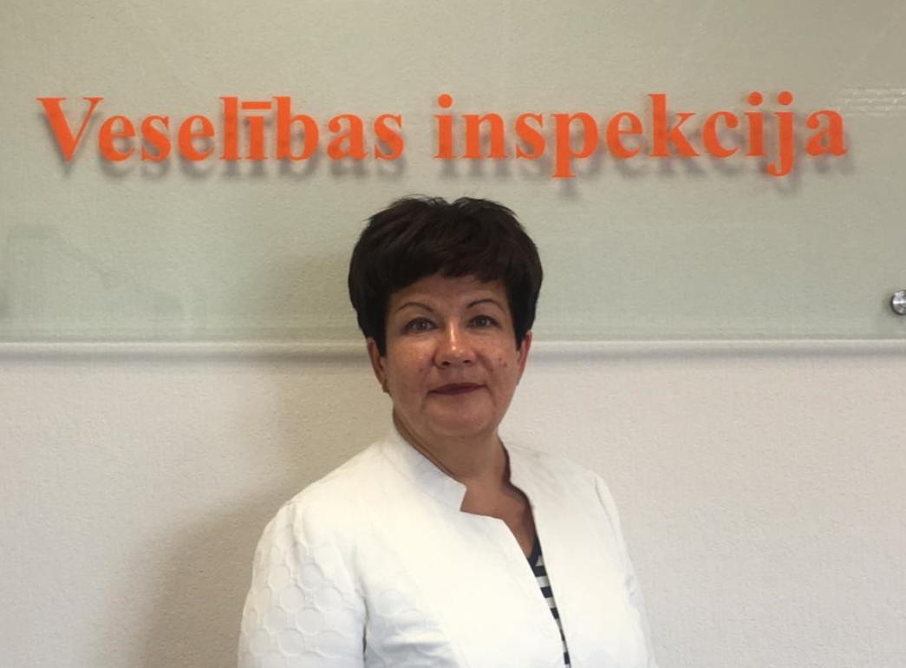
The EPSO board is very happy to be able to present as candidate for the EPSO Board :
EPSO Board Board Candidate Indra Dreika – cv and photo
Indra Dreika -Head of Health
Inspectorate of the Republic of Latvia
Senior experience in the field of supervisory organisations and health management
Lawyer by profession (graduated cum laude )Master’s degree in Business Administration (MBA)
Master’s degree in Public Administration (MPA)
Willing to represent and promote EPSO as a board member.

Slide 14
EPSO Board
The EPSO Board is happy with Indra as a person but also Indra for a number of other reasons :
Solid Leadership experience in a health inspectorate ;
Support from Latvia to become EPSO Board member;
Background as lawyer and business administration;
Coming from a different region than the other board members;
Good knowledge of EPSO
Good knowledge of EPSO peer evaluation activities.
Therefore the EPSO board asks the (paying) EPSO partners to let us know as soon as possible but no later than 1 November 2019 if there are any objections against appointment of Indra Dreika as EPSO Board member.
As the Board has a potential of 3-5 members the Board also asks potential candidates to come forward or be named by their organisation

Slide 15
EPSO Advisory Network 1
EPSO Advisory Network
In accordance to Article 12 of the EPSO Statutes the EPSO Board may institute an Advisory Board ( called Advisory Network) , whose task shall be to give the EPSO Board advice on:
- Directing the substantive activities of the foundation;
- Topics for working groups and conferences to be organised by the foundation to accomplish its objectives;
- Topics for research or training activities to initiate or effectuate by the foundation;
- possible substantive contributions from third parties;
- possible new members or participants to the activities of the foundation;
- possible new contacts or connections or relationships with third parties.
The Network has no financial , organisational, human resources or management powers and does not advice on these topics.
Further tasks and powers of the Advisory Network shall where appropriate be laid down in by-laws.
started actively this year with discussions about
Its tasks
The EPSO advisory network has at this moment the following active members; Call for new members;
Qualifications.

Slide 16
EPSO Advisory Network 2
The EPSO Advisory Network started effectively 7th June 2019 (tele meeting) by discussing
the Topics for EPSO conferences and working groups including the proposed topics for Malmö; and
Topics for further research.
It has the following active members:
Klas Öberg – former director at IVO, University Örebro - chair
Birgir Jakobsson – former chief inspector Iceland Health inspectorate and director of Karolinska Hospital - Sweden
Kieran Walshe –University of Manchester - England
Martin de Bree – Erasmus University Rotterdam- The Netherlands
Johan Thor –Jönköping Academy -Sweden
Henk Nies – director at VILANS knowledge centre and VU Amsterdam University

Slide 17
EPSO Advisory Network 3
The EPSO Advisory Network next meeting will be after the Malmö conference in October
At that meeting the Network will again discuss:
Conference and working group topics and
Topics for further Research
Possibility to invite new members
Furthermore the EPSO Joint Office will put on the Agenda a plan to come in contact with new members for the Advisory network.

Slide 18
EPSO Advisory Network 4
SO if you have ideas
about new members for our EPSO Advisory Network ?
please let us know !

Slide 19
EPSO Advisory Network 5
Characteristics for the EPSO Advisory Network:
the members are willing to share their knowledge and ideas with peers of a similar level of experience, thinking and working.
The Advisory network should be an instrument to use as save and trusted feedback for their own new ideas and research plans as well as platform to discuss other management instruments in professional organisations like inspectorates or regulators.
If EPSO becomes a partner to co-operate in international projects and international cooperation, the members of the Advisory network would be the first to be asked to participate in such cooperation,.
the Advisory network is a small and coherent, however unpaid “think tank” in EPSO.
The members do not have the obligation to join the EPSO conferences but are welcome will where appropriate being asked to present their research or ideas.
The network will meet at the conferences or by phone. The EPSO Joint Office will organise the meetings.

Slide 20
Thank you for your attention and look forward to keep in contact also in between conferences !

