Slide 1
Permits and Licences equal Quality?
Republic of Croatia
Ministry of Health
Independent Sector for Health Inspections
Vesna Sokol, DMD
Bojana Budimir, LLM
Ante Čović, LLM, MBA

Slide 2
Independent Sector for Health Inspections
SECTOR
Health Inspection
Health Inspection for BTC
Pharmaceutical inspection
5 inspectors:
5 inspectors:
4 inspectors:
3 lawyers
2 DMDs
1 sanitary engineer
1 MD
4 biologists
3 biologists
1 chemist
Law on Health Care
The Law on Medicines
Notes:
Intruduction. The structure of the Sector. The prefix "independent" refers to the position of the sector within the structure of the Ministry, it’s not part of any directorate. The sector consists of three services, of which in this presentation we will look at the work of two that operate under the Law on Health Care. P.I. Has it’s own sets of rules etc.

Slide 3
Organizational forms of health care
Ltd.
institution
Private practice
01
02
03
The company is founded on the basis of the Law on Health Care, and the Law on Companies is also applied in a subsidiary manner. Performs healthcare activities without the possibility of contracting with the CHIF. They do not have to have full-time employees.
The health institution is established on the basis of the Law on Health Care, and the Law on Institutions is applied in a subsidiary manner. These are: institutes, clinics as stand-alone institutions, clinical hospitals, clinical hospital center, general hospitals, special hospitals, health centers, departments. It may or may not have a contract with the CHIF.
Private practice is established in accordance with the Law on Health Care The practitioner is a physician as a natural person. It may or may not have a contract with the CHIF.
Law on Health Care
Company law
Law on Institutions
Notes:
Apart from the above, there are differences in the tax treatment of companies and institutions. Businesses are in the VAT system and institutions are not. Institutions, on the other hand, have to have full-time employees and companies don’t, so the founder individually evaluates which option is better for him.

Slide 4
Establishment procedure
Application
Review
Registration
Request
Investigation
Approval
Permit
After reviewing the documentation, the Ministry by Decision determines that the act of incorporation is in accordance with the Law on Health Care.
After being entered in the court register, the party submits a request to the Ministry of Health requesting a decision on the commencement of work and encloses the relevant documentation.
If the minimum technical requirements are fulfilled, the Ministry by a decision determines that the institution meets the requirements in terms of workers, equipment and premises, that is, it is approved to start performing certain health care activities.
The application shall be accompanied by the Founding Act and other related documentation.
The party shall be entered in the Commercial Court Register.
An Expert Committee shall be established and shall record the minimum technical requirements.
The permit is issued for an indefinite period of time.
Notes:
© Copyright PresentationGO.com – The free PowerPoint and Google Slides template library

Slide 5
Note: Private Practice
Application
Review
Registration
Request
Investigation
Approval
Permit
The procedure for establishing a private practice is slightly different. It also begins with a request from the party submitting supporting documentation, but there is no first stage – a permit is issued after the investigation.
Notes:
© Copyright PresentationGO.com – The free PowerPoint and Google Slides template library

Slide 6
Permits and Licences
Permit
Licence
Licence
It is obtained by healthcare institutions, health care companies, private practices. Issued by the Ministry. The investigation is carried out by committees appointed by the Minister.
They are obtained by healthcare professionals from the competent chambers for independent work.
Licence for BTCO. The examination is carried out by the Health Inspection for Blood, Tissues and Cells, the approval is issued by the Minister based on the opinion of the Inspection.
01
02
03
Notes:
© Copyright PresentationGO.com – The free PowerPoint template library

Slide 7
Permits – conditions for obtaining
PREMISES
WORKERS
By-law act
PERMIT
The requirements are laid down in detail in the Ordinance on the Minimum Requirements Regarding Space, Workers and Medical and Technical Equipment for Performing Health Care Activities.
EQUIPMENT
Notes:
It should be noted here that in addition to the above conditions, the Health Inspection for BTC also checks the quality system.

Slide 8
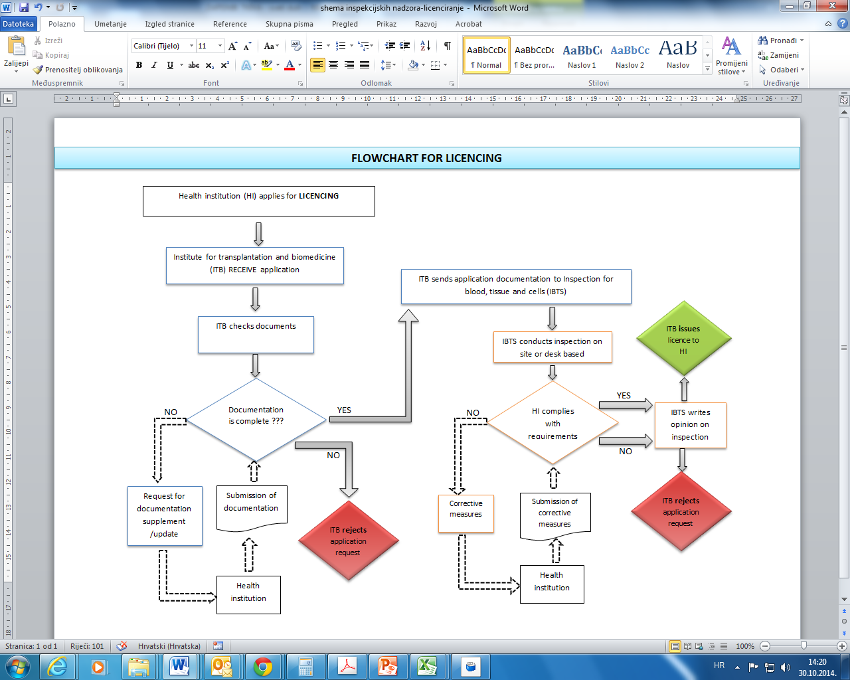
Licences for BTC – the procedure

Slide 9
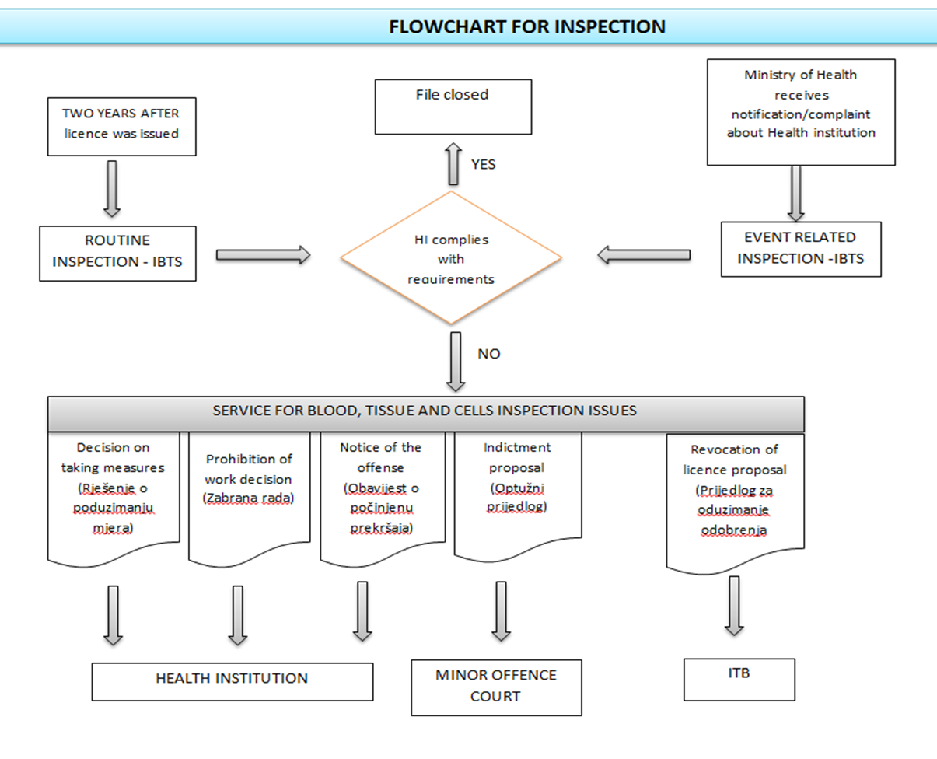
Permits and Licences – inspection
Notes:
The BTC Health Inspectorate has a legal obligation to carry out inspection every two years, as the law defines relicensing. Thus, they carry out regular inspections every two years or they carry out inspection upon notification of an adverse event or adverse action, while the Health Inspectorate most often carries out inspections upon request.

Slide 10
Inspection – taking measures
When an institution is established and started operating, health inspectors, when performing supervision, should find that the institution no longer meets the requirements regarding workers, premises and equipment. In that case they have the right and obligation to take one of the following measures:
1
DECISION
Order elimination of identified irregularities and deficiencies within a specified period.
2
DECISION
Temporarily prohibit the practice of an institution, company or a private healthcare professional until the elimination of identified irregularities.
3
DECISION
Prohibit the performance of activities or work if the irregularities identified are not remedied within a specified period.
4
DECISION
To submit a proposal to the competent authority for the termination of the activity or the termination of the activity, if the legal conditions are not fulfilled.
5
DECISION
Prohibit the pursuit of an activity if it is performed without the required authorization (Ministry Decision). An indictment is also filed in this case!
Notes:
© Copyright PresentationGO.com – The free PowerPoint and Google Slides template library

Slide 11
The health inspection does not participate in the investigation
Health Entitiy
Workers
Equipment
Premises
Investigation, positive outcome
Procedure
Health Entity
Inspection
Permite
Health Inspection
Corrections
Prohibition
Permit – signed by the Minister
Corrections/prohibition – signed by Health Inspector
Notes:
So, after all that is shown, it's time to answer the question: do permits and licenses equal quality? In principle, of course they do. Laws and regulations determine what is needed for permits and licenses, and without that we would have not only a lack of quality, but a disaster. But the mere fact that there are permits and licenses does not automatically mean that there is quality. Quality is not a permanent condition, but a condition that needs to be constantly checked.

Slide 12
Thank you!

