Slide 1

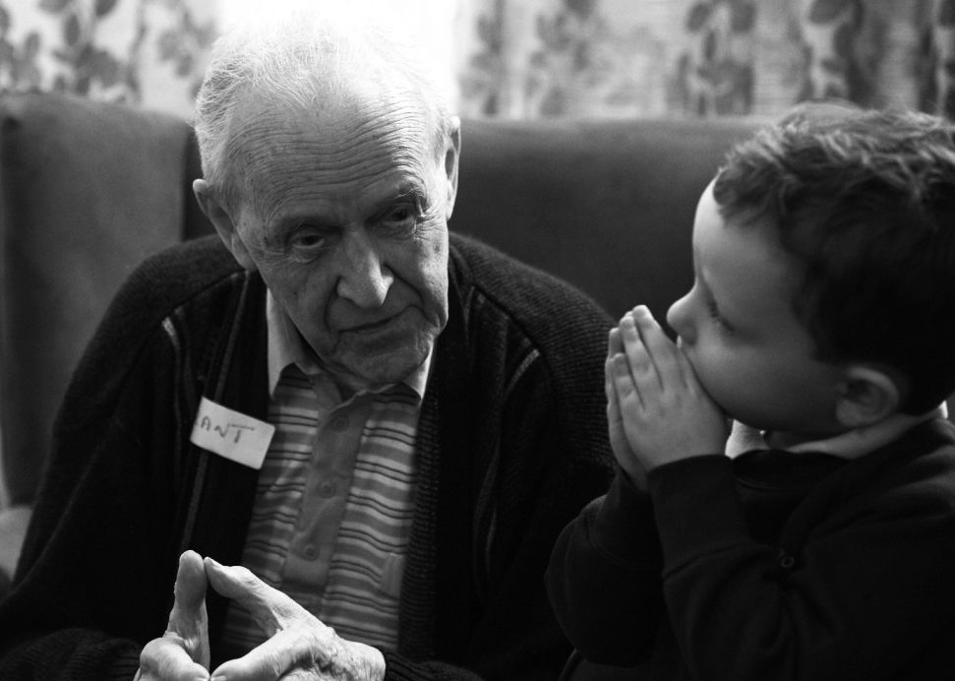
28th EPSO CONFERENCE
SEPTEMBER 2019
Peter Macleod
Chief Executive
Care Inspectorate

Slide 2

OUR VISION:
The Care Inspectorate’s vision is for world-class social care and social work in Scotland, where every person, in every community, experiences high-quality care and support, tailored to their rights, needs and wishes.

Slide 3
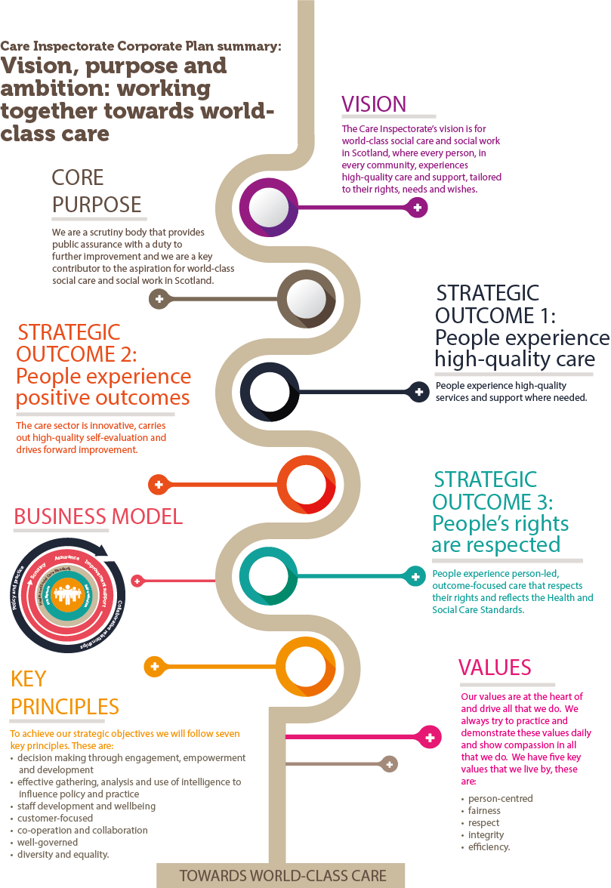

Slide 5
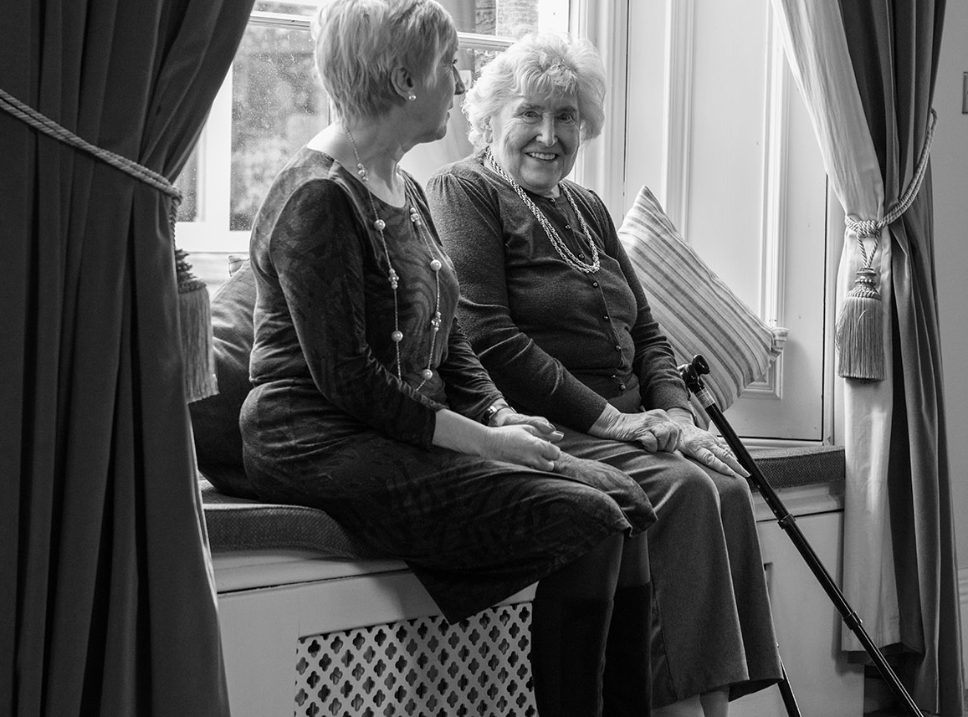

HEALTH AND SOCIAL CARE STANDARDS
The new Standards are significantly more rights-based, person-led and outcome-focused than before. This is to allow coherence and supporting improvement activity at every level and reflect the fact that many people use different types of care at the same time. The Standards will help everyone focus on what really matters. They are based on five
headline outcomes.
I experience high-quality care and support that is right for me.
I am fully involved in all decisions about my care and support.
I have confidence in the people who support and care for me.
I have confidence in the organisation providing my care and support.
I experience a high-quality enivronment if the organisation provides the premises.

Slide 6
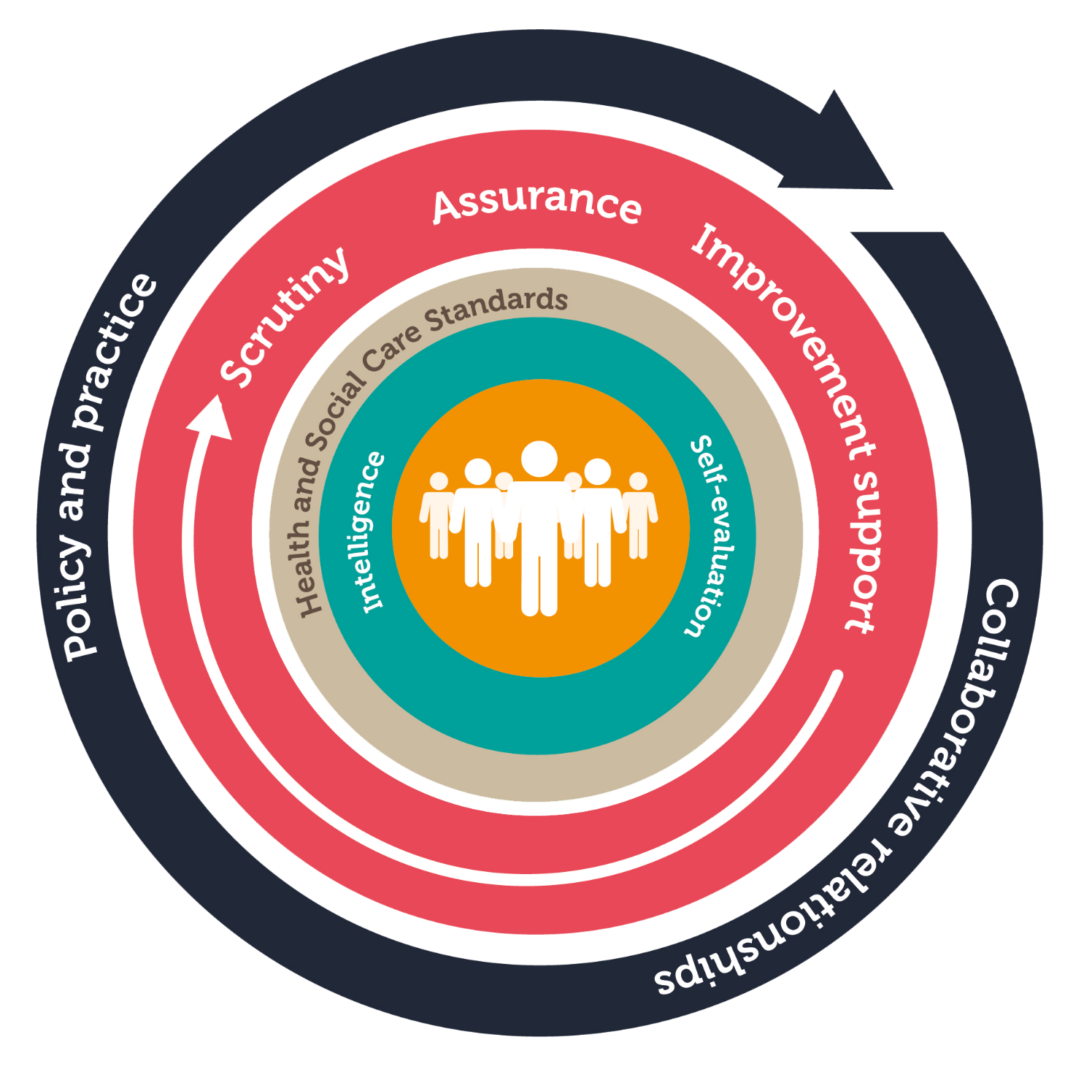
OUR BUSINESS MODEL

Slide 7

“Kindness changes things – we are at our best when we recognise the importance of emotions and deep human connections.”
“It is not enough to be compassionate.
You must act.”
HIS HOLINESS THE DALAI LAMA
CARNEGIE TRUST UK

