Slide 1
Including The Rights of the Child in supervision
Elisabeth Dahlin
The Ombudsman for Children in Sweden

Slide 2
The Ombudsman for Children in Sweden
Sweden ratified the UNCRC in 1990
Agency established in 1993
The Government (cabinet)appoints the Ombudsman for Children
Regulated by
The Ombudsman for Children Act
Independent based on the Paris principles

Slide 3
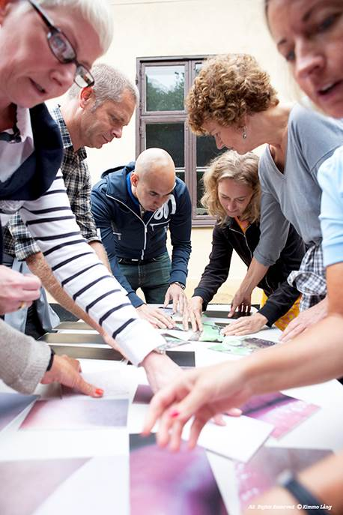
What we do
Represent the rights of children and youth in Sweden
Monitor how the CRC is adhered to on all levels
Proposals for legal changes
Initiate own research and studies
Authority to call and to consult with government bodies on all levels of society
Advocate and participate in the public debate
Part of the international child rights development
Inform and educate about the CRC

Slide 4
What we do not do:
We do not intervene in individual cases, but we have however a reporting duty if children are at risk
Do not have inspection or supervisory duty
Cannot discipline other bodies
Third additional protocol of the CRC not ratified by Sweden yet

Slide 5
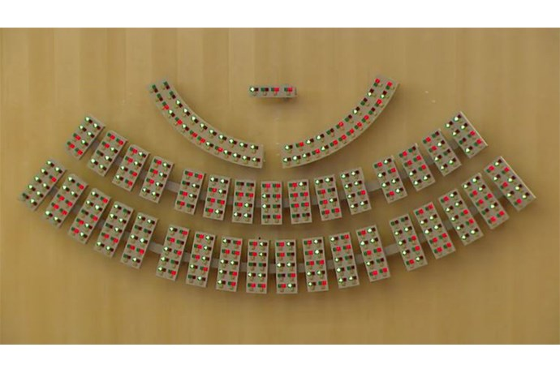
The CRC will become national law in 2020

Slide 6
The UN Convention on the Rights of the Child (CRC)
Every child has rights
54 articles
Adopted in 1989 – ratified by all countries except one
The “Core Principles”:
Non-discrimination (article 2)
Best interest of the child (article 3)
Right to life survival and development (article 6)
Right to be heard (article 12)
Notes:
The most complete statement of children’s rights. It’s also the most widely-ratified international human rights treaty in history. A child is a person under 18 years of age.
54 articles that cover all aspects of a child’s life and set out the civil, political, economic, social and cultural rights that all children everywhere are entitled to.
Every child has rights, whatever their ethnicity, gender, religion, language, abilities or any other status.
The Convention must be seen as a whole: all the rights are linked and no right is more important that another, but there are four articles in the convention that are seen as special.
They’re known as the “General Principles” and they help to interpret all the other articles and play a fundamental role in realizing all the rights in the Convention for all children.

Slide 7
Incorporating the CRC – problems and possibilities
Children are not seen as right holders
The CRC is not implemented in practice
The best interest of the child
Right to be heard
Law – can be adhered to immidiately
Not a perspective- it’s a law
Stronger than guidelines and directives
Important tool for inspection and supervision
Children are not getting the support they need
Notes:
Sweden has made the decision to incorporate the CRC 2018 to the Swedish law. Enters into force 1 January 2020
One of the reasons that lead to the decision was that the CRC is not implemented in practice.
The children are not seen as rights holders, but for example as objects to protect they’re not treated as children.
From a study regarding court cases concerning domestic violence against children made earlier this year, the BO could conclude that the courts often diminish the value of the child’s statement due to the way the children give their testimonials in court. Which is by video-recording. This way to give a testimony is seen as a protective measure for the child’s benefit, but it does diminish the child’s right to be heard in a proper way. We need to ask ourselves if the ways we talk and get information from children do promote the child’s right to be heard and is at the same time in the best interest of the child.
There is a lack of knowledge. We can see shortcomings when it comes to the child’s right to be heard and failures in how for example the social services consider the best interest of the child.
This leads to that children are not getting the support they need, this is most palpable when it comes to children in vulnerable situations such as children within the social care system. We have seen problems within the social care system for example when it comes to the child’s right to heard or how the social services do assess the best interest of the child.
These reasons could also be seen as possibilities to incorporate and further implement the CRC in a society, for example in supervision.

Slide 8
Child as a Right Holder in supervision
Every child is unique and has her own needs and interests
Every child has the right to be heard and respected
Adjust the supervision situation according to the best interest of the child
Make sure the child knows her rights and where to turn to if these rights are violated
Notes:
Few important points regarding childrens rights and supervision.
Children have fundamental rights. Children are not only subjects to protect. This means that it is our duty to make sure that the child is comfortable to talk to us:
Before the supervision activity:
Are there children involved? As patients/care-takers or as related to them?
What do we know about their situation? On a structural level? On a personal level?
How can we involve children in the supervision activities we are planning?
Adjust the supervision situation according to the best interest of the child
There is also ways to empower the child as a rights holder through supervision. For example by informing the child about their rights and by referring to them through and after supervision.
Also, do not forget to inform the child after the supervision about the results.
Do not take for granted that the adult persons around the child will do this.

Slide 9
Best Interest of the Child in supervision
Every child is unique and has her own needs and interests
Every child has the right to be heard and respected
How can we consider the best interest of the child, when we don’t have a specific child to consider?
Child Impact Assessments or other tools
Follow-up!
Notes:
One question that might be hard to tackle is when we have to consider the best of the child, when we don’t have a specific child to consider? For example when giving permits to new residential homes.
In these situations we can at least ask what do we know already, other children’s experiences, gather and analyse knowledge.
Use Child impact assessments, or other tools, such as Child checklists to ensure that decisions you make have a child perspective coming from the CRC. Make sure that the institutions you’re supervising also work in the best interest of the child.
Find different ways of gathering opinions from children – eg by asking children who have been in residential homes before what is important for them there, when giving permits for new ones.
Follow-up the child’s experiences, not only for example how a specific residential home works. Good example: KOMMMUNEN DÄR VARJE PLACERAD BARN FICK KOMMA OCH GE FEEDBACK OM PLACERINGEN EFTERÅT…?

Slide 10
The Right to be Heard - Using children’s experiences to assess quality
The child’s experiences can add important perspectives on what we consider as good quality
Dare to ask and take the child seriously!
Analyse - from the child’s perspective
Meeting the child on her own if possible
Remember to give feedback after the supervision is concluded
Notes:
Bikupa? Reflections from the film
The child’s experiences can give an another view on what’s to be considered as good quality, beyond routines and guidelines, beyond, of course important matters such as safety.
This film wakes questions such as should children be locked-up at all? How can residential care homes be made more child-friendly? How can different needs and situations be met? Sucidal/not suicidal in the same home
During the supervision activity:
- Reflect on who you’re talking with when for example parents are present – the child or the parent? And why?
- Take the child’s experiences seriously.
- Dare to ask and do listen.
Example 1:
Sweden was the first country in the world with a ban against corporal punishment in 1979
1980 1981 – more than 90 % of all Swedish families had knowledge about the prohibition
Still 11,000 police-reports on violence against children in Sweden each year. A study from 2016 shows that 44 % of children had been victims of some type of child abuse at some point during their lives.
Severe violence against children aged 2-17 previous years, a minimum estimate in Europe 12%
Most, or if not all, of these children do meet different authorities during their life that could dare to ask about their experiences of violence
Example 2: The Swedish magazine Veckorevyn published a survey last spring that summoned cases of sexual abuse, rape and other sexual exploitation of 133 children that have taken place at residential care homes during the past 4 years. Most of these had been reported to the authorities. This is just an example of the violence children do meet.
After:
Analyse and assess from the child’s perspective. Use the CRC as a ground.
Remember to give feedback after the supervision is concluded! Considerations on the child’s wants and needs, her agency and need for protection, can be tough and do need discussions with the child, for example prohibition to smoke on residential care homes or unlawful marriages.
By including children you can get answers and solutions from the children themselves.

Slide 11
Thank you!
Notes:
Our website has also material in English.
Thank you!

