Slide 1
Assessing quality in social care
and empowering social care providers
EPSO conference in Porto, 12th April 2019
Raquel Campos Franco, Católica Porto Business School

Slide 2
an intro…

Slide 3
Students
Companies
and institutions
Teachers
Higher Ed
A peer accreditation model for business schools
Staff
Context, governance and strategy/programmes/students/faculty/research/corporate connections/Ethics and Sustainability
Processes
Competition
Satisfaction
Assurance of learning
Infrastructures

Slide 4
The Portuguese social care
Mostly non-profit, publicly funded
Quality = inspection
403
5.400
Quality certificates (2015)
ISO9001:2008 | 145
EQUASS | 179
MAQRS | 79
Traditional
Historically innovative
in early child care
The non-profit nature of transactions is different from the public or the private sectors’.
What are the specific challenges?
Sardinha et al, 2015

Slide 5
Who evaluates quality in social care?
2 major challenges of the social care sector (Beresford, 2011)
Funding
Culture

Slide 6
Different nature of transactions
CLIENTS
VOTERS
USERS
Private
FOR PROFIT ORG
Private NON-PROFIT ORG
PUBLIC
ORG
SHARE
HOLDERS
TAX
PAYERS
FUNDERS

Slide 7
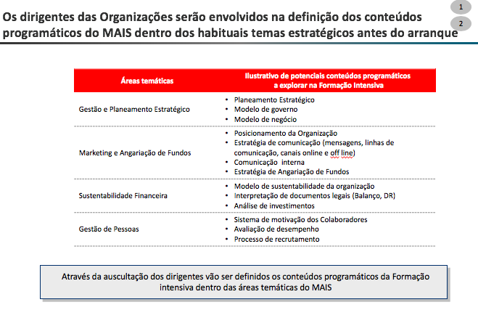
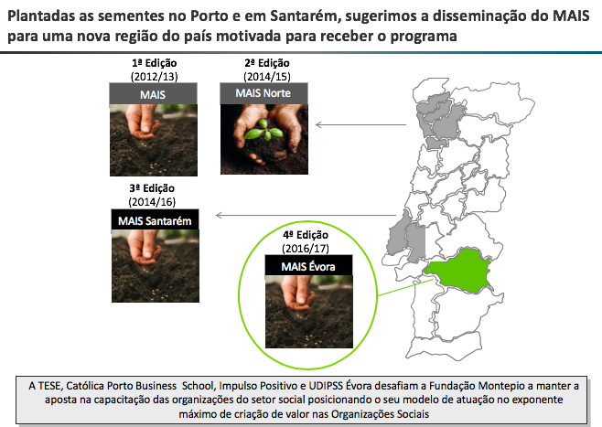
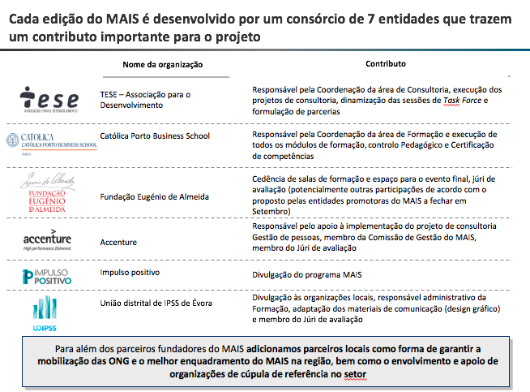
Priority fields
NPOs
Dissemination and Scale
Consortium – resources, competences, partnership
Different style of teaching and learning

Slide 8
Social care
(Adult) Social Care

Slide 9
What is quality in social care?
Assess the quality of the support system in general
Efficiency
Equity
Accessibility
Asking parents about the quality of the kindergartens, or a caring relative about the quality of the home care arrangement means arguing about a part of a much broader question:
How good is your municipality or your country when it comes to helping you in child-raising or elderly care?
Assess service quality
Quality of care
Quality of life
Collaborative aspect of social care
and the central role of the
carer-user relationship
(person-centred suppot)
Malley and Fernandez, 2010; Evers, 1997

Slide 10
What is quality in social care?
Quality of care
Service accessibility, accountability, attitudes and behaviour of staff, continuity of care workers, fluid communication of changes in care, flexibility of the service to meet changing needs, privacy and dignity, reliability and responsiveness of care workers, and skills, knowledge and trustworthiness of staff
Quality of care
Malley and Fernandez, 2010
Notes:
Provider side reforms – Governments across the world have introduced reforms to social care services to diversify markets, purchasing from for profit and not for profit organisations
Consumer directed reforms – Gove more choice and control over their care
Result: increasing separation between service commissioners and providers
In time of austerity and retrenchment in public services it is all the more important to measure quality to ensure that quality does not suffer unduly at the expense of initiatives to save costs.

Slide 11
What is quality in social care?
Quality of life
Extent to which they improve users’ health and physical functioning, they meet basic physical needs with activities of daily living, they guarantee personal safety and security, ensure a clean and tidy environment, helps users stay alert and active, provide access to social contact, ensure users are in control of their life, maximise autonomy, skills, morale and self confidence, and assist users coming to terms with impairment
Quality of life
Malley and Fernandez, 2010

Slide 12
What is quality in social care?
What everybody is doing is not easy …
Care Services are performances, so they are intangible, therefore not easy to measure, test or verify – they are “experienced goods”
Care Services are labour intensive, therefore heterogeneity is high
Consumption and production of Care Services are simultaneous and inseparable, therefore difficult to disentangle influences - the providers’ from the users’
Malley and Fernandez, 2010

Slide 13
What is quality in social care?
‘Search properties’ (stable) - Structural quality indicators
Egs:
Residential care homes – single occupancy rooms?, rooms size, range of facilities, nurse-patient ratio
Home care – care workers qualifications and experience
Relatively insensitive to changes in quality through time
By definition removed from the core focus of quality assessment:
the care worker-service user relationship
An indirect measure of quality – a necessary but not sufficient condition for quality
Malley and Fernandez, 2010

Slide 14
What is quality in social care?
‘Experience properties’ (during or after consumption)
- Process and Outcome quality indicators
Service users voice: flexibility, degree of empathetic behaviour of the care worker, the way the care worker communicates and listens; feelings of safety, choice and control over daily life, improvements in physical functioning; treating people as individuals
Both are direct measures of the care performance
Process indicators focus on the way the service is delivered – eg. Service managers for service improvement; or of interest in their own right (having a say in what is provided, when and how services are delivered, being valued and treated with respect, being treated as an individual)
Outcome indicators focus on the result of the care activity – are preferable for the purpose of comparing quality across different types of services
Malley and Fernandez, 2010; Beresford et al, 2011

Slide 15
What is quality in social care?
Outcome indicators
Ideally – quality for the entire care network
In reality – focus on user outcomes
Eg. Improved health and emotional well-being, improved quality of life, making a positive contribution, choice and control, freedom from discrimination, economic well-being, personal dignity
Malley and Fernandez, 2010
Notes:
The attribution problem . An accurate estimation of the contribution of social care services to final outcomes relies on the capacity of the model used to capture all of the non-service-related factors that have an influence over outcomes. The difficulties involved in controlling for all of the relevant non-service-related factors influencing outcomes can lead to unobserved heterogeneity and to biases in the estimates of quality. The fact that higher levels of services are provided to individuals with greater needs means that failing to control fully for differences in need in the analysis, will lead to a positive bias in the estimates of the social care quality.

Slide 16
How to empower the social care providers?
Empowerment is the capacity of individuals, groups and/or communities to take control of their circumstances, exercise power and achieve their own goals, and the process by which, individually and collectively, they are able to help themselves and others to maximize the quality of their lives.
Degrees of empowerment are measured by the existence of choice, the use of choice and the achievement of choice.
Adams, 2008

Slide 17
Develop benchmarking
Invest in leadership
Involve users, carers, other relevant stakeholders
Invest in transparency
Inspectors as demanding
and knowledgeable mentors
Learn Action Research skills
/ Learn to Learn while acting
Invest in managers / in management training
Invest in governance (clarification and training)?

Slide 18
Develop benchmarking
Invest in leadership
Involve users, carers, other relevant stakeholders
Trust
Invest in transparency
Learn Action Research skills
/ Learn to Learn while acting
Invest in managers / in management training
Invest in governance (clarification and training)?

Slide 19
How to assess quality in social care? Learning from CQC in user involvement
‘Individual voice’ I - Existing sources, before inspection / to inform subsequent inspection; to CQC “intelligent monitoring” to determine what to inspect, when and where to focus their attention.
Individuals are asked to contact CQC, comment cards in prominent locations, asking local or national partners to share information, requesting information from the provider; routinely collected feedback
Representatives of service user groups and voluntary sector organisations share collected data
‘Individual voice’ II - Consulting around the time of inspection, for the inspection
Listening events in the local community, focus groups, drop in sessions and home visits
‘Experts in experience’
Involving users in inspection
‘Collective voice’ - Used to prioritise forthcoming inspections and inform the areas of focus for inspection teams
Speaking with local service user groups, voluntary organisations, and other stakeholders, as well as through advisory panels
‘Support engagement afterwards’ – feedback and follow-up after inspection
Richardson et al, 2018
Notes:
The UK case
Prior to 1997 few attempts were made to measure directly quality in social care; measurement tended to focus on activity, expenditure and costs.
Over time the focus of the assessment of quality in public social care has become more outcomes-focused
However the increased emphasis on the use of user surveys poses considerable practical challenges – expense and burden; many care clients need help (high rates of non response)
Richardson et al, 2018:
CQC has a large remit, tasked with regulating all health and social care providers in England but limited resources.
The overhaul of CQC’s regulatory regime in 2013 brought with it opportunity for service user voice to have a greater role in regulatory activities.
CQC conducted various activities to include the service user voice within inspection and rating.
Our findings highlight how difficult it can be to involve service users in health and social care regulation.

Slide 20
How to assess quality in social care? Learning from CQC
 | + | -
‘Individual voice’ - Existing sources | PR, ratings and public reports are leading to an increase in individuals contacting CQC directly | Effectiveness varied by organisation, and was dependent on the amount and quality of the information held and capability and capacity of the groups to interpret it and respond to CQC
‘Individual voice’ - Consulting around the time of inspection |  | Events were often not well publicised and organised without enough advance notice for certain groups to attend, particularly those who might require assistance Time needed to gather the adequate groups of people (learning disabilities, n-events in the hospital, positive as well as negative experiences) Relevant the reflection on how to translate this into the inspection
Richardson et al, 2018
Notes:
The UK case
Prior to 1997 few attempts were made to measure directly quality in social care; measurement tended to focus on activity, expenditure and costs.
Over time the focus of the assessment of quality in public social care has become more outcomes-focused
However the increased emphasis on the use of user surveys poses considerable practical challenges – expense and burden; many care clients need help (high rates of non response)

Slide 21
How to assess quality in social care? Learning from CQC
 | + | -
‘Experts in experience’ | Greater insight, multiple perspectives | Could colour or affect contributions of the users Experience was often not very relevant to the services or providers they were involved in inspecting Better at challenging professionals than users User groups and voluntary sector representatives were not aware of this involvement, to which they might contribute
‘Collective voice’ | Voices of smaller groups are brought into much larger networks These groups have valuable information, as they are exposed to a wide range of user experiences | Capacity varies in groups in the building of an established relationship with CQC
Richardson et al, 2018

Slide 22
How to assess quality in social care? Learning from CQC
 | + | -
‘Support engagement afterwards’ |  | Feedback was often not provided by CQC to the service user groups or voluntary organisations, or users participating in inspections “A mystery process” - They would have wanted to hear how their voice had been translated into the inspection process and how their input had resulted in change or action Sometimes people disagreed with the inspection findings or outcomes and wanted to voice this but did not know how to (suggestions: events, newsletter, comments visible in the report, …)
Richardson et al, 2018

Slide 23
How to empower the social care providers?
Don’t loose the wider perspective
The dangers of focusing too narrowly on partnership with, and listening to, the voices of those receiving services include losing sight of factors such as how to structurally improve the circumstances of the most excluded and poor people and how to combat deep-rooted inequality, the unequal exercise of power, and national and transnational economic and social influences.
Adams, 2008

Slide 24
Thank you!
EPSO conference in Porto, 12th April 2019
Raquel Campos Franco, Católica Porto Business School

