Slide 1
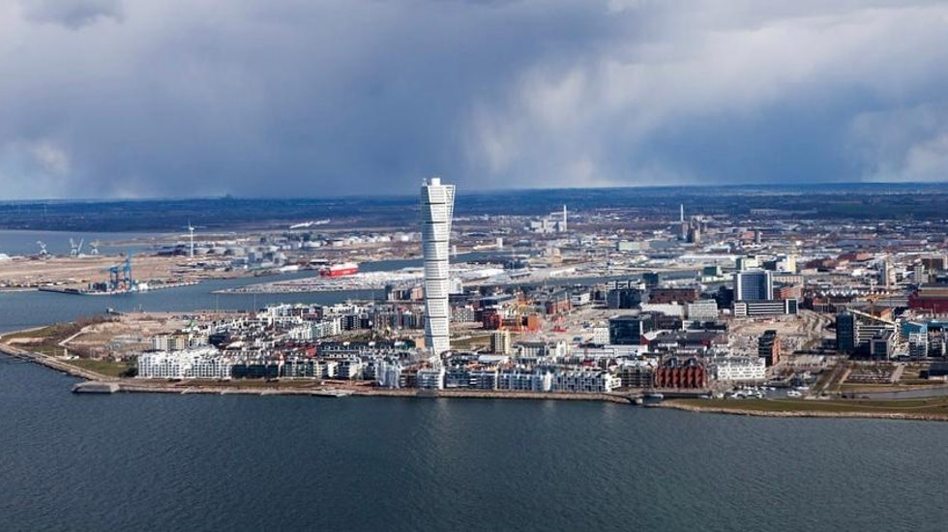
Welcome to Malmö 23-25th of September

Slide 2
Topics
Supervision of eHealth
Continue on the subject of supervising the system
Reopen the WG user participation
Continue WG Permits, licenses and registration
What do you think?

Slide 3
The Nordic conference 26-27th
Free for EPSO-delegates
User participation and impact

