Slide 1
Quality framework for homecare in the Netherlands
A new Dutch development from
service users and supervisory perspective
Annemarie Koopman
senior consultant Vilans

Slide 2
Nice to meet you!
Vilans primarily works for all professionals involved in care providing organisations in long-term care at local, provincial, national and EU level.
I studied nursing science and health policy & management. As senior advisor I help organisations in long term care to improve safety and quality of care

Slide 3
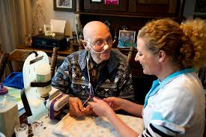
Overview
The vision and organisation of the quality of Dutch home care is developing and so is the vision and organisation of its supervision
Presentation
Dutch home care till 5 years ago
Development quality framework for home care
Supervision of home care
Experiences and challenges
Questions for the round table discussion

Slide 4
Dutch home care till 5 years ago: Vision and organisation
High grade of institutionalisation (next to home care)
Increase of the number of elderly people with need for care
Increase of costs
Goverment policy: more home care instead of institutional care!

Slide 5
Dutch home care till 5 years ago: Vision and organisation
Home care: focus on medical/physical aspects of life
Solution for reducing costs: focus on efficiency of home care
Home care: devided by interventions (‘products’) by various care professionals with various kinds of (low) education.
Every care professional responsible for their on (small) part in home care
Clients see a lot of care professionals for different interventions
Responsability spread over various professionals. Nobody had the whole picture
Financing of interventions/products in minutes: Incentive to ‘produce’’/keep clients in care instead of prevention and make clients independent of care again.

Slide 6
Dutch home care till 5 years ago: Quality of care
On the same time: a lot of incidents in long term care (home care and nursery homes)
Public pressure: distrust
Definition of minimum, basic care (for example medication safety)
Goal: an objective standard of quality of care (good/not good)
Caregivers: focus on proces, registration, checklists, administration instead of client needs

Slide 7
Dutch home care till 5 years ago: Effect
Client satisfaction low: see a lot of care professionals, who only act on a small part of their needs
Care professionals satisfaction low: many administration, professionals are not allowed to act on broader needs of clients
Still an increase of costs: because of the way home care is financed

Slide 8
Quality framework for home care National reform of the home care system
Integrated vision of quality of care: quality of life, positive healthcare,
Accent on self-supporting of clients and their own and local support systems
Accent on support on other life-domains, prevention
Reintroduction of the highly educated community nurse in the home care en social care, with an generalistic integrated view: ‘What is nessacary for an indivual to experience quality of life and to stay at home’, linking pin to other life-domains.
Need of professionalisation and support of workers in home care settings
Need of introduction standardized terminologies in home care settings to collect data to improve the quality of care in term of contribution to quality of life
Need of new way of financing home care: financing by characteristics of a population (a fixed fee per client) instead of interventies/products per client as an impuls to focus on more prevention and to come to new, different solutions

Slide 9
Quality framework for home care Quality of care
Quality framework in use (2018) ; whole caresystem involved (policy government, insurance companies, national nursing organization, care providers etc); implementation just started.
A framework instead of a definition of minimum, basic care
Focus on clients perspective en the self-supporting of the client en their supporting system
Emphases on trust instead of distrust
To a partially subjective standard of quality of care (something is good for this client or in this situation)
The framework offers both limits (you need to meet professional standards) as possibilities to act open, learn and improve
Caregivers: focus on dialogue about quality of care with clients, with each other and their organisations (to create the right conditions) to improve quality of home care

Slide 10
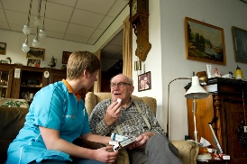
Quality framework for homecare Perspective and goals
Not just a description of quality of care but an ambition for the development of home care (not primairy instrumental)
Supports reforms and improve public health care
Key is working together with client and informal caregivers
Supports nurses to professionalize
Make their work more transparent
Stimulates use of data for research and development

Slide 11
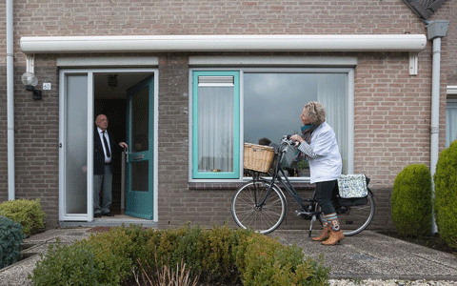
Quality framework for homecare Content
What can the client expect from home care?
To what professional terms must home care meet?
To what organisational conditions must home care meet?

Slide 12
Supervision of home care Goals
Stimulate good home care
Contribute to policy for home care
Enforce the position of the community nurse

Slide 13
Supervision of home care Related supervision framework
Safety
Integrated care
Client central
Steer on quality by the organisation
Professional autonomy community nurse

Slide 14
Supervision of home care Proces
Just started (2019)
Perspective client and role community nurse starting point in the supervisory
Accent on experiences/real practice instead of processes and paper
Besides interviewing management:
Interviewing care professionals
Walk along with care professionals during their daily routine
Interviewing clients en their supporting system at home with a check on the dossiers
From ‘check is it all in order’ to ‘a dialogue with all participants about improvement of care’

Slide 15
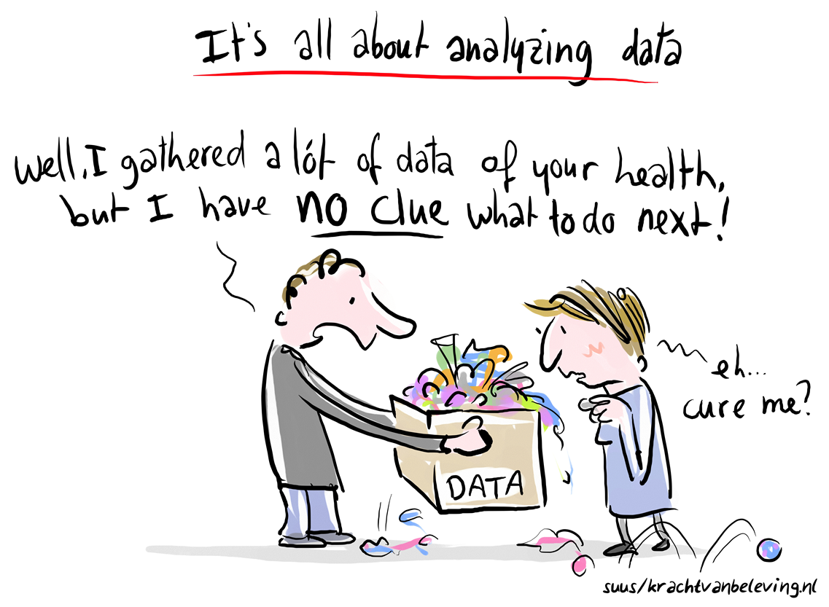
Experiences en challenges
The implementation of both the quality framework as the new way of supervision has just started. First impressions are positive.
Finance of home care is still based of the ‘old system’ of interventions/products: slows down the transition
Informal garegivers: prevent them from stress to heavy burden
Give advice, instructions
Start Support groups
Community approach
The movement from risk-avoidance to risk acceptation is under pressure when incidents take place
Use data from careplans
One language helps
How to use data?

Slide 16
Questions round table discussion
What can supervisory organisations learn form the Dutch approach in the home care?
Dialogue instead of control?
Is the Dutch approach of supervision on the home care transferable to other countries?
Why? You can start any moment with the dialogue-form of supervision?
Or why not? If the vision and organisation on home care of a country is focussed on control en checks it does not work?
Is the Dutch approach of supervision in the home care transferable to other health domains (hospitals)?
Why? You can start any place with dialogue-form of supervision?
Or why not? If the vision and organisation of other domains is focussed on control en checks it does not work?

