Slide 1
Indicators of health system coverage and activity in Ireland during the economic crisis – from more with less to less with less
Prof Steve Thomas, Dr Sara Burke, Dr Sarah Barry,
Centre for Health Policy and Management, Trinity College Dublin
25 September 2014
ESPO meeting, Dublin Castle

Slide 2
The Resilience Project
Resilience of the Irish health system: surviving and utilising the economic contraction: Oct 11 – March 14
Methods:
Quantitative – gathering national & international indicators
Qualitative – in-depth interviews with 19 senior health policy makers and health service managers
Collaboration:
Centre for Health Policy and Management, TCD
Economic & Social Research Institute
WHO, Health Systems Strengthening, Barcelona, European Observatory, LSE Health
http://www.medicine.tcd.ie/resilience4health/

Slide 3
Health System Resilience
Financial resilience: the protection of funds for health care, and particularly that of the vulnerable, in the face of economic contraction.
Adaptive resilience: the ability of government and providers to manage the system with fewer resources, through efficiencies, while not sacrificing key priorities, benefits, access or entitlements.
Transformatory resilience: the ability or capacity of government to design and implement desirable and realistic reform when the current organisation, structures and strategies are no longer feasible.

Slide 4
Public spending on health fell disproportionately in 18 countries
Source: WHO NHA database, 2013
Notes:
Ireland most affected – fell by 2.33%

Slide 5
Reallocation across government
Source: Cylus and Pearson in Thomson et al 2014
Notes:
The mix of spending by governments has changed, as countries seek ways in which to improve efficiency, reduce unnecessary expenditures, and shift money among different priorities. For example, the percentage of the budget dedicated to economic affairs increased by 25.9 percentage points in Ireland between 2007 and 2010; to compensate for this expenditure cuts were made in all other sectors including health, education, and social protection.
04 - Economic affairs
04.1 - General economic, commercial and labour affairs
04.2 - Agriculture, forestry, fishing and hunting
04.3 - Fuel and energy
04.4 - Mining, manufacturing and construction
04.5 - Transport
04.6 - Communication
04.7 - Other industries
04.8 - R&D Economic affairs
04.9 - Economic affairs n.e.c.
05 - Environmental protection

Slide 6
Resilience indicators Health budget, pop & O’65s 05-14

Slide 7
Resilience indicators Health €, staffing, pop & medical card numbers 05-14

Slide 8
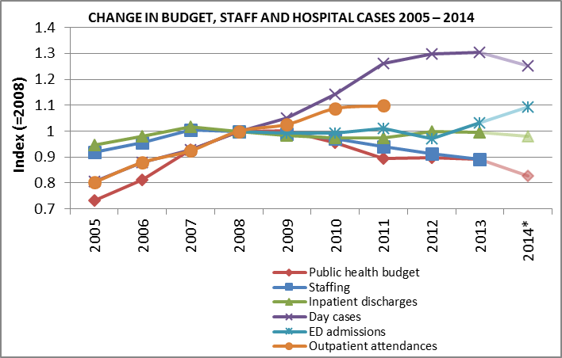
Resilience indicators Change in budget, staff &hospital cases 05-14

Slide 9
Resilience indicators Numbers covered public health schemes 05-12

Slide 10
Resilience indicators Nos of items dispensed public health schemes 05-12

Slide 11
Resilience indicators Cost of drugs in public health schemes 05-13

Slide 12
Resilience indicators Numbers of adults & children waiting for inpatient & day case hospital treatment 2008 to 2013

Slide 13
Cost shifting onto people 08 - 13

Slide 14
Policy makers & health service managers
Semi-structured interviews
senior civil servants, HSE managers, political advisors – health/finance (19)
Wave 1: Sept 2011 – Jan 2012 (4), Dec 2012 – Jan 2013 (2)
Wave 2: Dec 2013 – March 2014 (13)
What do senior policy makers & health service leaders think about
the impact of the economic crisis on the health system
on-going decision-making including analysis of system reform
identifying health reform priorities
managing complexity of reform v resource constraints/austerity

Slide 15
Drivers of health reform
Reform as radical as this can only come from a change in government
there were political imperatives
There were only four priorities, patients, patients, patients and patients
at a national level the only, the only discussion or the only strategy we had was around economics…
over the last four years, the only measure that has been considered important in the health service is the budget and head count numbers
the troika arrive they start talking about top 3 priorities & suddenly health was there alongside the future of banking, mortgages arrears, debt sustainability
then its the Irish Troika that really runs the government

Slide 16
Health reform priorities
Safety & Quality
The guiding principle was that we’d have high-quality patient services, patients that were going to be a priority
Improved patient outcomes. That’s… what it’s all about
The business of the health service is caring for patients
I’m not saying it wouldn’t have happened otherwise but clearly it [death of Savita Halapanavar] was an enormous kind of an earthquake type event, which has changed the way lots of people think about the issue of patient safety

Slide 17
Health reform challenges
Austerity versus quality
at a national level … we’ve created the same environment that existed in Mid-Staffordshire, but instead of doing it on a hospital by hospital basis we’ve done it on a national basis, because we have said the only thing that really matters in discussion is budget, money and head count… this is austerity
I really wish that finance and DPER could really truly look at the health services as an investment in our citizens rather than a money pit
that tension between the need for cash extraction and system reform, I don’t think we’ve actually hit the full clash of that yet. I think… that’s yet to come and I, and I don’t think that’s going to be pretty

Slide 18
Governing Values in Conflict?
quality
reform
austerity

Slide 19
Governing Values in Conflict?
austerity
reform
quality

Slide 20
Governing Values in Conflict?
quality
reform
austerity

Slide 21
In conclusion
Financial resilience:
YES: almost 600,000 more medical cards since 2005
NO: cost shifting onto the old and the sick, up to €100 in cost back onto all individuals since 2008
Adaptive resilience:
YES: 2007 – 2012 ‘more with less’: efficiency gains/less flabby
NO: 2012 – 2014 ‘less with less’: service cuts/performance losses/access issues
Transformatory resilience:
NO transformation, ‘survival’….
A more complex reality:
System fragmentation – constant organisational change/different rationales
System/structural weakness – management capacity/systems etc.
Political environment – ambiguity and uncertainty

Slide 22
In conclusion
Significant & arbitrary nature of the health cuts
Conflict between reform & austerity & quality
Increasing access issues due to austerity
Ability to continue to deliver services ‘in severe jeopardy’ (€ & politics)
Alongside expectation to improve services
A resilient system?
Initially yes, but not anymore
Hard to quantify impact on quality but growing consensus that viability & safety of system at risk

Slide 23
Thank you for listening! Any questions and comments please
www.resilience4health.com
sarabur@gmail.com
saraburke.com
@sburx

