Slide 1
Crisis and healthcare in Portugal
Álvaro Moreira da Silva
Health Regulation Authority, Portugal

Slide 2
Outline
Political and economic background
Recent healthcare policy in Portugal
Healthcare system performance
Conclusions

Slide 3
In the shadow of crisis, a new kind of healthcare emerges…
“Growing healthcare gaps, as crisis hits poorer parts of Europe”.
“European healthcare keeps improving, in spite of crisis”
“Empowered patients contribute to healthcare improvement”.
Health Consumer Powerhouse
Euro Health Consumer Index 2013 repo

Slide 4
1. Political and economic background
Public debt as % of GDP
Public deficit as % of GDP
SGP limit
SGP limit
Real GDP growth rates (2006 prices)
Unemployment rate

Slide 5
1. Political and economic background
On 16 May 2011, EU and IMF approved a €78 billion ‘bailout’ package
In exchange, Portugal signed a Memorandum of Understanding (MoU):
committing itself to strict economic policy conditionality
aimed at reviving growth and ensuring fiscal and financial stability and sustainability
including transversal and sector-specific reforms, most implying substantial cuts in short-term public expenditure and rationalisation of public services

Slide 6
2. Recent healthcare policy in Portugal
Healthcare system in the MoU
Targets:
Improve efficiency and effectiveness
Rational use of services and control of expenditures
Savings in the area of pharmaceuticals
Savings in hospital operating costs
Content:
Mix of structural reforms and short-term changes

Slide 7
2. Recent healthcare policy in Portugal
Healthcare system in the MoU
Scope of measures:
NHS and public subsystems financing
Pharmaceuticals and the pharmacies’ sector
Prescription and monitoring of prescription
Centralised purchasing and procurement
Primary care services
Hospital services
Cross services

Slide 8
3. Healthcare system performance
A system under pressure:
MoU conditionality
Financial difficulties (overall and health-specific)
Demographic changes
Healthcare policy effects:
Changes intended to tackle problems and assure financial sustainability
But concerns over negative impacts in quality, access, health status and equity

Slide 9
Healthcare system performance – health status
Infant mortality rate (age<1)
Life expectancy at birth
Suicide rate
Total mortality rate

Slide 10
Healthcare system performance – access
Waiting time for surgery
Doctors consultations
Patients complaints by subject

Slide 11
Healthcare system performance – expenditure
Total expenditure on health
Out-of-pocket payments
OOP share:
2011: 27%
2012: 29%
Public expenditure on health

Slide 12
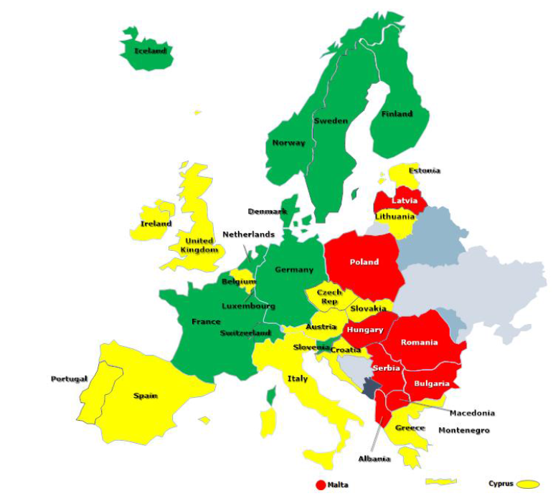
Healthcare Quality Measured as Outcomes Outcomes scores in EHCI 2013
Health Consumer Powerhouse
Euro Health Consumer Index 2013 report

Slide 13
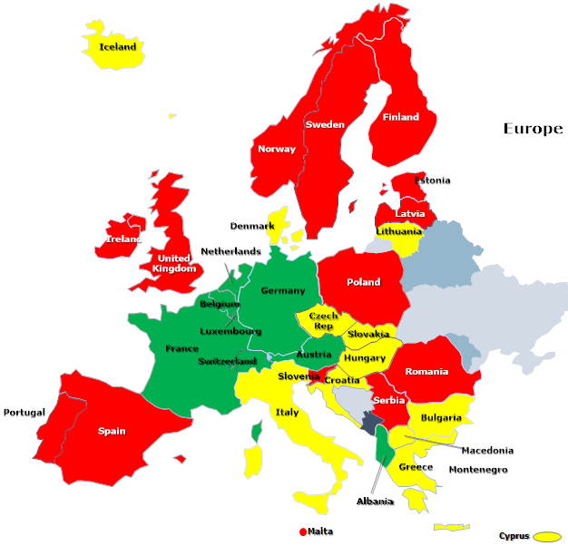
Waiting times in European healthcare 2013
Health Consumer Powerhouse
Euro Health Consumer Index 2013 report

Slide 14
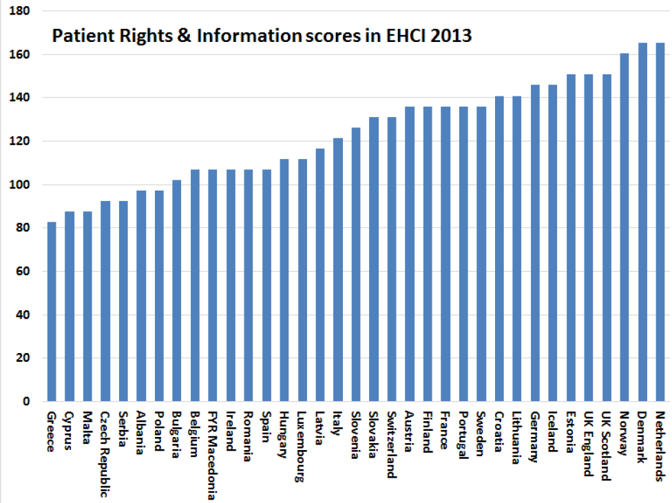
Closing the gap between the patient and professionals
Health Consumer Powerhouse
Euro Health Consumer Index 2013 report

Slide 15
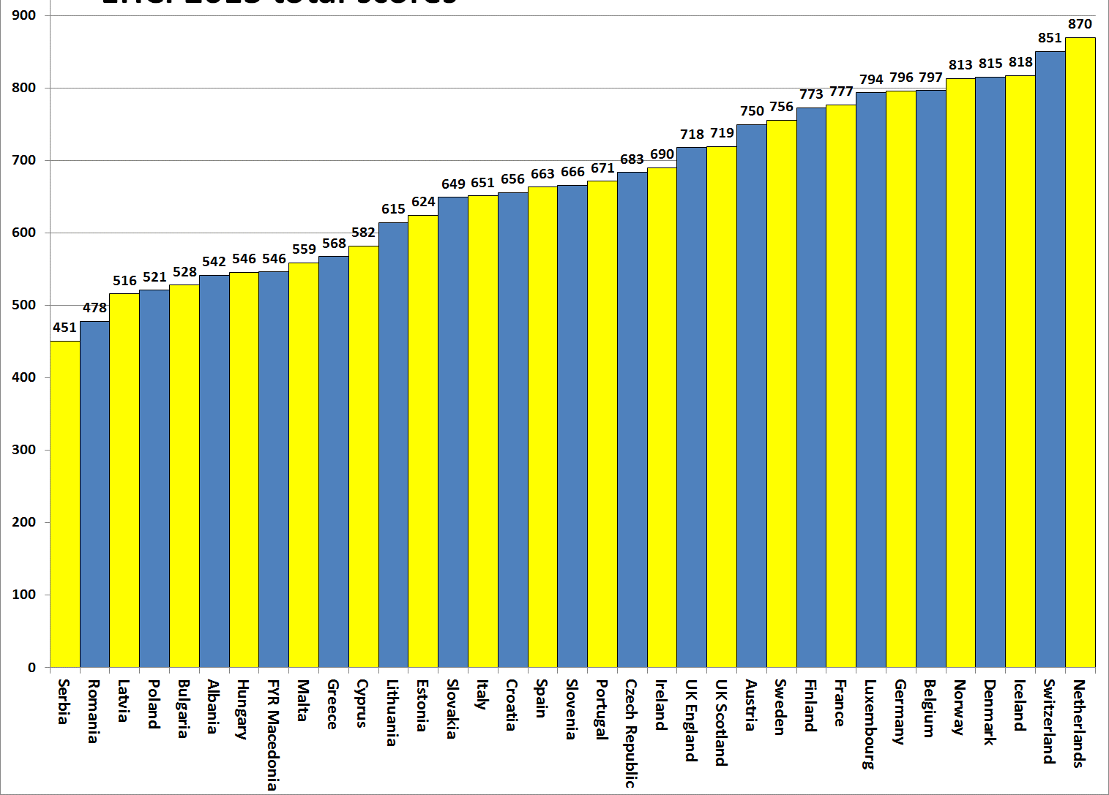
EHCI 2013 total scores
Health Consumer Powerhouse
Euro Health Consumer Index 2013 report

Slide 16
3. Healthcare system performance
Portugal
Makes a very impressive climb: 16th place on 671 points (up from 25th place in 2012).
This is all the more remarkable, as Portugal is one of the countries most notably affected by the euro crisis!
Health Consumer Powerhouse
Euro Health Consumer Index 2013 report

Slide 17
4. Conclusions
Impacts of recent healthcare policies are not yet completely observable
Not easy to disentangle from the effects of the crisis itself
What do aggregate indicators tell us?
Health status and access to health care have not been deteriorating since 2009
The financial burden with health care is increasingly falling on families.

