Slide 1
4 Nations Thematic Activity Conference Jan Warner and Steven Wilson

Slide 2
THIS PRESENTATION • An introduction to Healthcare Improvement Scotland • An overview of our Healthcare Quality Standard and Healthcare Scrutiny Model • An example of a thematic review

Slide 3
HEALTHCARE QUALITY STANDARD
1 standard
4 key components
People focus
Shared strategic vision
Capacity, capability & culture
- Governance arrangements for clinical quality
10 key elements (self evaluation)

Slide 4
Previous MODEL of peer review
Much loved and in demand but …
Limited patient/public input
Multiple sets of standards…. bureaucratic and paper heavy
No consistent risk assessment of providers or services
Inconsistent methodology
Limited use and sharing of existing information
Everything applied to everyone every time

Slide 5
NEW Healthcare scrutiny model
4 elements:
Information gathering
Analysis and Interpretation
Scrutiny
Reporting and Follow up

Slide 6
ORGANISATIONAL profile
Metrics about organisations (population, beds, services)
Relevant qualitative and quantitative intelligence added
(inc. information from other regulatory bodies)
Risk based scrutiny– outlier based
Information updated in real time (eventually)
Consistent self evaluation
Systematic, knowledge based approach

Slide 7
THEMATIC REVIEW
Improving Nutrition……Improving Care
Linking Scrutiny and Improvement

Slide 8
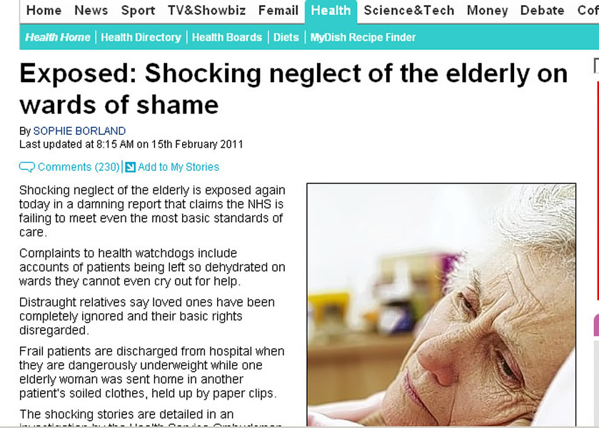
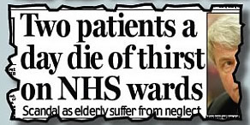
Notes:
3 million people in the UK suffer from malnutrition
Costs exceed 13 billion pounds per year
NICE predict nutrition to be the largest cost saving area in the NHS

Slide 9
Improving Nutritional Care Programme: 18 month programme
Aim: Ensuring adults at risk of malnutrition receive appropriate and safe nutritional care and the assistance they require to eat and drink
Person Centred
Effectiveness
Safety
Efficiency
Supporting self-management of nutritional care
Improving meal processes: reducing waste
Preventing re-admission
Managing transitions between hospital and care home
Ensuring people get the support they need to eat and drink
Notes:
The improving nutritional care programme is an 18 month improvement programme (due to end in March 2012) which aims to ensure adults at risk of malnutrition receive appropriate and safe nutritional care and the assistance they require to eat and drink.
Providing good nutritional care is key to people’s experience of healthcare and addresses all three quality ambitions of the Healthcare Quality Strategy.

Slide 10
3 Priority areas: rationale
Making Meals Matter
Food Fluid and Nutrition Standards highlighted areas for improvement
Self-Management (LTC/COPD)
3 million people in UK: COPD
Better Together (patient experience) assistance with eating and drinking statistics
30% of people admitted to hospital from care home at risk of malnutrition
Improving transitions (care home/hospital)
13,000 discharges from hospital to care home in Scotland (ISD)
Variation in communication re: nutritional care
5th Leading cause of death in the UK
NHS Costs: 600 million/year
Supporting self-management of nutritional care
Food fluid and nutrition standards – area for improvement
Notes:
Priority areas were identified by the programme through a process of segmentation, consultation and critical appraisal.
The 3 areas for targetted improvement work were:-
To improve meal time processes to ensure people get the right help they need to eat and drink.
To improve the transition (initially between care home and hospital) to ensure that communication relating to nutritional information is fully documented and transferred with the patient.
To improve knowledge and understanding of nutritional information to enable people with long term conditions to self-manage their nutritional care

Slide 11
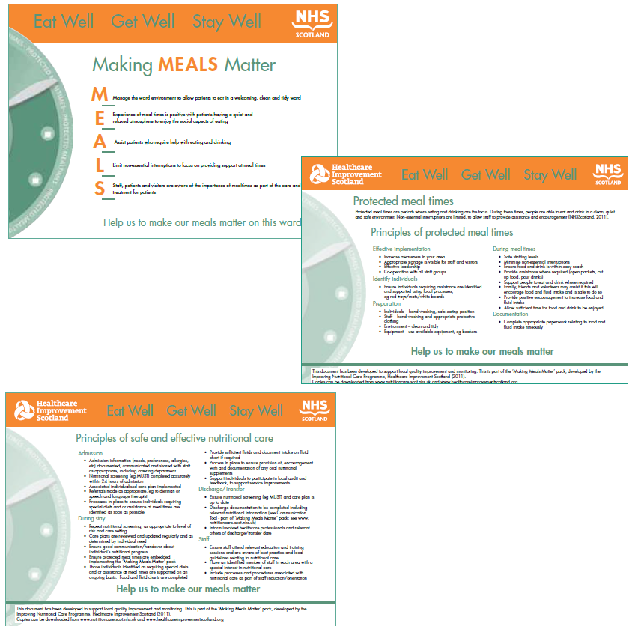
Making Meals Matter Resources
Posters for display in clinical areas
Protected meal time principles, observation tool, staff and patient experience questionnaire
Principles of safe and effective nutritional care, observation tool and patient experience questionnaire

Slide 12
Communication Tool and Feedback
“I didn’t have to go searching for information. Everything was at a glance”
“Should have happened a long time ago”
“ A lot of people don’t consider people need help with prompting and cutting up, this section is helpful”.
“Able to plan from the beginning”.
“Good information to support care and catering staff”

Slide 13
Spreading Improvements
Volunteers at Meal Times
Resources
Communication Tool and Staff Survey
Making Meals Matter Resources
prototypes, shared learning, experience and methodologies
Purpose of spread: Ensuring adults at risk of malnutrition receive appropriate and safe nutritional care and the assistance they require to eat and drink

Slide 14
Original Test Sites for the Improving Nutrition...Improving Care Programme
Improving Transitions | Making Meals Matter/ Volunteers at Meal Times
Hospital Sites: City Hospital Aberdeen, Aberdeen Royal Infirmary, Blowarthill Hospital Glasgow, Lightburn Hospital Glasgow, Corstorphine Hospital Edinburgh Care Homes: Fairview, Aberdeen Grandholm, Aberdeen Kingsmead, Aberdeen Wyndford Locks Glasgow, Greenfield Park Glasgow, Clurry Lodge Edinburgh | Hospital sites: Ayrshire & Arran, Greater Glasgow and Clyde, Fife

Slide 15
Spreading Improvements
Improving Transitions | Making Meals Matter/ Volunteers at Meal Times
City Hospital, Aberdeen Aberdeen Royal Infirmary Blowarthill Hospital, Glasgow Lightburn Hospital, Glasgow Corstorphine Hospital , Edinburgh Ayr Hospital, Alisa Hospital and Crosshouse Hospital NHS Ayrshire & Arran Borders General Hospital, NHS Borders NHS Dumfries & Galloway NHS Fife Forth Valley Royal Hospital, NHS Forth Valley Stephen Hospital, NHS Grampian Glasgow Royal Infirmary, NHS Greater Glasgow & Clyde Raigmore Hospital, NHS Highland Monk lands Hospital, NHS Lanarkshire NHS Shetland NHS Orkney Ninewells Hospital and Murray Royal Hospital, NHS Tayside NHS Western Isles The State Hospital | Fairview, Aberdeen Grandholm, Aberdeen Kingsmead, Aberdeen Wyndford Locks, Glasgow Greenfield Park, Glasgow Clurry Lodge, Edinburgh Abbeyfield House, Ayrshire Lambhill Court, Glasgow Erskine Home, Glasgow Springboig Care Centre, Glasgow Stoneywood Residental Home, Glasgow Eastleigh Care Home, Aberdeen Fidra Home, Edinburgh Clement Park, Dundee Thorneycroft , Dumfries & Galloway Cartvale Care Home, Glasgow Bankhouse, Lowerjohnshill, Nethanvale MHA Auchlochan Garden Village, Lanarkshire Clarence Court, Glasgow Greencross, Morningside Thistle Healthcare, Glasgow Brookfield Residential Home, Carnouiste Hogganfield Loch Nursing Home, Glasgow Arran View Care Home, Arran

Slide 16
Thank you

