Slide 1
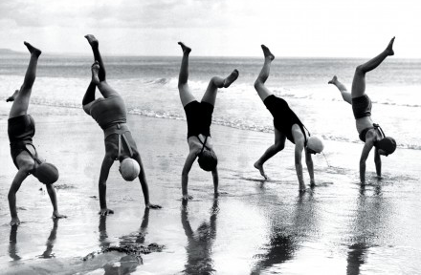
Inspectors making a difference: using discretionary space collectively
Suzanne Rutz - Dinah Mathew - Antoinette de Bont - Paul Robben
Joint Inspectorate for Youth - Care Quality Commission - Health Care Inspectorate - Erasmus University

Slide 2
Warming up
How do you feel:
should inspectors be encouraged to use discretion?
?

Slide 3
Critique on individual discretion
Is considered necessary to increase responsiveness
May lead to inconsistency and unfairness
Answer: constraining and controlling discretion which may diminish responsiveness

Slide 4
Central question
How can we understand
the individual and collective aspects of
inspectors’ discretionary space?
?

Slide 5
Two inspectorates compared
Care Quality Commission | Joint Inspectorate for Youth
2010 | 2003
1885 staff / ± 900 inspectors | 5 staff / 15 inspectors
Various professional backgrounds (social work, care, cure, research, patient safety, etc) | Various professional backgrounds (social work, teaching, legal, youth care, ethology, epidemiology, etc.)
Inspectors work from home | Inspectors work in teams
Structured inspections | Reflexive inspections
Legislatively-led regulator | Mission-led regulator
Assessing organisations’ compliance with standards | Driving improvement across the whole sector

Slide 6
Inspectors need the inspectorate to make a difference
‘[I] started to tire of it a bit, mainly because of the lack of any authority really in terms of trying to get providers to do any actions or anything like that. So that’s why I joined the CQC, to try and have a bit more clout and try and improve things’. (CQC)

Slide 7
Discretionary judgement
Individual discretion
Involving colleagues
Including managers
Engaging stakeholders

Slide 8
1. Inspectors use discretion individually
‘Adapting the procedures and starting a dialogue with the municipality has paid off. They started to think about possibilities and started to communicate with us. They were no longer defensive. What I had to do to accomplish that is jumbling up various procedures’ (JIY)
Notes:
Inspectors use their discretionary space individually. The way inspectors do so is quite similar at the CQC and at the JIY.
Example:
We highlight two examples of these situations. The first example concerned a situation in which a JIY-inspector acted specifically to enforce action of a local municipality. The local municipality did not fully accept the inspectors’ judgment and the inspector decided to start a dialogue with them about it:
That municipality did not accept our report about care for children with linguistic and developmental disorders. They felt that it was formulated too negatively and they were not motivated to take action in response to the report. Like: ‘hand the report over to us and we will see what we are going to do about it’. Then you [as an inspector] know that you need to intervene and do something positive and stimulating. When I visited them as part of the monitoring phase, I started by telling them how I thought that they experienced their situation: ‘I think you perceived the inspection as follows…’ I think I expressed that very well because as a consequence they relaxed and started to show commitment. And then I said: ‘Well, I will monitor your improvements a bit differently compared to other municipalities’. Adapting our procedures and starting a dialogue with the municipality has paid off. They started to think about possibilities and started to communicate with us. They were no longer defensive. What I had to do to accomplish that is jumbling up various procedures’.
This inspector used his individual discretion to address the specific situation, which meant that he had to interpret the procedures for monitoring aberrantly, and was successful in effecting a change in the municipality’s motivation to make improvements.

Slide 9
2. Involving colleagues to create support
‘I think that the bottom line with that is that you will be faced with situations which are difficult, and I think it’s knowing when to make a decision yourself, and when you need other people to help you make that decision’. (CQC)

Slide 10
3. Including managers for mandate
Warning notice
(Enforced) self-regulation
Cancel registration
Suspend new admission
Criminal prosecution

Slide 11
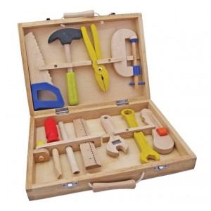
4. Engaging stakeholders to create extra options
“At the moment a midwife service does not seem to cooperate. X said to them: ‘an inspector of your own inspectorate will call you’. I am fine with that, let me call and persuade them.” (JIY)

Slide 12
To sum up
Individual discretion |  | And collective work to use discretion.
Individual professional Critique on individual discretion |  | Full repertoire of roles, tactics and opportunities Answer to the critique; increasing consistency and responsiveness

Slide 13
Discuss in groups
?
Do you recognise the findings?
What are the advantages and disadvantages of organised discretion from the viewpoint of:
inspectors (group 1)
inspectorate (group 2)
service under scrutiny (group 3)
service user (group 4)

Slide 14
Rank your inspectorate
Consistency
Responsiveness

