Slide 1
International Review –
Use of Information for the regulation of health and social care
Barbara Foley, PhD
Tracy O’Carroll
Health Information and Quality Authority
26th September 2014

Slide 2

Presentation overview
Part 1
  Background
  Methodology
  Use of information for regulation
Part 2
  Quality indicators
  Tools to inform quality of care
  Reporting

Slide 3

Objective
Conduct international review to identify how regulators and health improvement agencies use data to improve health and social care.

Slide 4

About HIQA
To drive continuous improvements in the quality and
safety of health and social care in Ireland
Setting Standards
Supporting Improvement
Monitoring Quality and Safety in Healthcare
Inspecting Social Services
Health Technology Assessment
Health Information
  Technical Standards
  Health Information Quality
  Business Intelligence

Slide 5
Jurisdictions reviewed
New Zealand
Ontario, Canada
England
Netherlands
Denmark
Scotland
Wales / N.Ireland (summary)

Slide 6
Consultation with key individuals
Jurisdiction | Organisation | Name | Title
New Zealand | Health and Quality Safety Commission | Richard Hamblin | Director of Health Quality and Evaluation
New Zealand | Ministry of Health | Caroline Boyd | Manager, Strategy and Policy
Ontario, Canada | Health Quality Ontario | Gail Dobell | Director of Evaluation and Research
Ontario, Canada | Health Quality Ontario | Wiser Haj-Ali | Manager - Performance Measurement & Reporting
England | Care Quality Commission | Neil Prime | Head of Analytics
England | Care Quality Commission | David Harvey | Team Manager
Netherlands | Inspectie voor de Gezondheidszorg (IGZ) | Perry Koevoets | Advisor – Research & Innovation
Denmark | Danish Health and Medicines Authority | Anne Mette Dons | Head of Supervision and Patient Health
Scotland | Healthcare Improvement Scotland | Dr Brian Robson | Executive Clinical Director
Scotland | Healthcare Improvement Scotland | Donald Morrison | Business Intelligence Division

Slide 7
Structures in place
Country | Regulation | Quality Improvement
New Zealand | Ministry of Health (HealthCERT) | The Health Quality and Safety Commission (HQSC)
Ontario | Ministry of Health and Long-Term Care | Health Quality Ontario
England | Care Quality Commission (CQC) | Care Quality Commission
Netherlands | Inspectie voor de Gezondheidszorg | Quality Institute ; CBO
Denmark | The Danish Health and Medicines Agency | Danish Institute for Quality and Accreditation in healthcare (IKAS).
Scotland | Healthcare Improvement Scotland The Care Inspectorate | Healthcare Improvement Scotland (HIS)
Wales | Healthcare Inspectorate Wales (HIW) Care and Social Services Inspectorate Wales (CSSIW) | NHS Wales and Welsh government.
Northern Ireland | Regulation and Quality Improvement Authority (RQIA) | RQIA

Slide 8

Key findings
(www.hiqa.ie)

Slide 9
1. Vision/Strategy
All the countries reviewed had strategic approach in place for the use of information to improve health and social care
Information being used as both regulatory and quality improvement tool
Changing profile of regulation – increased emphasis on information /intelligence

Slide 10
2. Defining the information
Quantitative
Qualitative
  Surveys
  Patient/staff experience
Structured/unstructured
  Social media
  Complaints/whistle-blowing
Types of indicator data
  Focus on existing datasets

Slide 11
3. Applying Business Intelligence
Clear vision/ action plan around Business Intelligence
Key strategic approach to Information and Intelligence
Outsourcing of analysis - “Data Partners”
Centralised structure
Presentation of information “intelligently” - interactivity of information / web-based

Slide 13
Use of Information - Regulation
England (CQC) - New “Intelligent Monitoring”/ Surveillance model for NHS Acute Trusts
Netherlands (IGZ)- Risk-led supervision
  Proactive - analysis of information provided routinely
  Reactive – incident-led; complaints etc

Slide 14
Intelligent Monitoring (CQC)
Previously – Quality and Risk Profiles (QRPs) for acute hospitals
  advanced statistical modelling
New model - Intelligent monitoring informs programme of inspections (Sept 2013)
Clarity about indicators they will prioritise, rather than a model that claims to scan all information all the time
Uses local and national information sources
14

Slide 15
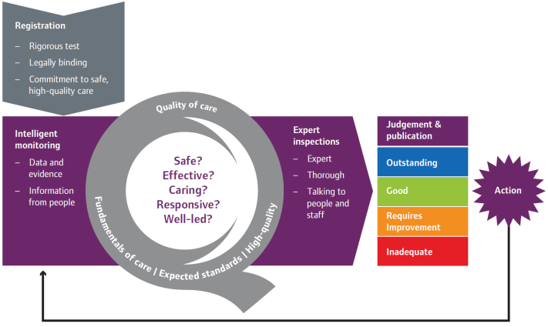

Slide 16
Indicators – Intelligent Monitoring
Avoidable infections (e.g. MRSA)
Notifications of deaths, severe and moderate harm and abuse
Never events
Mortality rates
‘Your Experience’ form – CQC
Patient and staff surveys
Complaints

Slide 17
Dutch model for risk-led supervision
Dutch Healthcare Inspectorate
Inspectorate Risk detection System (IRiS)
Intelligence data sources
  Care-related indicators
  Corporate - Management and finance indicators
  Incident reports (incidents and near-misses)
  External signals
  Own observations/info from other regulators

Slide 18
Summary – Part 1
Intelligent monitoring informs programme of inspections
Part 2:
  Indicators
  Qualitative data – tools to inform quality
  Reporting and publishing of information

Slide 19
Key Performance Indicators (KPIs)
Specific and measurable elements of practice
that can be used to assess quality of care.
Indicators are measures of structures,
processes or outcomes that may be
correlated with the quality of care delivered.
Notes:
Indicators allow flags of healthcare quality using a 3 part model:
Structures – buildings, equipment, specialist personnel and finances
Processess – what is done for service user and how it is done
Outcomes – state of health of the individual as a result of their interaction with the healthcare system

Slide 20

KPIs are not intended to be direct measures
of quality but instead act as alerts to warn us
of opportunities for improvement in the process and outcome of service-user care.
JCAHO
Notes:
Joint Commission on Accreditation of Healthcare Organisations in the United States.

Slide 21
Understanding
Key Performance Indicators
Objective: Improve the quality and safety of care provided
Effective: Clear definitions
Valid KPIs: Measure what they are intended to measure
Reliable KPIs: Consistently produce the same result regardless of who performs the measurement

Slide 22
Health Quality and Safety Commission New Zealand
Notes:
There are a total of 17 indicators, of which 12 either exist already or are easily sourced from routine data and five that require further work to define, and in some cases collect, the data.
In addition, there are a further seven areas where we know we want an indicator of some description, but currently there is no plausible data available or we are uncertain about what would make a suitable measure.
Key
Green: fast-track– An existing defined and tested indicator; there is likely to be good availability of data from existing collections. In some cases these will be collected as indicators, in others they will be derivable from existing data sets.
Orange: under development– Work underway to define indicator; further work required to understand availability of data.
Yellow: placeholder– Important area but significant further work required during next phase to
develop indicator and derive data.
http://www.hqsc.govt.nz/assets/Health-Quality-Evaluation/PR/HQSI-Feedback-and-Engagement-document-
July12-web.pdf

Slide 23
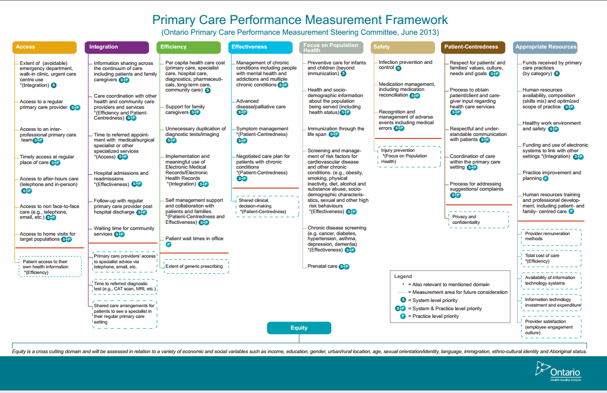
Health Care Ontario
Primary Care KPIs

Slide 24
Quality and Safety Indicators
Avoidable Infections
Adverse Events
Never events
Medication Safety
Surgery
Hospital Mortality
Hospital Activity
Disease-specific outcomes
Patient experience
Complaints
Maternity Indicators
Social-care specific
Structures

Slide 25

Patient and Staff Experience
All Jurisdictions
  all organisations should seek out the patient and carer voice as an essential asset in monitoring the safety and quality of care.
  A Promise to Learn – a commitment to act. Improving the Safety of Patients in England”
Notes:
National Advisory Group on the safety of patients in England

Slide 26
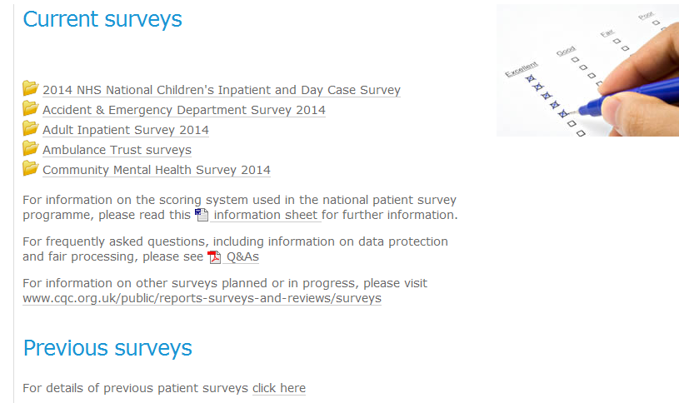
NHS: England
National Patient Survey Programme
  The Picker Institute Europe, a private charity, coordinates patient surveys.
National NHS Staff Survey in place

Slide 27



Patient Experience
New Zealand : Health Quality Safety Commission
License: use of Picker’s inpatient survey questions, library of 250 questions
4 domains:
    Communication Partnership
    Co-ordination Physical and emotional support
Adopt an approach comparable with international best practice to allow international comparisons.
The National Danish Survey of Patient Experiences (LUP)
LUP is conducted under an agreement between the Danish government and the Danish Regions.
Survey is conducted by the Unit of Patient Perceived Quality.
The unit carries out surveys, research and development projects concerning patient-perceived quality.
HEALTH QUALITY ONTARIO
Launched pilot survey of patient experience in primary care in 2014

Slide 28
Quality Accounts
A report about the quality of services by the service
Provider
Denmark
England
New Zealand
A statement from the organisation detailing the quality of the services they provide
Signed statement from the most senior manager of the organisation
Mandatory

Slide 29
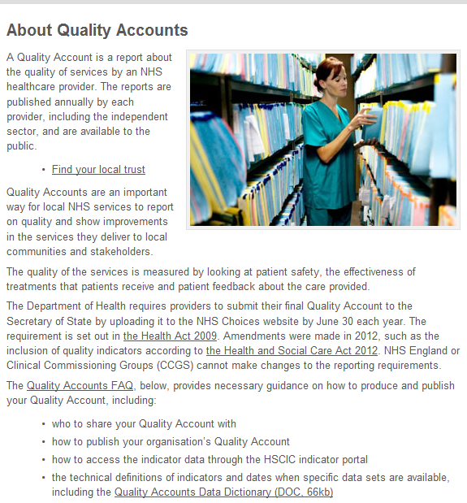
NHS: Quality Accounts
Source: http://www.nhs.uk/aboutNHSChoices/professionals/healthandcareprofessionals/quality-accounts/Pages/about-quality-accounts.aspx

Slide 30
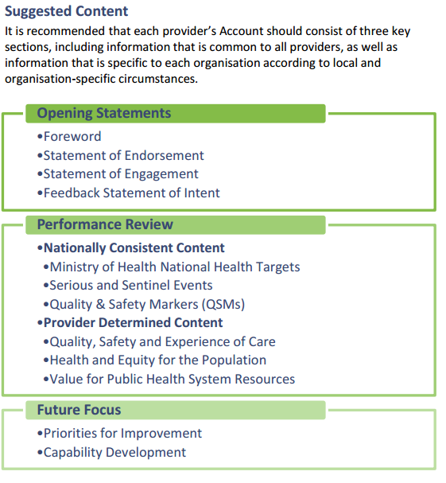
HQSC: Quality Accounts
Quality Accounts
A Guidance Manual for the New Zealand Health and Disability Sector

Slide 31
Corporate and Governance Review Netherlands
Annual Social Responsibility report:
  Management and Finance (liquidity, debt ratio)
  Personnel turnover
  Staff absenteeism
Notes:
The Annual Social Responsibility report is mandatory

Slide 32


Structured vs Unstructured
Structured vs Unstructured
vs.
Notes:
Image Number P1580 Object Number (TMS) NGI.19589 Title of artwork (TMS) The Castellated Rhine Constituents (All) (TMS) Artist: Joseph Mallord William Turner ,1775-1851 Classification (TMS) Drawings Date (TMS) c.1832 Medium (TMS) Watercolour and graphite on paper

Slide 33





Reports
State of the Nation
New Zealand, Ministry of Health
Health and Independence Report
England, CQC
The state of health care and
adult social care in England
in 2012/13
Thematic
  Læs mere i 'Forebyggelse af indlæggelser
  synlige resultater' : Prevention of admissions visible
  results (IKAS)
  Performance indicators as an independant measure of the quality of hospital care (IGZ)
  Primary care summary( HQO)
  Childcare Statistics (HIS)
  Perinatal and maternal mortality review committee reports (HQSC)
Notes:
IKAS – Danish Institute for Quality and Accreditation
'Prevention of admissions
visible results'

Slide 34
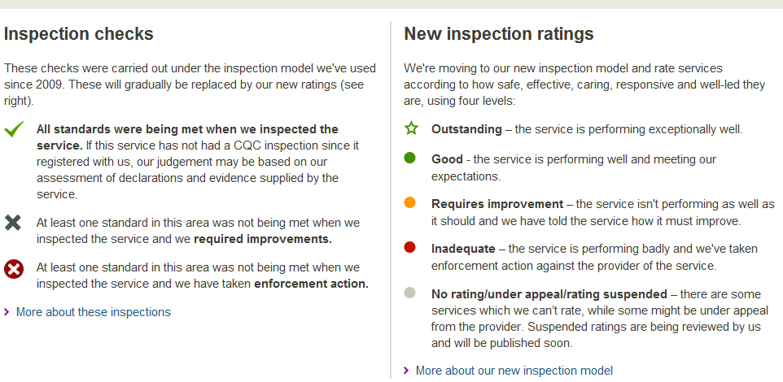
Care Quality Commission: Reporting
http://www.cqc.org.uk/provider/RTG#icon-keys

Slide 35
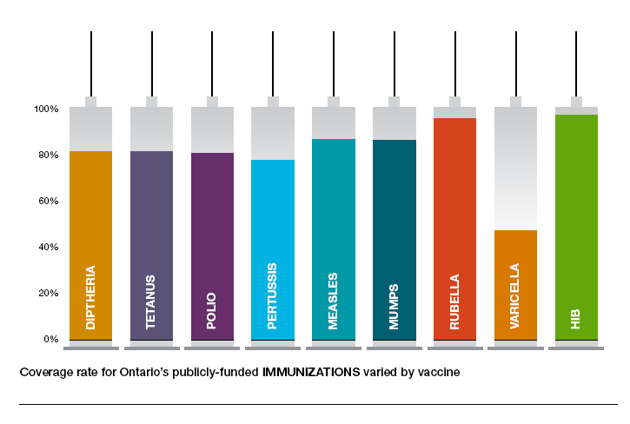
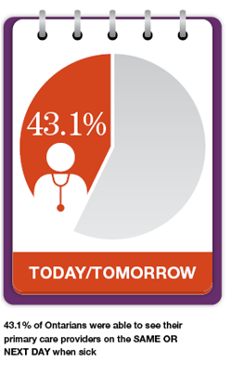
Health Quality Ontario:
Annual Report
HQO: AR 2013

Slide 36
Website and displaying information
Interactive
Dynamic
User-friendly
Targeted

Slide 37
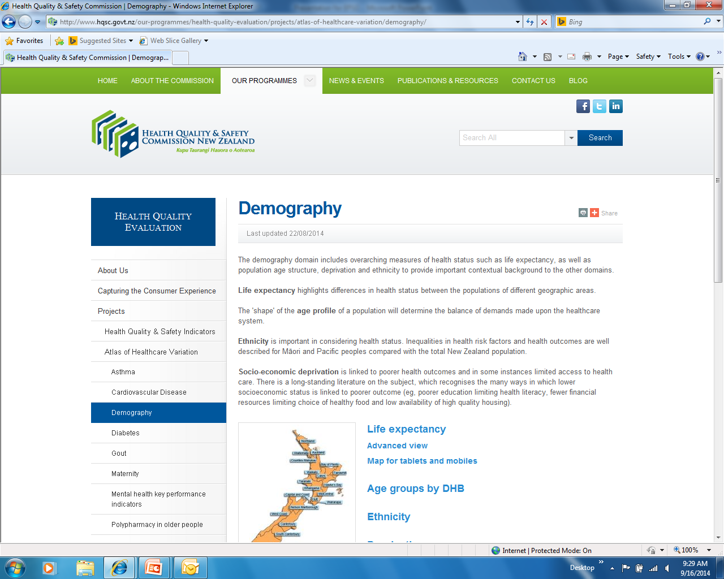
New Zealand: Website and displaying information

Slide 38
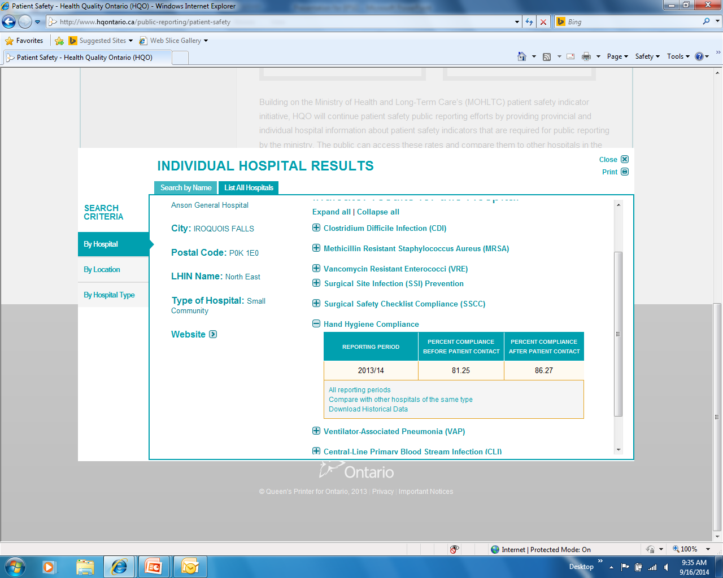
Health Quality Ontario: Website and displaying information

Slide 39
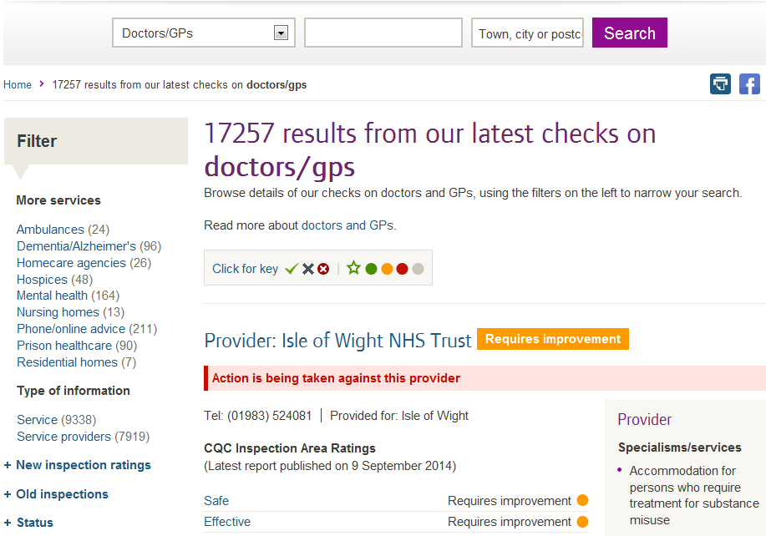
CQC: Website and displaying information

Slide 40

Danish Health and Medicines Authority Website and displaying information
Notes:
Rich site summary

Slide 41

Summary
It is only worth measuring if it changes your practice or the practice of service providers
Have clear definitions for indicators
Engage as many people as possible in the process
A business intelligence strategy is crucial
Publish intelligently

