Slide 1
Service user involvement in mental health services
EPSO
26th September 2014
Shari McDaid, PhD
Director
Notes:
Shari

Slide 2
Notes:
Shari

Slide 3
Our goal is for an Ireland where people with mental health difficulties can recover their well-being and
live a full life in their community.
Notes:
Our values include equity and human rights.

Slide 4
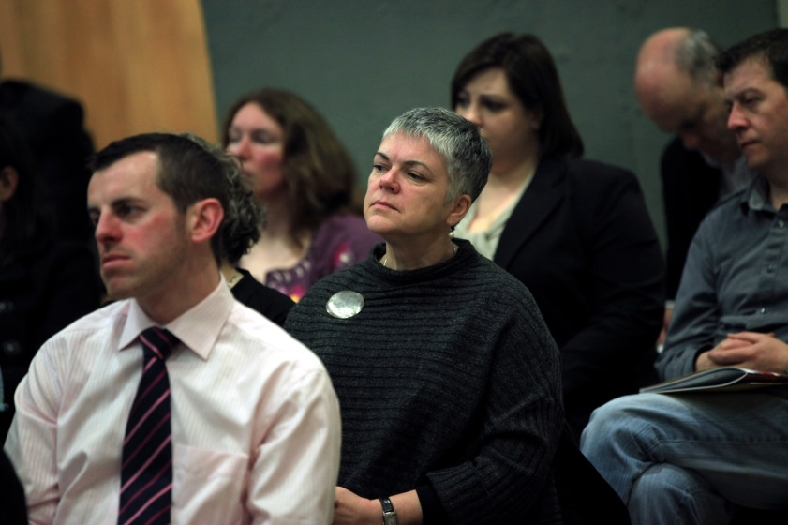
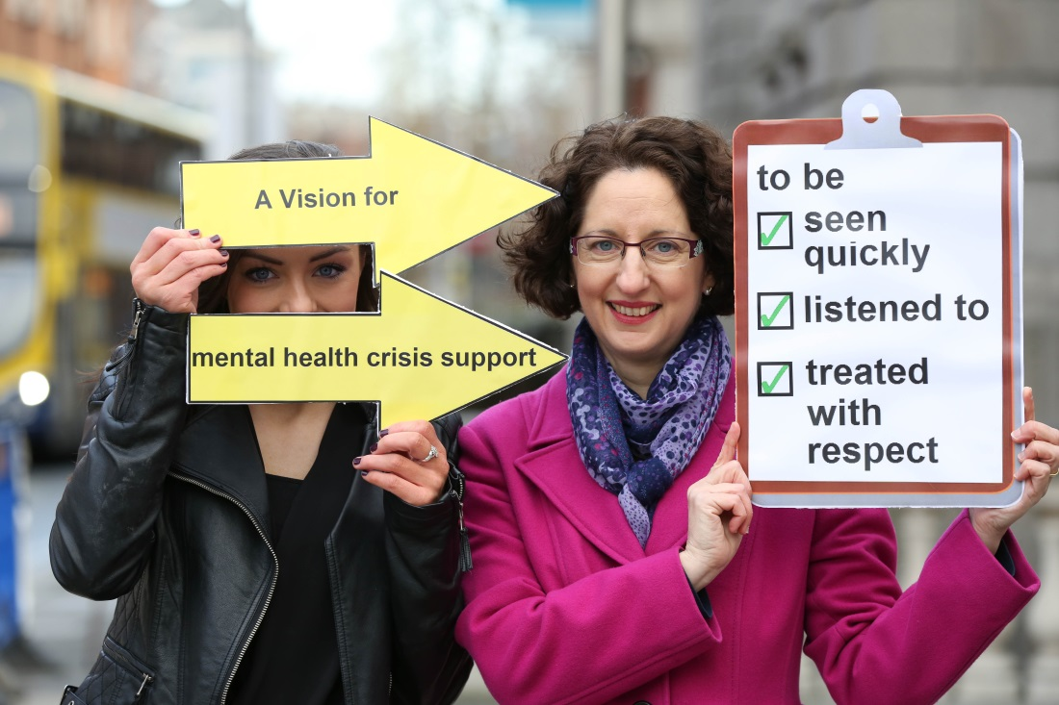
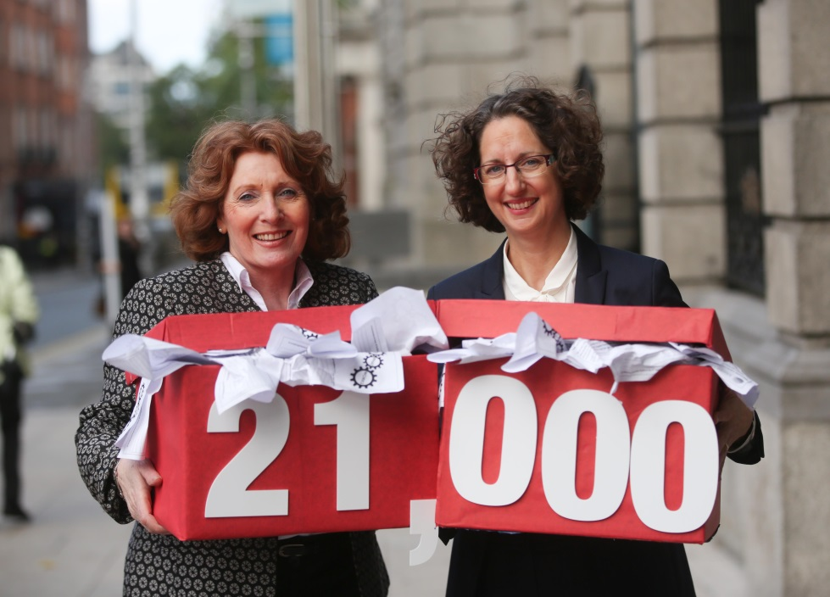
Unite – inform - advocate
Notes:
Shari

Slide 5
Why service user involvement in mental health services?
Consumerist approach
Democratic approach
Community development approach

Slide 6
History of service user involvement in Ireland
1998 – almost no service user involvement in mental health
1999 – the Derry conference
270 people with self-experience in a safe space
Widespread consultation, led by Paddy McGowan
Engendered the Irish Advocacy Network

Slide 7
History of involvement in Ireland
Mental Health Act, 2001

Slide 8
History of involvement in Ireland
2001 – Department of Health national policy

Slide 9
History of involvement in Ireland
2006 – A Vision for Change

Slide 10
Implementation 2001 – 2014
Mental Health Commission, tribunals and inspection team
National Service User Executive
HSE Office of Service User & Family Engagement
HSE Consumer Panels
Amnesty International Ireland’s Advisory Group
Refocus group at the College of Psychiatrists

Slide 11
Challenges for the future
Insider vs. outsider
Representativeness
Sustainability

Slide 12
Challenges for the future
“Future developments within the movement are likely to continue to be shaped by the inherent tension between insider and outsider strategies, and between contesting the current paradigm of bio-psychiatry and its disempowering practices and collaboration with it in order to seek reform of the current mental health services. The risk for the user/survivor movement remains that without independently funded, sufficiently robust user-controlled organisations with strong links to active local service-user groups, influencing the professionally dominated policy environment of mental health services will remain a daunting challenge.” Liz Brosnan 2014, p.93

Slide 13
www.mentalhealthreform.ie
Twitter - @MHReform
www.facebook.com/mentalhealthreform
Email: info@mentalhealthreform.ie
Tel: 01 874 9468
Coleraine House, Coleraine St., Dublin 7

