Slide 1
How to elaborate an alert tool for preparing accreditation visits of healthcare organizations?

Slide 2
A new challenge of HAS
From data on a healthcare organization, collected as indicators, filled by the healthcare organization itself or other organism, HAS wishes through a processing software of these data :
To be able to identify a risk profile of this organization in terms of warnings ( e.g. green, orange, red, like in traffic warnings):
For instance, the analysis of a combination of two indicators can lead to classify a healthcare organization in "red" warnings class of surgical risks.
Then, based on the risk profile identified, the HAS wishes to develop a best schedule for accreditation visits:
For example , a "green" warning means that the healthcare organization controls more the risks associated with one or more data.

Slide 3
A new challenge of HAS
Database 1
3
4
Database 2
Data processing software
Objective 1: identify and obtain a risk profile of the healthcare organization in terms of warnings
.
.
.
2
Database n
Objective 2: develop and obtain a best schedule for accreditation visits
5
Data filled, in term of indicators, by the healthcare organization itself or other organism
1

Slide 4
A new challenge of HAS
Other equivalent problems:
Detection of “bad” taxpayers: The purpose of this tool will be to refine the criteria for selecting taxpayers for possible inspection like unannounced control,
Reduction of time border control: targeting of goods and passengers in an airport.

Slide 5
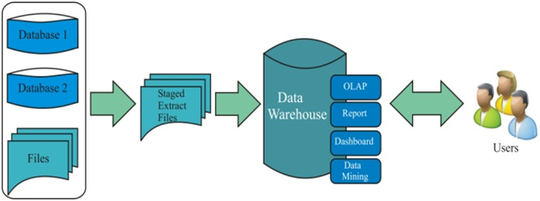
A new challenge of HAS
HAS problem can be viewed as an elaboration of a Business Intelligence System:
Business intelligence (BI) is the set of techniques and tools for the transformation of raw data into meaningful and useful information for business analysis purposes.

Slide 6
A new challenge of HAS
Proposition
HAS problem = elaboration of a Business Intelligence System with a specific data processing software
Software where Data are analyze by combining Multiple Criteria Decision Aid (MCDA) and Machine Learning (Datamining) techniques
Data processing software
=

Slide 7
A new challenge of HAS
HAS problem = elaboration of a Business Intelligence System with a specific data processing software
Hospidiag
Analyze by Multiple Criteria Decision Aid models combined with Machine learning algorithms
PMSI
Dashboards…
…
SAE
Data processing software
Visualization
Results
Databases

Slide 8
Multiple Criteria Decision Aid (MCDA)
MCDA is a subfield of operations research
MCDA aims at representing preferences of a Decision-Maker over a set of alternatives or options evaluated on several criteria often conflicting
To define a MCDA problem, there is a need to build or choose:
A set of alternatives on which the decision will be made;
A set of consistent criteria which will be take into account during the decision process
A “suitable” method (weighted sum, ELECTRE methods, UTA methods, Choquet integral method,…) which will be used to evaluate the alternatives. This is one of crucial steps.
Example: Evaluation of students on Math, Physics… by using a weighted sum

Slide 9
Multiple Criteria Decision Aid (MCDA)
In our context:
Set of alternatives = set of healthcare organizations.
There approximately 2600 different healthcare organizations in France
Set of criteria: set of relevant and consistent indicators.
There are more than 80 indicators available in French databases
Problem: How to choose relevant indicators among them?
Because many indicators are filled by healthcare organizations in Medicine Surgery and Obstetric, it seems natural to study them first

Slide 10
A hierarchical MCDA model for HAS problem
Miller’s Law: the number of criteria an average human can hold in working memory is 7 ± 2
So with more than 80 indicators, it is necessary to elaborate a hierarchical model
How to elaborate a hierarchical MCDA model?
“Top-Down” approach: start with a general goal which is then broken down into sub-goals, sub-goals which can be decomposed into sub-sub-goals, etc.
“Bottom-Up” approach: analyze the elementary consequences and then merge those which are close into sub-goals, etc.

Slide 11
Machine Learning
Machine learning is a subfield of computer science and artificial intelligence about learning to make predictions from examples of desired behavior or past observations.
Machine learning, and more generally data mining, focuses on prediction
Machine learning algorithms (decision tree; neural networks; …) will help to select consistent and relevant indicators for MCDA models

Slide 12
A hierarchical model obtained for HAS problem
By top-down approach: define a general goal and six sub-goals to evaluate a healthcare organization
Global Risk
Actitvity Risk
Quality/Safety Risk
Resources Risk
Range Risk
Organization Risk
Environment Risk

Slide 13
A hierarchical model obtained for HAS problem
Global Risk
Range Risk
Number of DRG roots

Slide 14
A hierarchical model obtained for HAS problem
Global Risk
Organization Risk
Emergency
Yes/No
Scheduled surgery
Yes/No
Ambulatory Yes/No
DMS/…
Hospitalization rates per emergencies/…

Slide 15
A hierarchical model obtained for HAS problem
Global Risk
Environment Risk
Consortium with other institutions (market share)
Urban zone
Precarious index of the region

Slide 16
A hierarchical model obtained for HAS problem
Global Risk
Resources risk
Human
Finance
Equipment
RIF/CAF/…
Turn Over/ absenteeism
…
Indicators

Slide 17
A hierarchical model obtained for HAS problem
Global Risk
Quality/Safety Risk
Mortality rates
Infection dashboard (ICALIN)
Satisfaction patient dashboard
Transverse indicators for quality/specialty

Slide 18
Global Risk
Activity Risk
Volume MCO
Specialization level yes/No
M
C
Chirurgie de recours
hyperspecialized surgery
O
Severity of cases
Digestive
…
Orthopedic
Nbr acts/DMS/ …
Nbr acts/DMS/ …
Nbre
acts/DMS/ …
Indicators
Indicators
Indicators
Indicators

Slide 19
A hierarchical model obtained for HAS problem
We propose a full hierarchy MCDA model based on this type color node
Global Risk
Level 6 (top)
Organization risk
Level 5
Emergency Yes/NO
Level 4
Scheduled surgery Yes/No
Level 3
Severity of cases
Level 2
GHM indicator
Level 1 (leaf)

Slide 20
Global Risk
Environment Risk
Range Risk
Organization Risk
Indice de précarité
De la commune
Zone urbaine
Groupement avec les autres établissements (part de marché)
GHM indicator
Urgences OUI/NON
Ambulatoire OUI/NON
Activity Risk
Resources
Risk
DMS/…
Volume MCO
Niveau Spécialisation OUI/NON
Chirurgie Programmée OUI/NON
Humain
Financier
Equipement
M
C
O
Chirurgie hyper spécialisé
Taux d’hospitalisation pour les urgences/…
Nbre actes/
DMS/…
Nbre actes/DMS/…
Nbre actes/DMS…
Turn Over/ Absenteisme/…
RIF/
CAF/
capacité à investir/…
Digestif
Indicateurs
Quality/Safety Risk
Chirurgie de recours
…
Orthopedie
Tableau de bord des infections (ICALIN)
Sévérité des cas
Tableau de bord satisfaction patient
Indicateurs transversaux qualité/spécialité
Taux de mortalité et complication
Indics
Indics
Indics

Slide 21
Roadmap to elaborate the HAS tool
Step 1 [6-12 months]: Elaborate and validate new MCDA hierarchical models. For instance, by:
Elaborating the “bottom-up’’ approach;
Asking to experts how they can imagine the accreditation survey in terms of indicators
Applying Machine learning techniques to select relevant indicators

Slide 22
Roadmap to elaborate the HAS tool
Step 2 [9-12 months]: Concrete evaluation of each node of the hierarchy
Analyze each scale used per indicator (criteria).
For instance, the scale defined for the Global risk node could be classes or categories: A (low exposed to risks); B (moderately exposed to risks); …
How to assess each node in the hierarchical decision model elaborated in step1? One can use for instance:
MCDA methods (weighted sum…)
Association rules
Machine learning algorithms

Slide 23
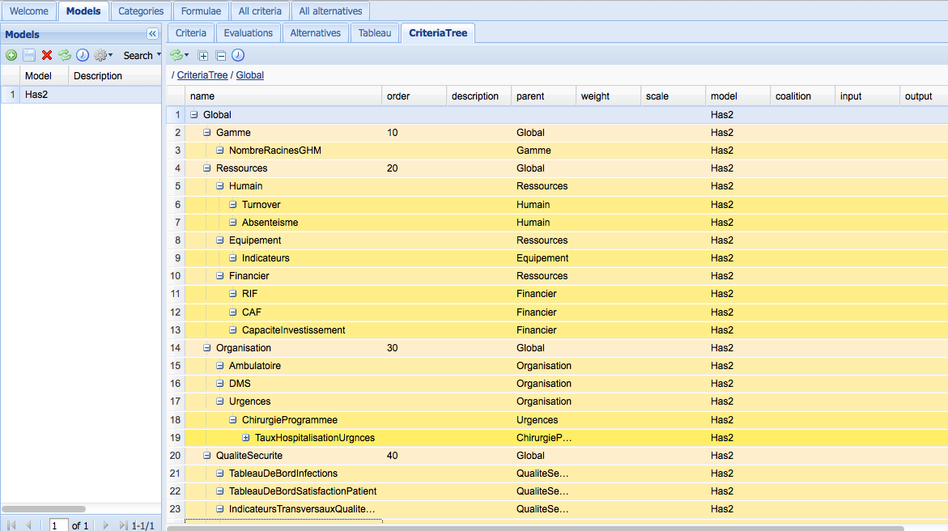
Roadmap to elaborate the HAS tool
Step 3 [12-24 months]: Conceive concretely the software tool as an extension of the software Decision Cloud of karmic Soft

