Slide 1
Experience in practice
Professionalism:
Sense of urgency is clear, but difficult to materialize
Dedicated people, not easy
Change is difficult for many
IGZ wants to be a learning institute
Autonomie versus need for leadership
Ronnie van Diemen
Inspector General

Slide 2
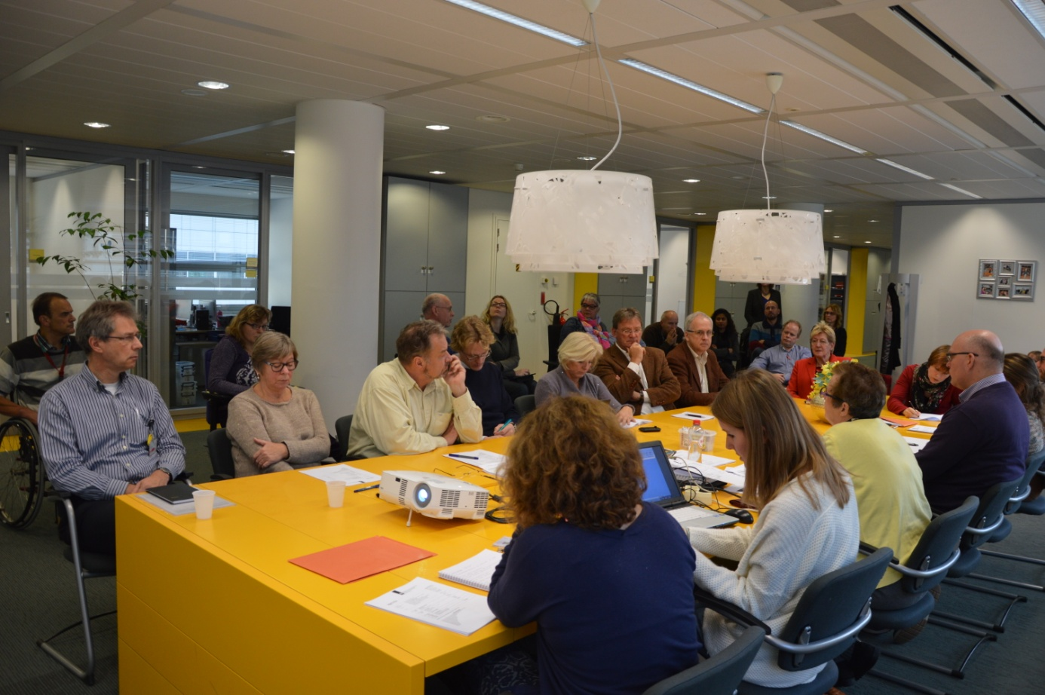
When you are afraid, you cannot learn

Slide 3
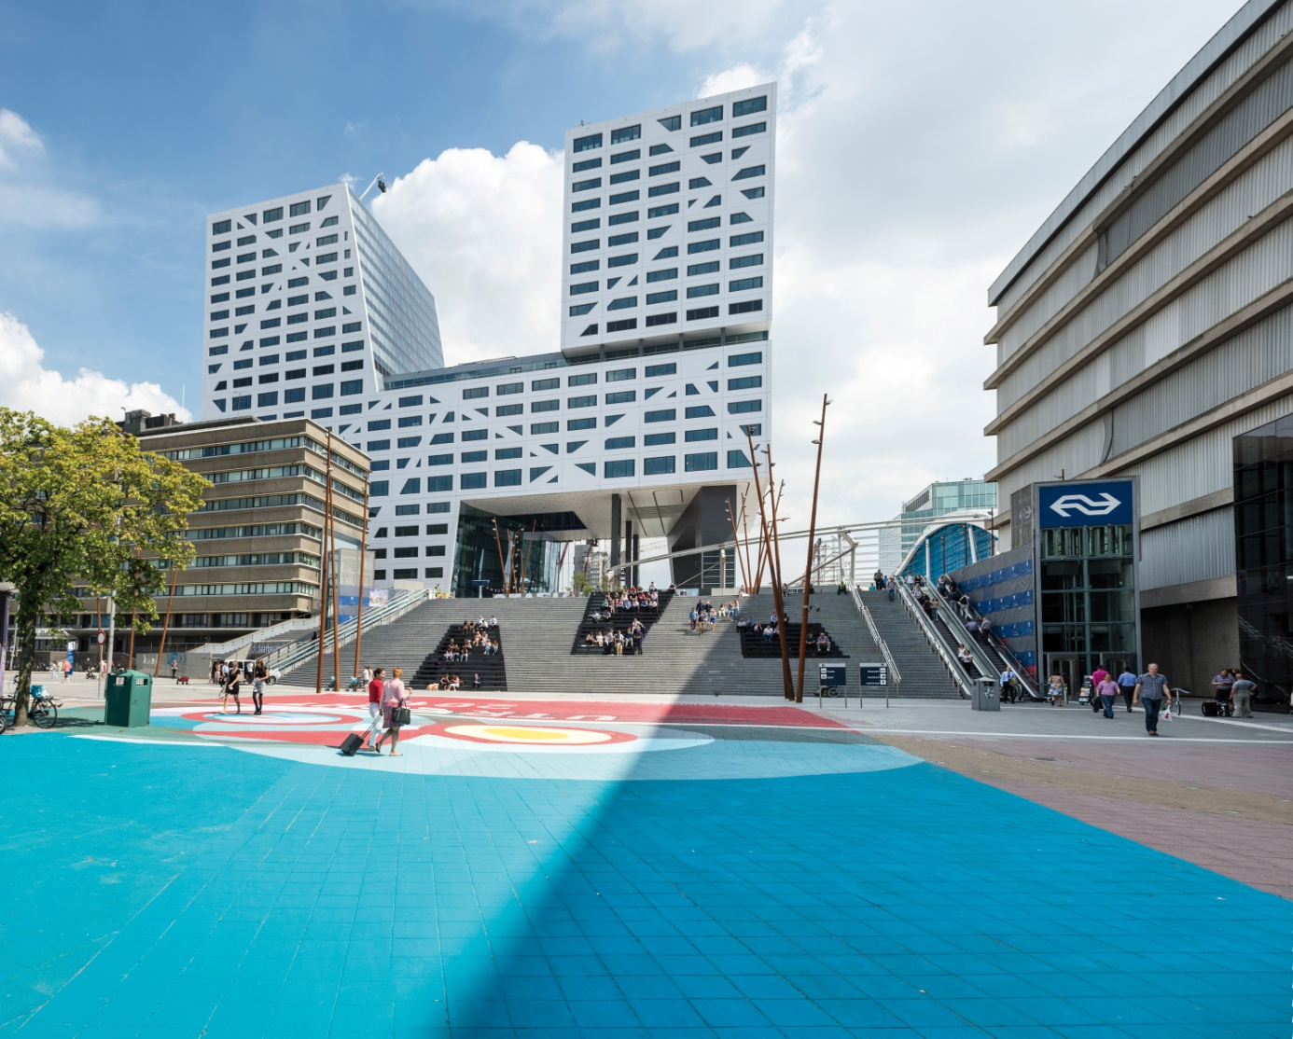
From a climate of fear to a safer climate

Slide 4
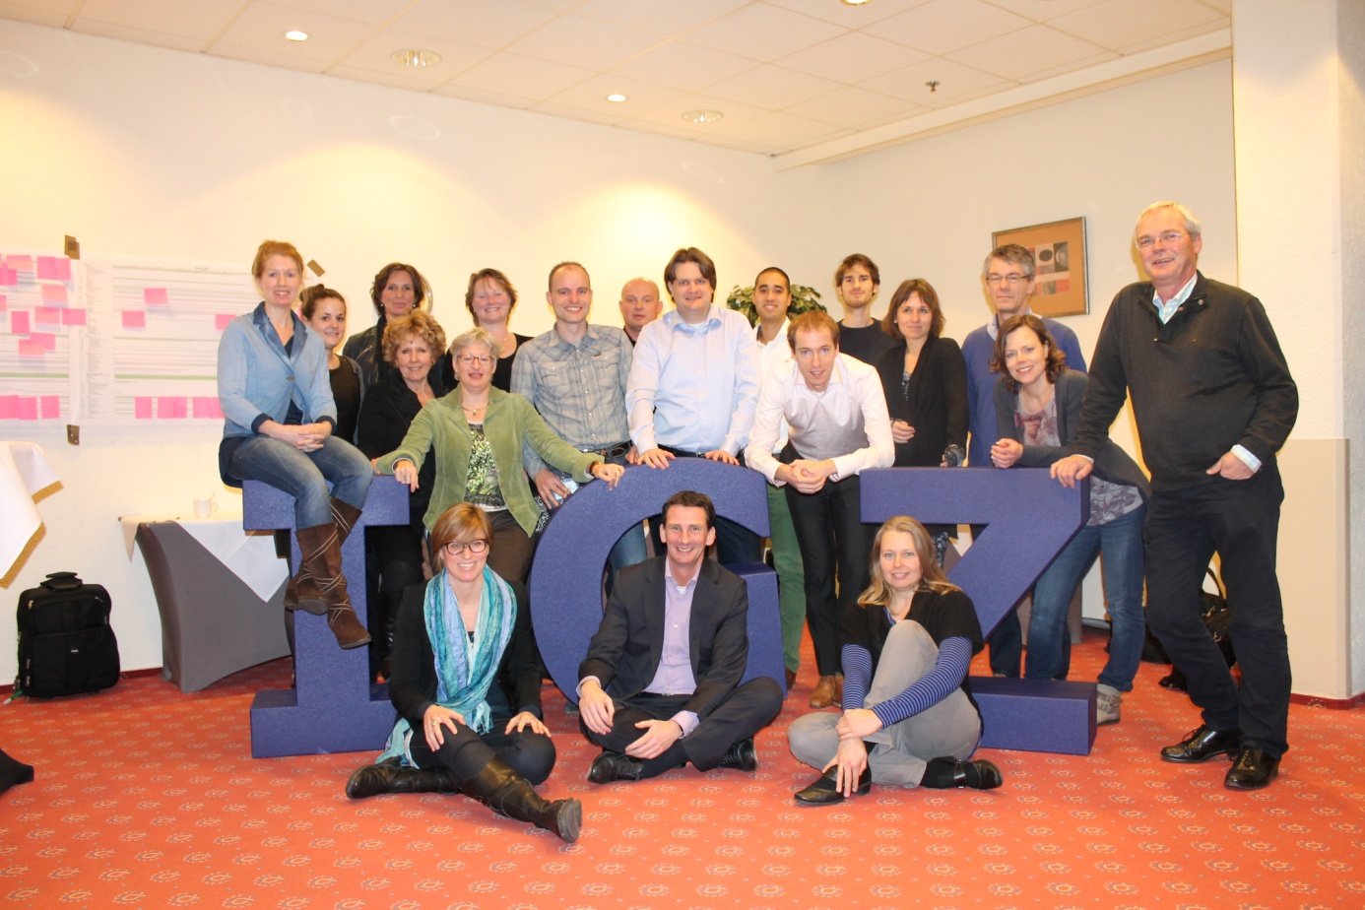
Trust is fundamental for our employees

Slide 5
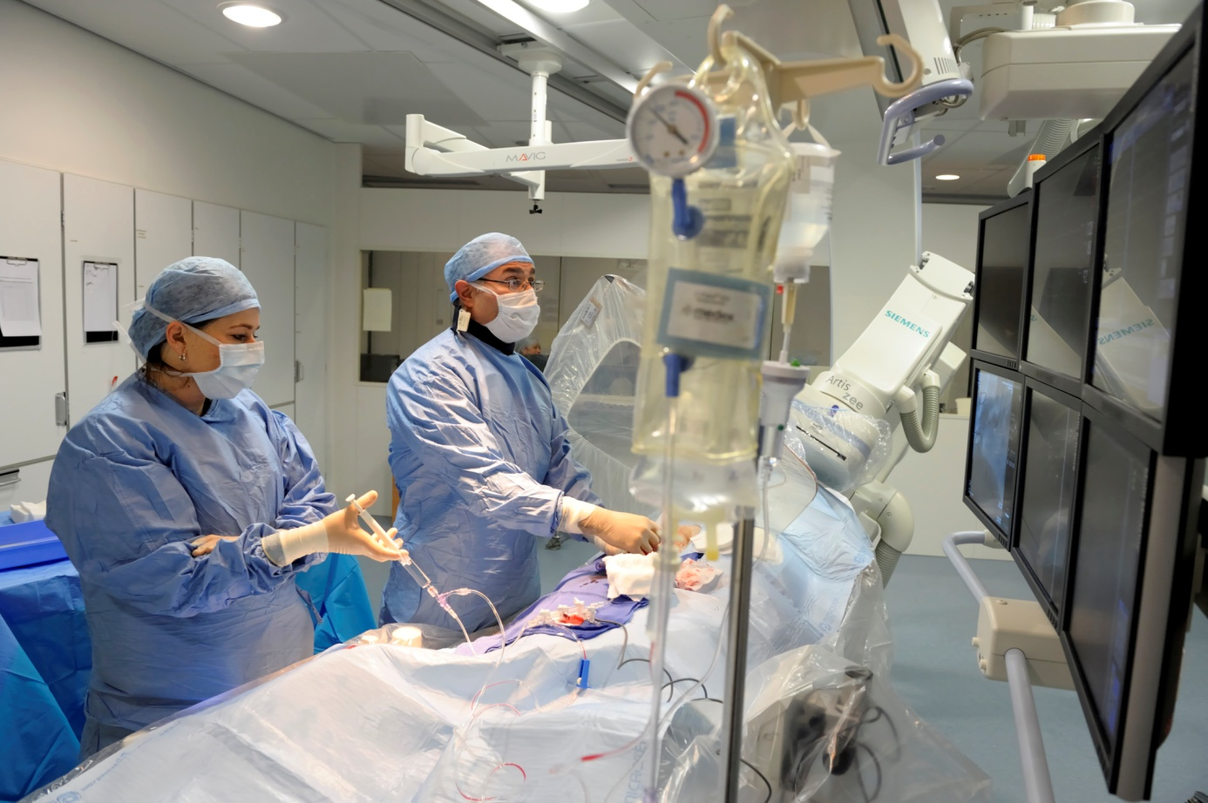
The audit enhanced our legitimacy

Slide 6
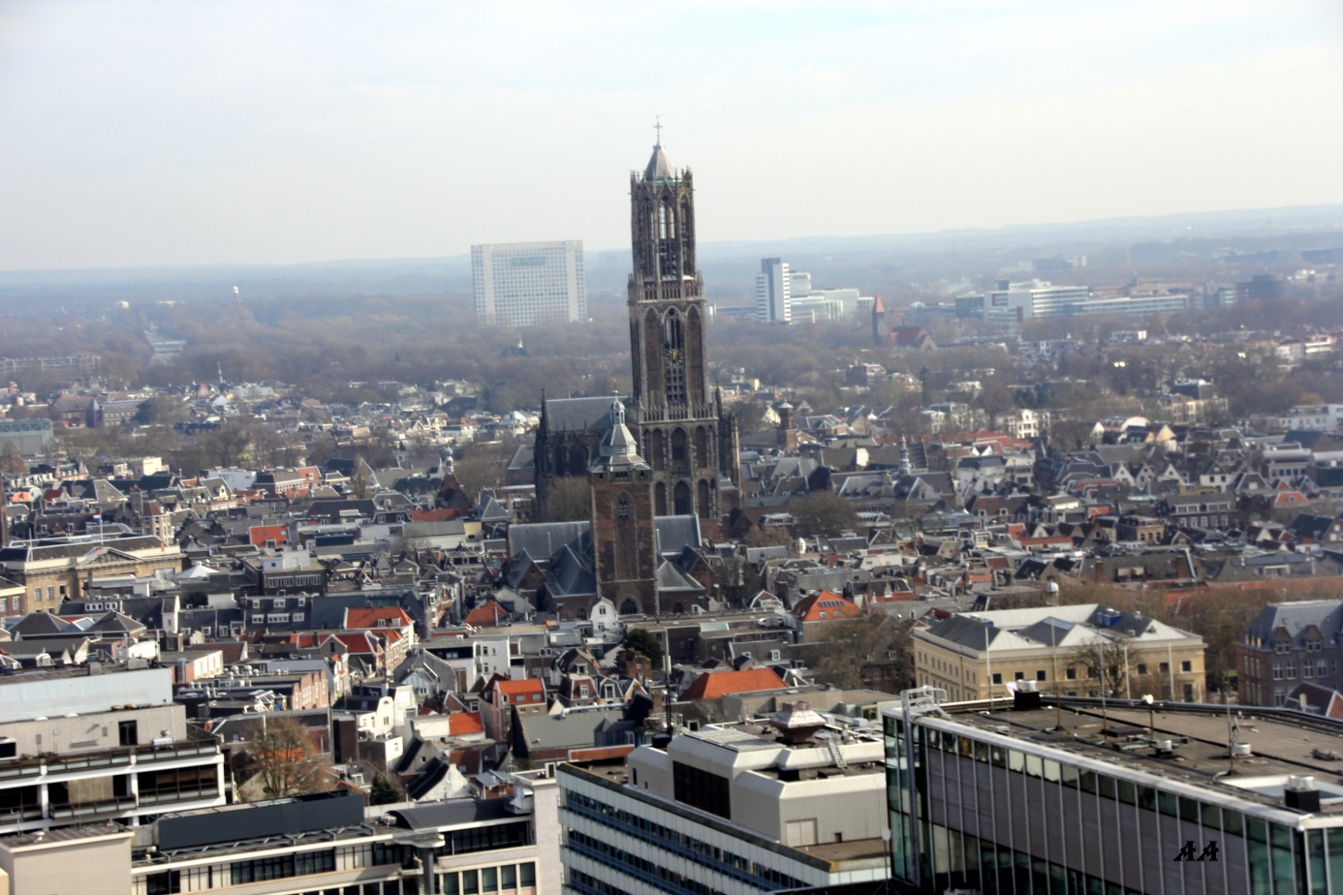
Lessons learned and looking forward

