Slide 1
Agenzia Nazionale per i Servizi Sanitari Regionali
NEW RESPONSIBILITIES OF THE NATIONAL AGENCY FOR REGIONAL HEALTHCARE SERVICES (AGENAS)
Mario Braga
20th EPSO Conference, Helsinki
29-30 September 2015

Slide 2
OUTLINE
1. THE ITALIAN HEALTHCARE SYSTEM- BRIEF OVERVIEW
2. AGENAS:
2.1 STRUCTURE
2.2 MISSION
2.3 MAIN ACTITIVIES
3. THE NEW RESPONSIBILITIES ASSIGNED TO AGENAS
Monitoring health care trust performances;
Technical Support to Anticorruption Agency in the health care sector;
Sustainability and transferability of health care delivery models;
Developing new professional training programs.
4. CONCLUSIONS

Slide 3
THE ITALIAN HEALTHCARE SYSTEM
BRIEF OVERVIEW
Art 32 of the Italian Constitution:
“…The Republic safeguards health as a fundamental right of the individual
and as a collective interest, and guarantees free medical care to the
indigent.”
INHS provides universal coverage
INHS is decentralized and organized into three levels:
- national general objectives and fundamental principles
- regional organization of healthcare service delivery
- local delivery of healthcare service delivery (through
local healthcare units and public and private accredited hospitals)

Slide 4
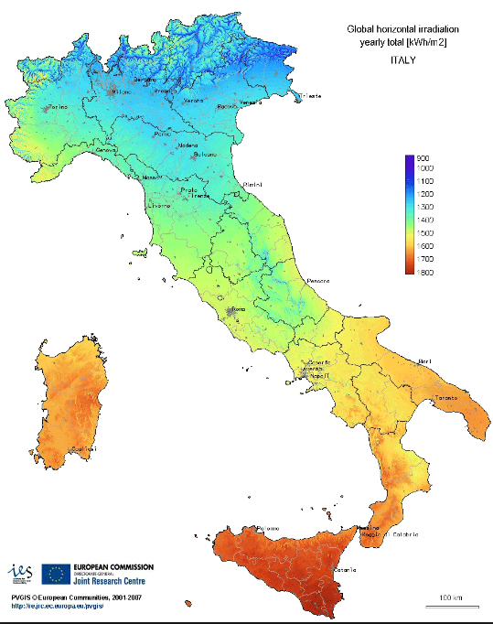
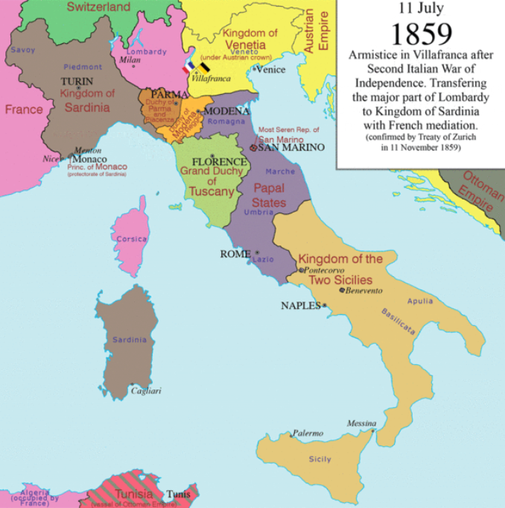
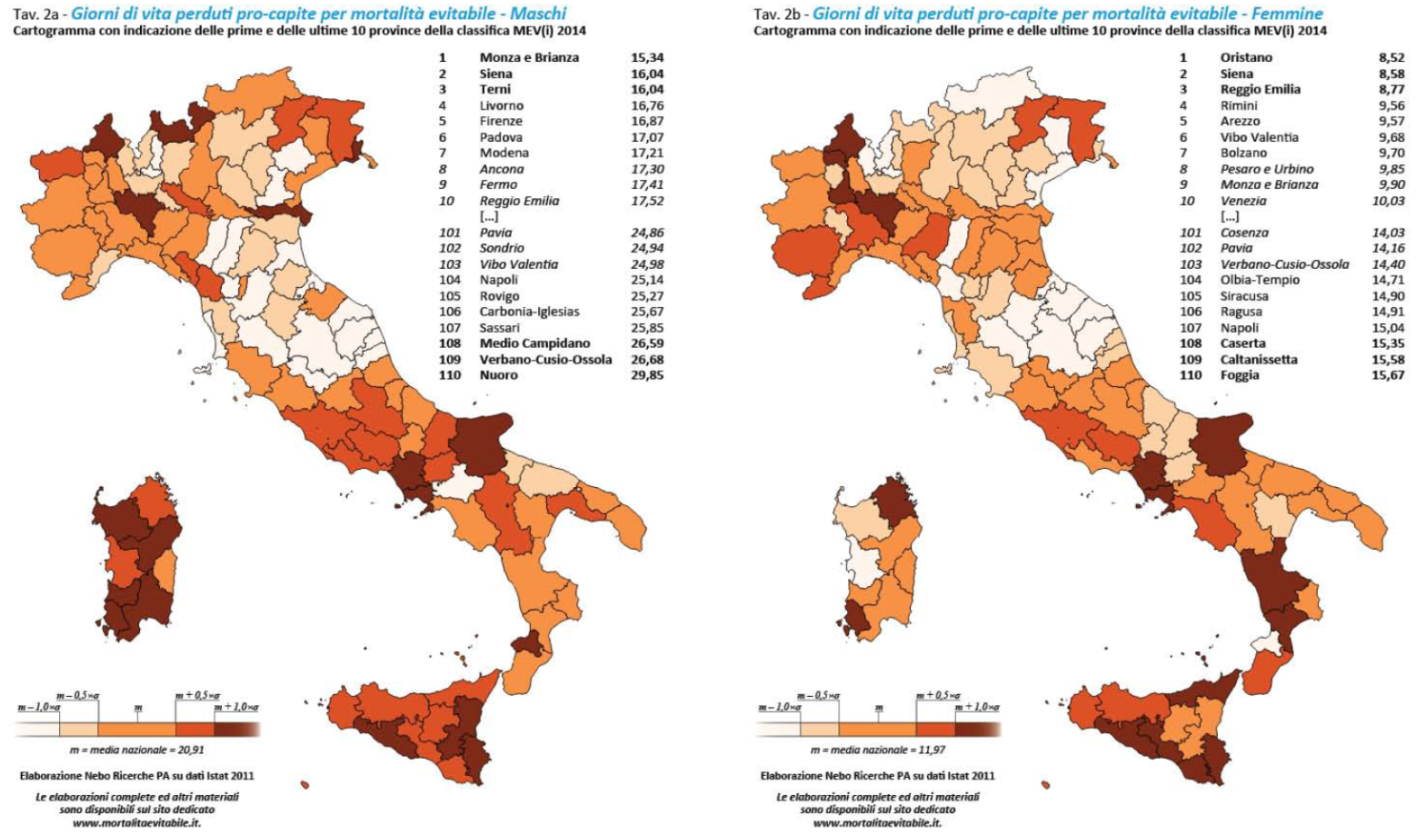

Slide 5
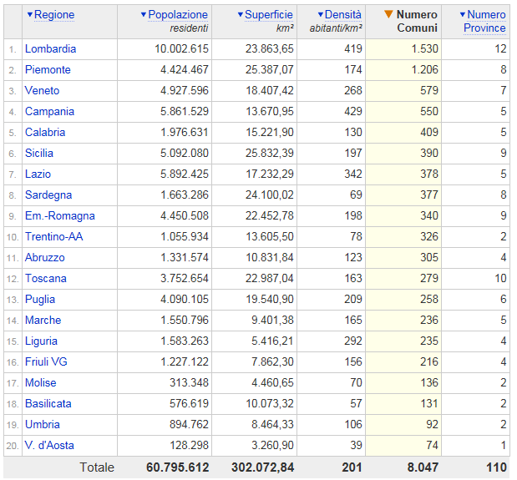

Slide 6
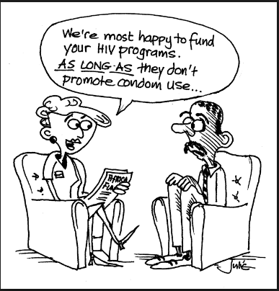
Power
Money

Slide 7
National Level
Standing Conference on the relations between the State and the Regions
Regional Level
Local Level

Slide 8
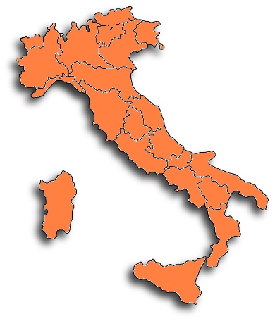
THE ITALIAN HEALTHCARE SYSTEM
BRIEF OVERVIEW
CENTRAL GOVERNMENT:
Public health protection and promotion
Defining and monitoring uniform and essential levels of health care services across the Country
REGIONS:
Planning, organizing and managing healthcare services
Monitoring quality, appropriateness and efficiency of the services provided
Financial responsibility
Agenas represents a Technical bridge between Central and Regional governments

Slide 9
THE ITALIAN INSTITUTIONS
UNDER THE VIGILANCE OF THE MINISTRY OF HEALTH
Ministry
of Health
ISS
National Institute of Health
AGENAS
National Agency for Healthcare
Regional Services
AIFA
Italian Medicine Agency
ISS is the leading technical and scientific body of the Italian National Health Service. Its activities include research, clinical trials, control, and training. It also serves as a major national clearing house for technical and scientific information on public health-related issues.
Agenas is a technical-scientific Agency of the Italian National Health Services; it promotes collaboration at the different levels of the NHS and it is involved in monitoring, conducting studies and elaborating proposals to share with the Ministry of Health and the Italian Regions.
The Italian Medicines Agency (AIFA) is the national authority responsible for drugs regulation in Italy.
Notes:
9

Slide 10
AGENAS ORGANIZATION
PRESIDENT
46 full time employees
About 200 collaborators/consultants/experts in different areas (quality improvement, health expenditure, HTA, Continuing Medical Education)
BOARD OF
AUDITORS
ADMINISTRATIVE
BOARD
GENERAL
DIRECTOR
DEPARTMENTS
Healthcare
Services
Organization
Quality
and
Accreditation
Monitoring healthcare expenditure and essential levels of care
Recovery plans and Continuous Medical Education (CME)
General
Affairs and
Human
Resources
Accounting

Slide 11
AGENAS: MISSION
State- Regions Conference
Central Government
Regions
National Agency for Regional Healthcare Services
(Agenas)
MISSION
Technical and scientific support to implement shared health policies

Slide 12
AGENAS: CURRENT ACTIVITIES
Monitoring healthcare expenditure and coverage of Essential Levels of Health Care
Healthcare Technology Assessment (HTA) – Horizon Scanning (HS) Medical devices/technologies
Quality/Safety/Clinical risk monitoring
Management/Accreditation/Performance evaluation
Healthcare services organization
Continuing Medical Education
Clinical Guidelines development
Support to regional recovery plans
Research

Slide 13
AGENAS: NEW RESPONSIBILITIES
National Healthcare performance monitoring
Anticorruption in Healthcare settings
Analysis and evaluation of healthcare models and their transferability
More emphasis on professional training
Reinforcing international relationships

Slide 14
National system for monitoring, analyzing and controlling the performances of the regional healthcare systems (Art. 2, Par. 7 Patto per la Salute 2014-2016)
HOW IT WILL BE STRUCTURED
MONITORING AND EVALUATION
DIMENSIONS
Quality
Efficacy
ALERT
Timeliness
Safety
Appropriateness
Efficiency
Sustainability
Patient centred
Equity

Slide 15
National system for monitoring, analyzing and controlling the trend in the performance of the regional healthcare systems (Art. 2, Par. 7 Patto per la Salute 2014-2016)
MAIN FEATURES
Computer based system
Accessible to different profile: decision-makers, professionals (citizens)
Based on shared rules (Ministry of Health, Agenas, Regions, Scientific Associations, Patient organizations)
Divided into 3 main areas: RESEARCH, ANALYSIS, ALERT

Slide 16
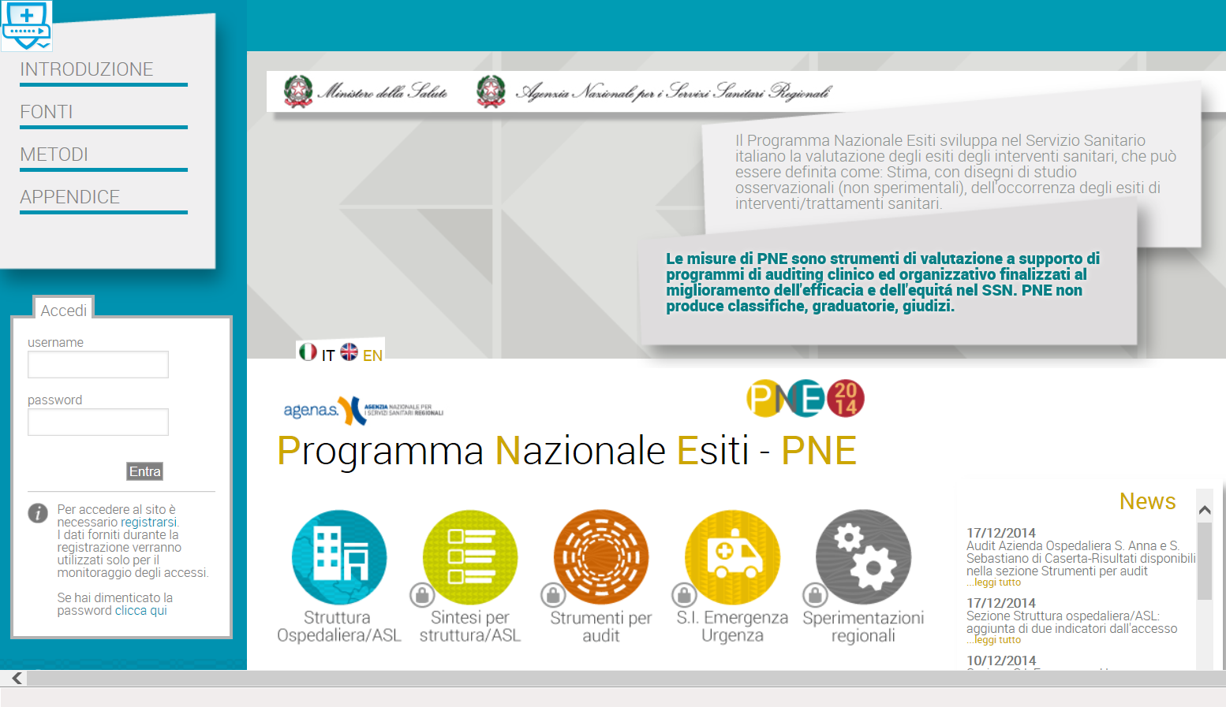
National Healthcare performance monitoring
PNE (National Outcomes Program)
Program that monitors health care outcomes across hospitals and municipalities. It began in the 1980s looking at outcomes in cardiac care and has since expanded to cover 129 indicators across a range of clinical areas. Indicators are selected to reflect clinical outcomes as far as possible (rather than inputs or processes) and are chosen in conjunction with professional and scientific societies, to ensure robustness and utility.

Slide 17
 | Main questions
10 | First question: Healthcare activity is able to secure the population health? | 11 | C’è la copertura dei LEA come da normativa? [COPERTURA LEA]
 |  | 12 | Le risorse disponibili sono di qualità sufficiente? [QUALITA’ DELLE RISORSE]
 |  | 13 | I processi clinici sono i più adatti per produrre effetti efficaci? [APPROPRIATEZZA CON RISVOLTI D’EFFICACIA]
 |  | 14 | Gli esiti delle attività sono positivi? [OUTCOME]
 |  | 15 | C’è attenzione nell’evitare i possibili rischi? [SAFETY]
20 | Second question: Healthcare activity place the person (patient)at the center of the system? | 21 | C’è rispetto per i bisogni personali degli utenti? [UMANIZZAZIONE]
 |  | 22 | Gli utenti sono soddisfatti? [SODDISFAZIONE]
 |  | 23 | Vi è partecipazione della popolazione nel governo del sistema? [PARTECIPAZIONE]
30 | Third question: Healthcare activity is using the different resources in a optimal way? | 31 | I servizi erogati sono tutti utili ed erogati nel setting appropriato? [APPROPRIATEZZA CON RISVOLTI DI INEFFICIENZA]
 |  | 32 | I fattori produttivi sono impiegati in modo ottimale? [EFFICIENZA PRODUTTIVA]
 |  | 33 | I fattori produttivi sono allocati correttamente? [EFFICIENZA ALLOCATIVA]
 |  | 34 | I costi di produzione/acquisto sono adeguati? [EFFICIENZA ECONOMICA]
 |  | 35 | Il clima aziendale è favorevole? [EFFICIENZA MANAGERIALE]
 |  | 36 | Sono attivati sistemi di programmazione, controllo e valutazione? [EFFICIENZA GESTIONALE]
40 | Fourth question: Healthcare activity is related to the healthcare needs? | 41 | C’è equità tra i territori? [EQUITA’ ORRIZZONTALE]
 |  | 42 | C’è equità tra i gruppi sociali? [EQUITA’ VERTICALE]
 |  | 43 | C’è attenzione ai soggetti fragili? [EQUITA’ DELLE FRAGILITA’]
50 | Fifth question: Is the system sustainable? | 51 | C’è equilibrio tra entrate ed uscite economiche? [EQUILIBRIO ECONOMICO]
 |  | 52 | L’andamento della spesa è nella norma [EVOLUZIONE TEMPORALE DELLA SPESA]
 |  | 53 | C’è un piano per investimenti futuri? [PROGRAMMA INVESTIMENTI]
 |  | 54 | Ci sono programmi di innovazione e miglioramento? [SOSTENIBILITA’ OPERATIVA]
 |  | 55 | C’è consenso della popolazione e delle diverse istituzioni sull’assetto della sanità? [SOSTENIBILITA’ ISTITUZIONALE]
60 | Sixth question: Are all the “rules” fulfilled (ethical, professional, legal, …)? | 61 | Sono rispettate le norme organizzative? [ADEMPIMENTI]
 |  | 62 | Sono rispettate le norme etiche e deontologiche? [DEONTOLOGIA]
 |  | 63 | C’è correttezza contabile? [CORRETTEZZA CONTABILE]
 |  | 65 | C’è garanzia di trasparenza [TRASPARENZA]
 |  | 65 | C’è contrasto alla criminalità [ONESTA’]
 |  | 66 | Il contenzioso è contenuto? [CONTENIMENTO CONFLITTUALITA’]

Slide 18
MEMORANDUM OF UNDERSTANDING BETWEEN THE NATIONAL ANTI-CORRUPTION AUTHORITY (ANAC) AND AGENAS
WHAT IS ANAC
An independent regulatory body, set up in 2009, to fight corruption.
ANAC (Autorità Nazionale AntiCorruzione) monitors public agencies for transparency compliance and enforces anti-corruption guidelines. It has the power to inspect offices and confiscate documents. The government intends to give the ANAC power to intervene directly in public-works contracts under investigation for alleged corruption, awarding management to an external expert so that work can go ahead even as the judicial inquiry continues.

Slide 19
CORRUPTION PERCEPTION INDEX 2014: RESULTS

Slide 20
CORRUPTION TYPOLOGIES

Slide 21
SELECTED LIST OF CORRUPT PRACTICES AND THEIR IMPACT

Slide 22
MEMORANDUM OF UNDERSTANDING BETWEEN THE NATIONAL ANTI-CORRUPTION AUTHORITY (ANAC) AND AGENAS
November 5, 2014
Collaboration aimed at identifying and testing specific governance models for healthcare organizations so as to prevent corruption and conflict of interest in healthcare.
Main points:
Development and adoption of specific guidelines addressing the issues of corruption and conflict of interest in healthcare
Cooperation regarding training activities
Carrying out of projects on issues of common interest.

Slide 23
MEMORANDUM OF UNDERSTANDING BETWEEN THE NATIONAL ANTI-CORRUPTION AUTHORITY (ANAC) AND AGENAS
Ad hoc Working groups provided for by the Memorandum of Understanding (composed of representatives from Agenas, ANAC and the Ministry of Health
Appointment of the person in charge of preventing corruption in healthcare
Code of conduct on the issue of conflict of interest
Purchases of good and services (PROCUREMENT)
Rotation of offices
Contractual agreement with private providers

Slide 24
Analysis and evaluation of healthcare models and their transferability

Slide 25
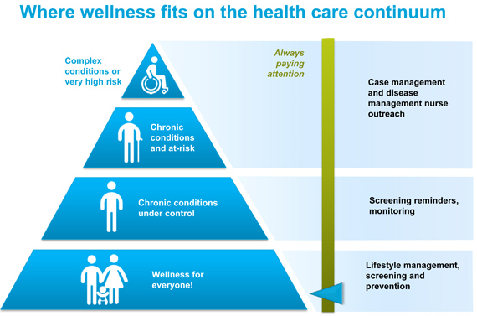
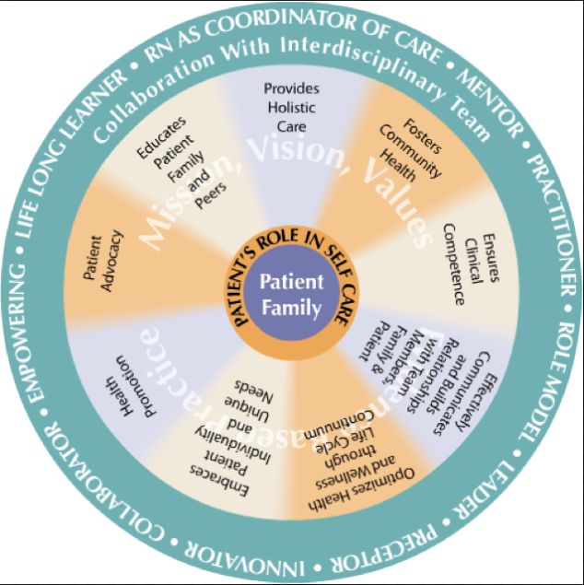
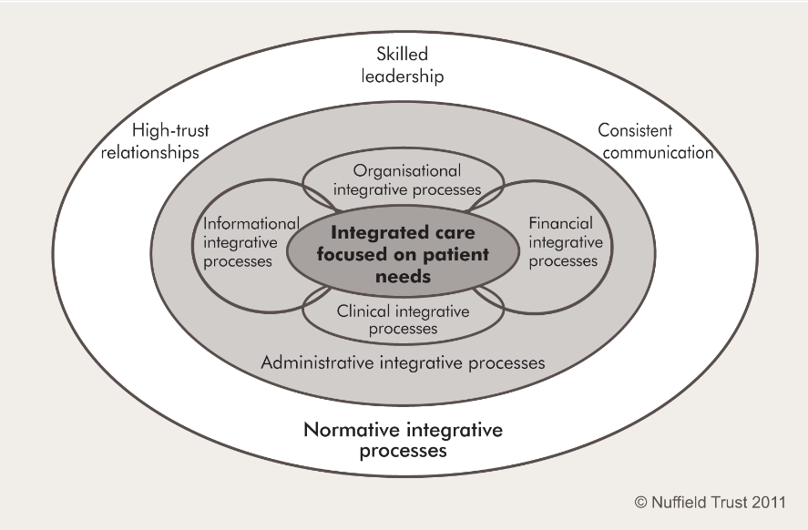

Slide 26
Few examples of geographical variation

Slide 27
Hip Fracture: % Patients Operated within 48 Hours .

Slide 28
Hip Fracture: % Patients Operated within 48 Hours .

Slide 29
Pancreatic cancer surgery: 30 days mortality.

Slide 30
Hospital admissions for short term diabetes complications.

Slide 31
Hospital admissions for short term diabetes complications
Hospital admissions for short term diabetes complications.

Slide 32
Integrated health care models;
New rules for the accreditation/certification of health care networks;
Tackling emerging Health care needs:
Care of elderly patients with frailty;
People with mental health conditions;
Homeless & immigrants;
Young adults and adolescents.

Slide 33
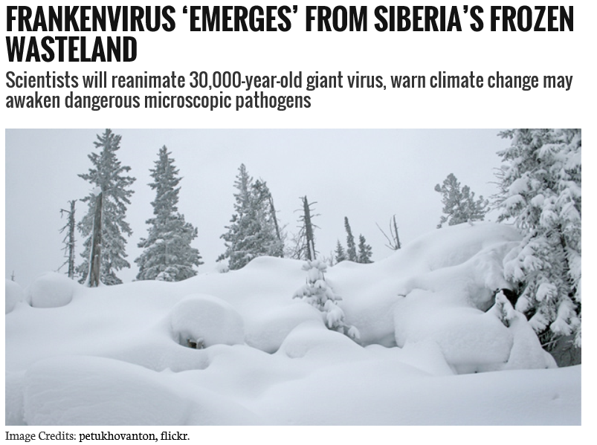
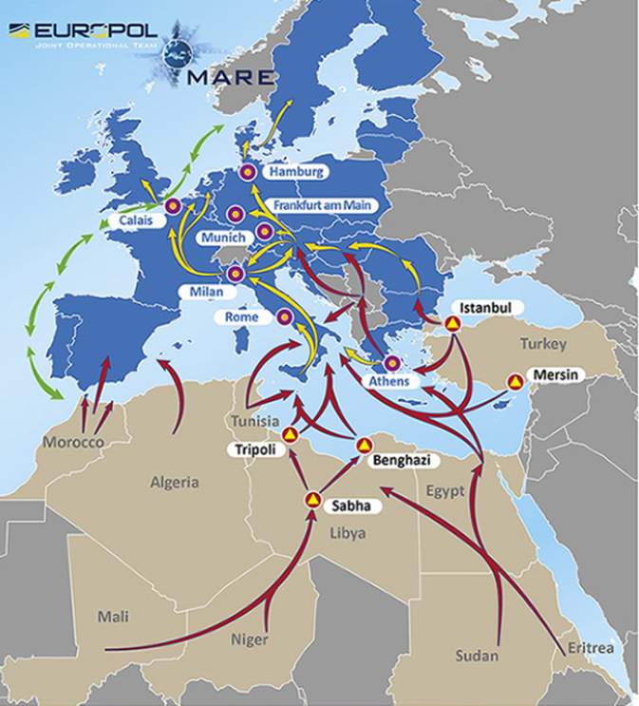
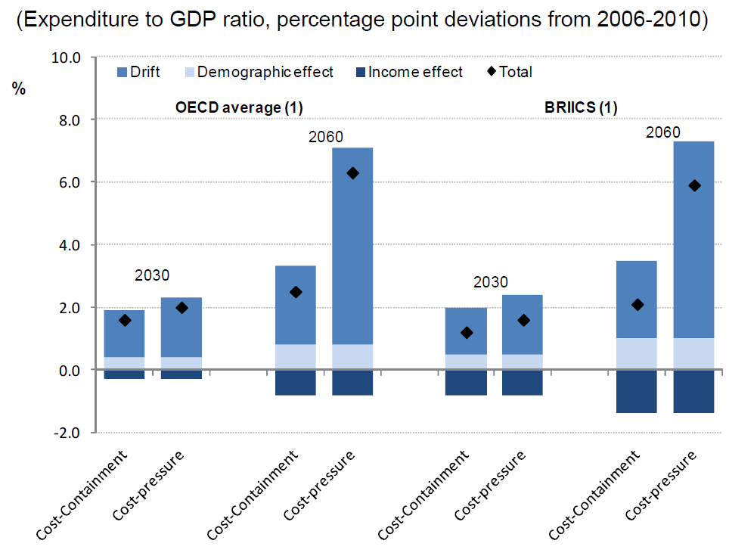

Slide 34
CONCLUSION
Agenas will play a crucial role in assuring technical support to the Ministry of Health and to the Regions for monitoring healthcare performances;
New responsibilities are emerging in the anti-corruption field;
Sustainability and transferability of healthcare models will be a specific focus both for the national and the international context.

Slide 35
THANK YOU FOR YOUR ATTENTION
braga@agenas.it

