Slide 1
21st EPSO Conference in Prishtina, Republic of Kosova
https://www.youtube.com/watch?v=tHVcypHc8CQ

Slide 2
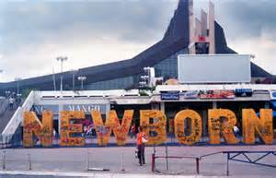
Content
Topics
Date and Place
Accommodation
Flights
Other

Slide 3
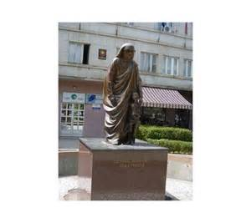
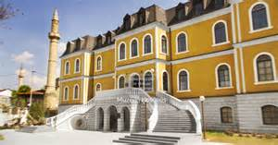
Topics
E health
Use of structural observation
on the workfloor during inspections
European context in supervising
health care

Slide 4
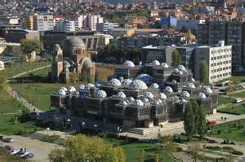
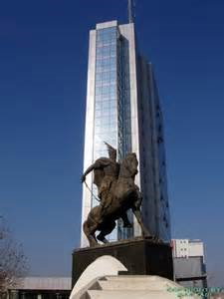
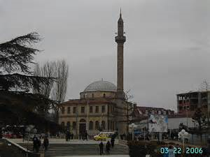
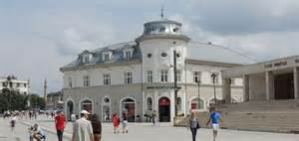
Date and Place
2-3 June 2016
Prishtina
Center of town

Slide 5
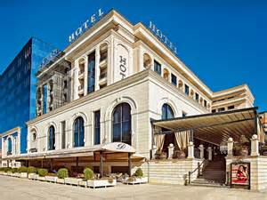
Accommodation
Swiss Hotel, Sirius Hotel, Grand Hotel
Prishtina Hotel,
Afa Hotel, etc.
www.balkan-hotel.com
www.hotelskosova.com

Slide 6
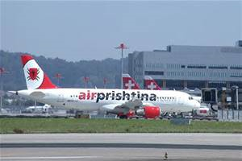
Direct flights to Pristina from
Switzerland: Basel, Cyrih, Geneva
Germany: Hamburg, Hanover, Munich, Stuttgart, Berlin, Dusseldorf, Frankfurt
Belgium: Brussels
Denmark: Copenhagen
Turkey: Istanbul
Slovenia: Ljubljana
UK: London
Norway: Oslo
Albania: Tirana
Austria: Vienna
Croatia: Zagreb
An alternative, Skopje Airport: 84 km, Skopje-Prishtina bus/train

Slide 7
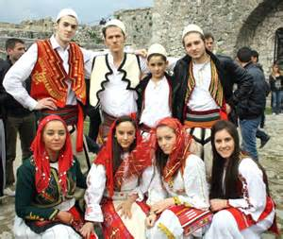
Other
Internet sources
Prishtina in your pocket
Kosovoguide
http://wikitravel.org/en/Kosovo
http://www.beinkosovo.com

