Slide 1
Some E- Health developments in Estonia
Mihhail Muzõtšin
Deputy Director General
Estonian Health Board
20th EPSO Conference

Slide 2
Estonian health care system
95% of population are covered by health insurance
  More than 800 family practitioners – private entrepreneurs
Care providers, owned by local authorities:
  3 tertiary care hospitals, incl University Hospital in Tartu
  4 central care hospitals
  11 general hospitals
  specialized and nursing care hospitals, out-patient care providers
Specialized private healthcare and dental care providers
EHK, 2014 https://haigekassa.ee/ru

Slide 3
Estonian eHealth Foundation http://www.e-tervis.ee/index.php/en/
Estonia has been an early adopter in terms of offering its citizens digital services of all kinds. The country has established an ID card-based infrastructure that allows secure access and digital signatures for all citizens.
Healthcare was added in 2009 with the establishment of a national electronic health record (EHR) that can be accessed both by medical professionals and patients
The health information system is a database that is a part of the state information system. The health care related data is processed in this database in order to conclude and execute the health care services provision contract, ensure patients’ rights, protect public health and quality of health care services, to maintain the registers of health conditions as well as to manage health care (The Health Services Organization Act and Associated Acts Amendment Act, §59¹ section 1).
Estonian eHealth Foundation

Slide 4
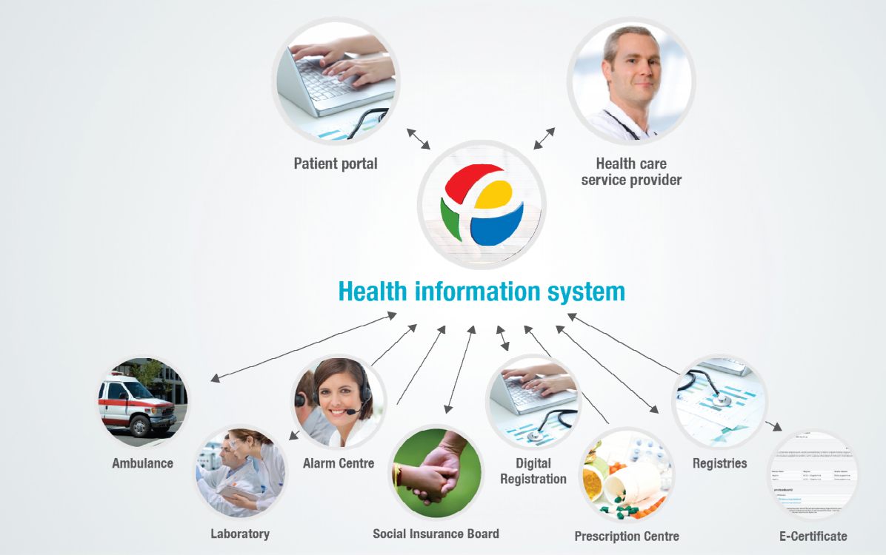
Estonian eHealth Foundation

Slide 5

Medical statistics
Medical Registers
Emergency Medical Departments
Dental care
Blood center
Genome Center
eAmbulance
Social Insurance Board
Health Care Board
Family Doctors
Hospitals
Health Insurance Fondation
Military Forces
Public Register
Patients
Nursing care
Homecare
Business
Register
Main e-health participants
on the x-road
Supporting services
Infrastructure services
External services
Institutional level–
users cooperation model
Data Exchange level
different e-services
Central System– Database
and related services
Subservices
Estonian eHealth Foundation

Slide 6
The main principles of security of Estonian eHealth system – Opt Out
Access only to licensed medical professionals. Attending doctor concept
Patient has the right to close his/her own data collected in the central database (opt out)
A secure authentication of all users with ID-card or Mobile ID
Digital signing or stamping of all medical documents
A maximum accountability (transparency): all actions will leave an unchangeable (and unremovable) secure trail
Estonian eHealth Foundation

Slide 7
Patient portal
Patient can:
view and print out medical documents sent by health care providers to the central system;
view information about their general practitioners and validity of health insurance;
provide general information about themselves for health care providers;
express his or her wish:
to donate cells, tissues or organs for transplantation after his or her death
to donate his or her dead body for academic work
about blood transfusions
to name contact person
to name a person who is authorized to purchase medication on behalf of the patient
monitor logs
Estonian eHealth Foundation

Slide 8
Estonian eHealth Foundation

Slide 9
Acceptance
Over 90% of Hospital discharge letters – digital
Over 97% of stationary case summaries have been sent to the central DB
Ambulatory case summaries sending
  No certain rules for sending ambulatory case summaries!
1.3 M person have documents in central system
92% of family doctors are sending documents on a regular base
Regional and central hospitals use central system on a regular base
The central system has over 8700 medical users
Estonian eHealth Foundation

Slide 10
Estonian eHealth Foundation

Slide 11
The main benefits of E-Health
Patients who live in remote places (like small islands) can still access medical care via telemedicine
All data on a single patient is theoretically contained in one database
Patients have access to their health data and all prescriptions. They may put under question entries into their personal e-health data and sometimes also prescriptions to make sure relevance thereof
Number of procedures and medical images can be reduced
Health care service providers, Ambulance and Social Insurance Board can use patients information on-line

Slide 12
The main risks for the health care sector when implementing e-Health?
the quality of data is low (either too much or too little, the data is not structured and machine readable);
service providers use different types of software programs that sometimes do not align with software used by E-health Information System that causes delays in sending information or the information is not sent at all, i.e. the data is not available;
service providers make use of the fact that they can access the data base in any place (for example prescribe using mobile telephone and not show up in their practice during the reception hours, allowing to use their ID cards by colleagues who are not qualified to write prescriptions);
failure of technics (and sometimes development of IT programs) or disability to make proper use thereof;
high costs and rapid development of new knowledge which brings to rapid deterioration of older programs;
when too many organizations have direct access to the E-health information system then many patients may close their information.

Slide 13
The opinion of the National Audit Office (2014)
The Ministry of Social Affairs should deal with the development of the e-health system more forcefully, as the initially planned objectives have still not been achieved.
Despite the initial plans, data in the e-health system cannot yet be fully used for treatment purposes, national statistics, registry-keeping or supervision.
Digital Prescription is the only e-solution created by the state that is actively used.
E-health could be implemented in full in the future, but only if it is developed on the basis of the interests of the state and society.

Slide 14
Supervision on e-health based on section 60 of Health Services Organization Act
an administrative authority shall process personal data only in the course of performance of public duties in order to perform obligations prescribed by law, an international agreement or directly applicable legislation of the Council of the European Union or the European Commission. (https://www.riigiteataja.ee/en/eli/529012015008/consolide)

Slide 15
Our main areas of supervision
issuing medical e-prescriptions (either by computer or m-phone) by doctors (and starting from the Oct 01, 2015 by nurses)
making sure that medical service providers send medical case summaries to E-health information system .
The subjects of our supervision are licensed health care providers in hospitals and outpatient care and in social care homes. We are not entitled to supervise the substantial quality of e-health services.

Slide 16

Supervisory activities in 2014
Jointly with Data Protection Inspectorate and Social Insurance Board supervision on forwarding case summaries to e-Health Information System (EHIS) to ensure timely nomination or review of disability pensions
The quality of information in EHIS jointly with Data Protection Inspectorate
Supervision on using psychoactive medicines

Slide 17
Examples of (supervising) e-Health?
Based on information that we received from the Estonian Road Administration we made an inquiry to e-prescriptions data based on the usage of psychotropic drugs by professional drivers.
The result was that 17,6 % of professional drivers aged between 40-65 have been prescribed psychotropic drugs. As according to Estonian law (contrary to the EU legislation) using of psychotropic drugs is an absolute contraindication for having a valid driver`s health certificate.
Based on this information we made a proposal to the Ministry of Social Affairs to consider to change the law and consider using of psychotropic drugs as a relative contraindication where the doctors have a say about their patient.

Slide 18
The main challenges for our organization concerning supervising e-Health?
Our main challenge is that we do not have a direct access to E-Health Information System as the Ministry of Social Affairs considers the privacy of delicate personal data the topmost value over other possible benefits pursued by supervision. In every case we have to ask for an extra permission from Ministry of Social Affairs based on what the E-Health Foundation is allowed to deliver us the needed information (or sometimes not).

Slide 19
Thank You for Your Attention!
Any questions?
mihhail.muzotsin@ terviseamet.ee

