Slide 1
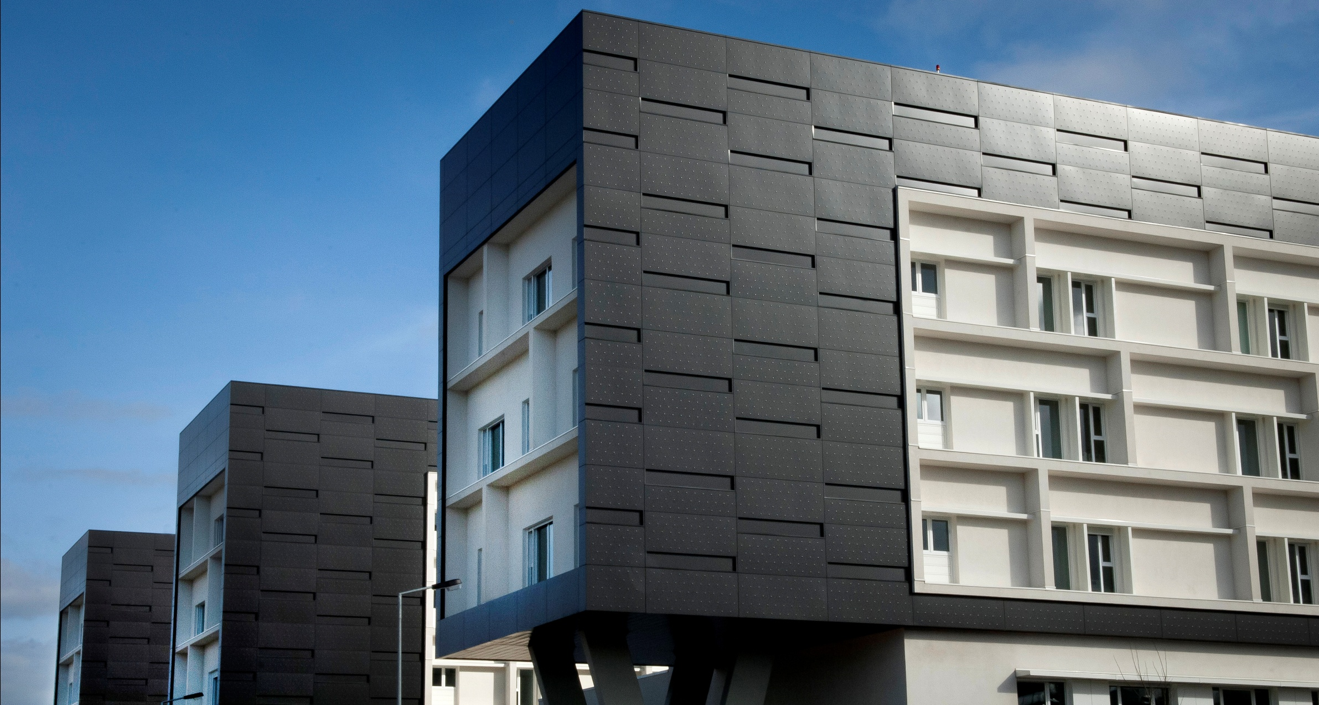
17th EPSO Conference
Directors of Hospital Boards in debate with CEO’s of Inspections and
Regulators
Porto, 9th May 2014

Slide 2
How to find the best incentives for co-operation between
hospital boards and health inspectorates/regulators in
hospital care?
1. Absolute independency of the Regulator
Art. 6 of Regulators Act 2013 – “Regulator entities can only be created to pursue the
regulation of economical activities that demands, because of their need for independent
development, not to be submitted do the direction of the government”
# 3, Art. 17 of Regulators Act 2013 – “The members of the Board are appointed by the government, after a presentation session with the respective parliamentary commission, by request of the government with the previous advice of the Public Administration Recruitment and Selection Commission, ”
# 4 Art. 20 of Regulators Act 2013 – “The dissolution of the administration board and the
destitution of any member of it depends exclusively on a resolution of the government, based in a justified reason”
Caesar’s wife must not only be honest but must also be seen to be honest

Slide 3
How to find the best incentives for co-operation between
hospital boards and health inspectorates/regulators in
hospital care?
2. Active market regulation
Operation of the North Rehabilitation Centre offer to the Porto Misericórdia (charity)
Lusa
18:38 , 21st november2013
Porto, 21st nov (Lusa) – Porto Santa Casa da Misericórdia (SCMP) will assume, during next three years, the management and operation of the North Rehabilitation Centre after the approval of the Minister’s Council of today.
“The Minister’s Council authorized the public costs to pay the Contract for the Management of the North rehabilitation Centre between the North Health Regional Administration and the Porto Misericórdia for the next three years. The Minister’s Council press release refers that the authorization has the value of 27,6 million euros.
For the president of the Porto Misericórdia this is a “very positive sign for the north of the country, because now on a reference equipment will be available and the government had the availability to accept the proposal of our Misericórdia to assume the operation of this centre.”
Government will offer the management of NHS hospitals to Misericórdias only with a 25% cost reduction
“O Público”
09/10/2013
Hospitals will be given back to Misericórdias, trough ten years cooperation protocols, with no need of public tenders.

Slide 4
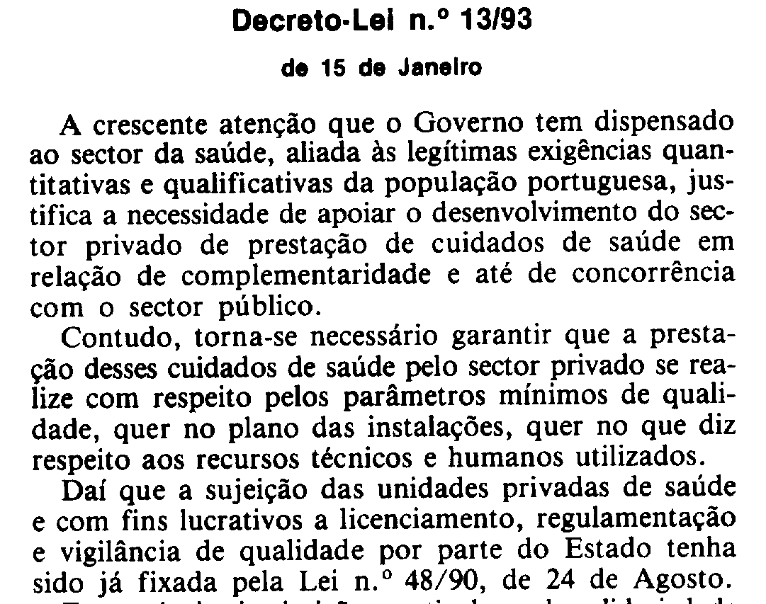
How to find the best incentives for co-operation between
hospital boards and health inspectorates/regulators in
hospital care?
3. Exigency of equal legal operational conditions for all players – public, private and social

Slide 5
How to find the best incentives for co-operation between
hospital boards and health inspectorates/regulators in
hospital care?
4. Technical domain of hospital operation and healthcare provision business
ERS detected serious failures in Maternidade Alfredo da Costa
22 OUT 2013
ERS detected serious failures in facilities and operation of Maternity Alfredo da Costa, violating quality and safety required norms.
Number of doctors in portuguese hospitals below european average
12 MAR 2012
ERS concluded that all portuguese hospitals present doctors and nurses staffs below european average figures.

Slide 6
How to find the best incentives for co-operation between
hospital boards and health inspectorates/regulators in
hospital care?
5. Consideration of health players perspectives
Advisory Board

Slide 7
How to find the best incentives for co-operation between
hospital boards and health inspectorates/regulators in
hospital care?
6. Avoid raking or rating systems that can make the Regulator a party of the game!

Slide 8
What should be the main objectives and future goals for health
inspectorates and inspectors to promote excellence or at least
the best possible care?
1. Quality evidence exigency for all providers
Exigency of independent accreditation for hospitals and primary healthcare organizations
of public, private and social sectors
Professional certification for independent healthcare providers (eventually together with
medical, nursing and other health professional’s associations or schools)

Slide 9
What should be the main objectives and future goals for health
inspectorates and inspectors to promote excellence or at least
the best possible care?
2. Clinical accountability demonstration by all providers
Information and reporting system improvement – risk adjusted mortality and morbidity of healthcare providers
Clinical capability to independently investigate failures and complains

Slide 10
What should be the main objectives and future goals for health
inspectorates and inspectors to promote excellence or at least
the best possible care?
3. Special attention to smaller units
Professional certification for independent healthcare providers (together with medical,
nursing and other health professional’s associations)
Auditing healthcare providers

Slide 11
What should be the main objectives and future goals for health
inspectorates and inspectors to promote excellence or at least
the best possible care?
4. Intelligent complaint’s management
Now that ERS will receive all the complains of NHS public services it will need a good system
to deal with “garbage” and to identify most important issues
Clinical capability to independently investigate failures and complains

Slide 12
What should be the main objectives and future goals for health
inspectorates and inspectors to promote excellence or at least
the best possible care?
5. Logical & rational penal system
Balanced punishment according to the impact of non conformities or failures

Slide 13
What should be the main objectives and future goals for health
inspectorates and inspectors to promote excellence or at least
the best possible care?
6. Publicity and Marketing of Regulator activity
Health Regulator activities and outcomes must be well spread trough media
Visibility is an essential issue of pedagogy of ERS activity and of it prophylactic purposes

Slide 14
Which road leads to mutual understanding between hospital
directors and inspectorates or regulators and
to mutual challenge to promote the best possible hospital care?
Independency
Technical skills
Trust
Adjustment to health services new chalenges (vg, Senior Friendly Hospitals, ...)
Adjusted pace of innovation implementation

