Slide 1
Update on the research on media strategies of supervisory organizations
Jorren Scherpenisse MSc
Netherlands School for Public Administration
17th EPSO-conference, Porto, May 08-09 2014

Slide 2
Outline
Research overview
Framework for media management
Data gathered from the EPSO members on the relation between media and supervisory organizations
Discussion about the interpretation and implications of the results
Notes:
Complimentary & competing
Levenson inquiry (News of the World, tapping phones)

Slide 3
Previous research
Perceptions of media-attention by EPSO-members (14th EPSO conference in Utrecht)
Increasing media attention for supervisory work
Which can be productive but also counterproductive for the work of the inspectorate
Media coverage and frames can be highly influenced by the inspectorate
Inspectorates should invest more in developing effective media strategies

Slide 4
Positions in practice
 | View of media | Prescription for policy | View of governance
Bending with media | Media as 'natural phenomenon‘, that definitely shows signs of 'media logic' but can be influenced | You cannot change much about media. Be pragmatic and think what you want to communicate | Media are an inherent element of governance and should be taken as it comes and managed as good as possible
Undergoing media | Media as independent negative force, highly biased, that should make more room for balanced news | Let it pass, not much can be done. Very difficult to cope with media logic, limited influence on media | Media disturb governance and steering, make things complex, are a disturbing and often annoying factor for public managers
Using media | Media are just as dependent on the dynamics of the governance process as they shape it. | Create strong images and communicate them, surf along with the complex decision-making process. | In highly complex and dynamic governance processes the media can be an instrument in the hands of public managers.

Slide 5
Framework for media management
Distinction between strategies for:
Impact enhancement: attracting positive publicity on the organization. For instance by publishing information, press conferences, pre-arranged interviews.
Damage control: protecting the organization against negative publicity. For instance by the spinning of potentially damaging stories or the suppressing of potentially damaging information.

Slide 6
Four logics behind media management
Effectiveness (impact enhancement and damage control)
Is it effective? Is it efficient?
Feasibility
Is it feasible in a political-institutional context? Is it attainable?
Acceptance
Is it socially accepted? Is it morally correct?
Rightfulness
Is it legal? Is it justified within the law?
Notes:
Concurrerende logica’s

Slide 7
Research questionnaire
Cases from the different Epso-countries
Concerning possible media strategies of supervisory organizations in health services in Europe
Impact enhancement and damage control through media management
What are the logics behind media strategies?
How do countries differ in their media strategies?
Notes:
There is always a media strategy. But not always consciously.
It’s not something you cannot do, but it something you can try do to better.
Aanleiding: discussion in the Epso-conference in Utrecht

Slide 8
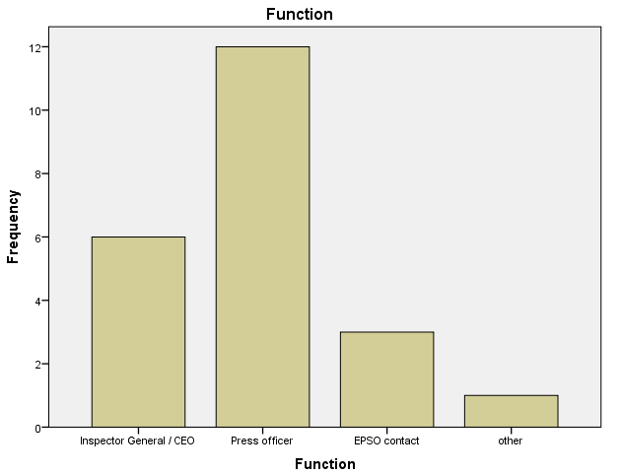
22 Respondents
Country
Belgium
Denmark
England
Estonia
France
Kosovo
Netherlands
Northern Ireland
Norway
Republic of Ireland
Portugal
Sweden

Slide 9
Overall picture
Clear preferences for certain media strategies in countries
The most preferable media strategies are also seen as moral, legal, effective and feasible
Different media strategies between countries
Wat can we learn from international differences?

Slide 10
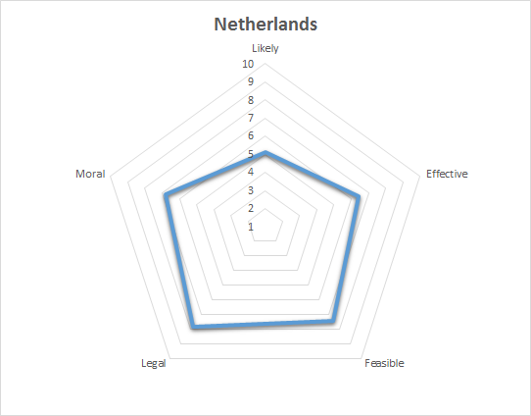
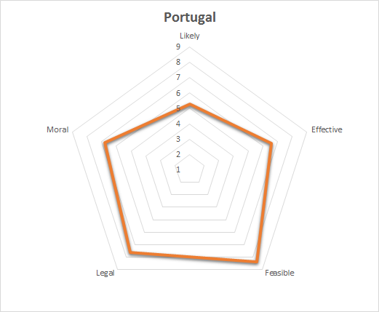
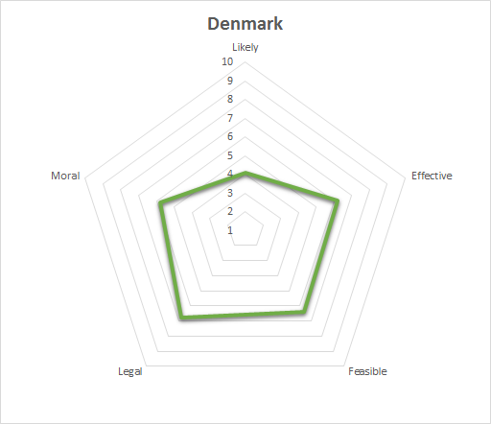
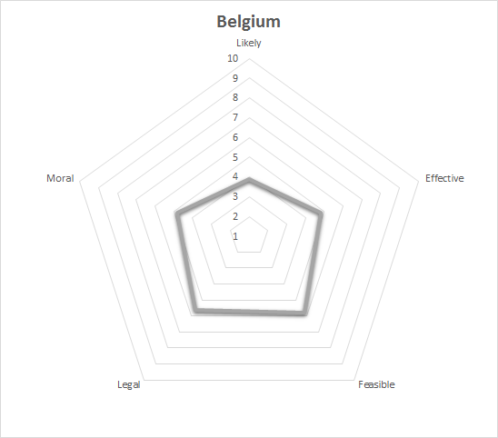

Slide 11
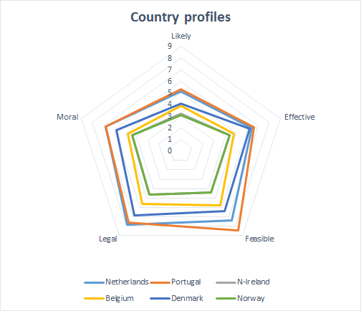

Slide 12
Case 1
Country | Strategic choice
Netherlands | 10
France | 9,5
England | 10
Northern Ireland | 4
Norway | 4
Denmark | 6
Republic of Ireland | 1,5
Belgium | 1,5
Portugal | 8
Estonia | 9
Sweden | 9
Kosovo | 5

Slide 13
Case 1
Your supervisory organization is receiving fewer worrying reports on general practitioner (GP) practices. The supervisory organization has recently completed research on GP practices.
On the website, your supervisory organization could publish anonymous results about the decreasing amount of GP practices who are subjected to tightened supervision. Journalists are often using this website as a source of information for their news items.
Strategic option: Do you use your own website to publish these anonymous results to inform journalists and the public about the improvements in the sector?

Slide 14
Case 2
Country | Strategic choice
Netherlands | 8,5
France | 9,5
England | 10
Northern Ireland | 4
Norway | 4
Denmark | 3,7
Republic of Ireland | 6
Belgium | 3
Portugal | 5
Estonia | 3
Sweden | 1
Kosovo | 8

Slide 15
Case 2
There are no specific complaints or negative sources of information. Your supervisory organization is conducting its regular periodic review of all major hospitals
You receive a request from a television broadcaster wanting to make a program about the work of your inspectors.
Strategic option: Do you collaborate with the program which will show the work of the inspectors inside the hospitals?

Slide 16
Case 3
Country | Strategic choice
Netherlands | 4,5
France | 7,5
England | 1
Northern Ireland | 4
Norway | 4
Denmark | 7
Republic of Ireland | 6
Belgium | 3
Portugal | 9
Estonia | 1
Sweden | 3
Kosovo | 6

Slide 17
Case 3
Your supervisory organization has received alarming information concerning a nursing home. The source of this information is a group of doctors and nurses from the nursing home. Your supervisory organization is planning on performing a critical review of the nursing home.
You find out that a television crew of a program is planning on revealing the ‘scandals’ in the near future, including negative remarks about the alleged failure of supervision exercised by your supervisory organization.
Strategic option: Do you issue a press release about the alarming information you have received concerning the nursing home and about the review you will conduct as a result of these signals?

Slide 18
Looking forward
National context might partially explain different preferences for media strategies.
Similar: Netherlands, France & England
Similar: Norway, Denmark, Northern-Ireland & Republic of Ireland .
Also, choices for media strategies depend mostly on professional preferences, and less on organizational strategy
By sharing insights and experiences from different countries in an open discussion, media management can be further professionalized

Slide 19
Contact details
Jorren Scherpenisse
Netherlands School of Public Administration
Scherpenisse@nsob.nl
Mark van Twist
Netherlands School of Public Administration
twist@nsob.nl

