Slide 1
Health policy and health system changes
in times of crisis: challenges for regulators and supervisors
8 - 9 May 2014 Margarida França

Slide 2
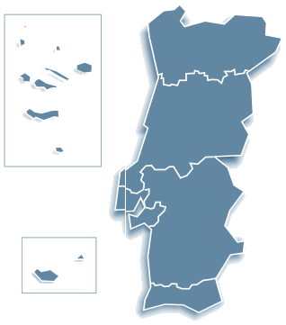
PORTUGAL HEALTH STATUS
Population – 10. 487. 289 (year 2012)
Life expectancy at birth - 79,78
(2010-2012)
Life expectancy at age 65 - 18,84
(2010-2012)
Birth rate – 8,5 (p/ 1000)
Mortality rate – 10,2 (p/ 1000)
Infant mortality – 3,4 (p/1000)
Font: DGS

Slide 3
THE PORTUGUESE HEALTH SYSTEM
Comprises:
. The National Health Service – NHS
. Private providers, both profit and non-profit
. The National Medical Emergency Service – INEM (112 )
. The national Medicines institute - INFARMED
. The Portuguese Blood Institute
. The Institute for Drug Addiction
. The National Institute of Health- national laboratory
. A network of ambulances, both profit and non profit
. A network of community pharmacies
. The Health Regulation Authority - ERS
Madeira and Azores Regions
Autonomous Health Services

Slide 4
THE NATIONAL HEALTH SERVICE
Years 1970-80 - increased financial investment in health with improvements in infrastructures, access to medicines and investment in new technologies
Years 1990 – administrative organization into 5 Regional Health Administrations
Year 2002 - PFIs for new hospitals (4 on 2014)
Year 2005 - Primary care reform launch
Year 2005 - Hospital mergers ( hospital centers)
Year 2006 - Long term care network launch
Year 2009 - New structure of public health services, at local and regional levels
National Health Service created by Law in 1979 network of global health suppliers for all population, in compliance with the Constitutional principles:
“everyone has the right to health protection”,
“universal, general and free national health service”
1989 revision of the Constitution changed the principle of free health care services to:
“tendentiously free” acess to care”

Slide 5
TROIKA Memorandum of Understanding May 17th, 2011
European Stability Mechanism (ESM)
the ESM provides financial assistance to euro area Member States experiencing or threatened by financing difficulties
The Board of Directors of the European Financial Stability Facility (EFSF) approves the last disbursement of €1.2 billion to Portugal following the 11th quarterly review of the macroeconomic adjustment programme on the 24th April 2014

Slide 6
TROIKA Memorandum of Understanding May 17th, 2011
Health Care System objetives:
improve eficiency and effectiveness in the health care system – more rational use of services and control of expenditures
generate aditional savings in the area of pharmaceuticals (reduce to 1.25% of GDP/2012; 1% of GDP/2013 and 2014)
generate additional savings in hospital operating costs
The Memorandum IDENTIFIED specific actions and targets in various health areas!

Slide 7
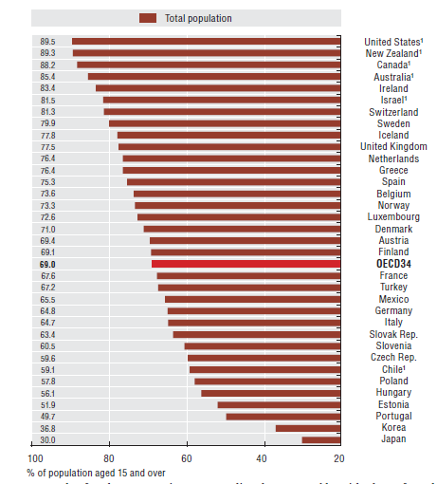
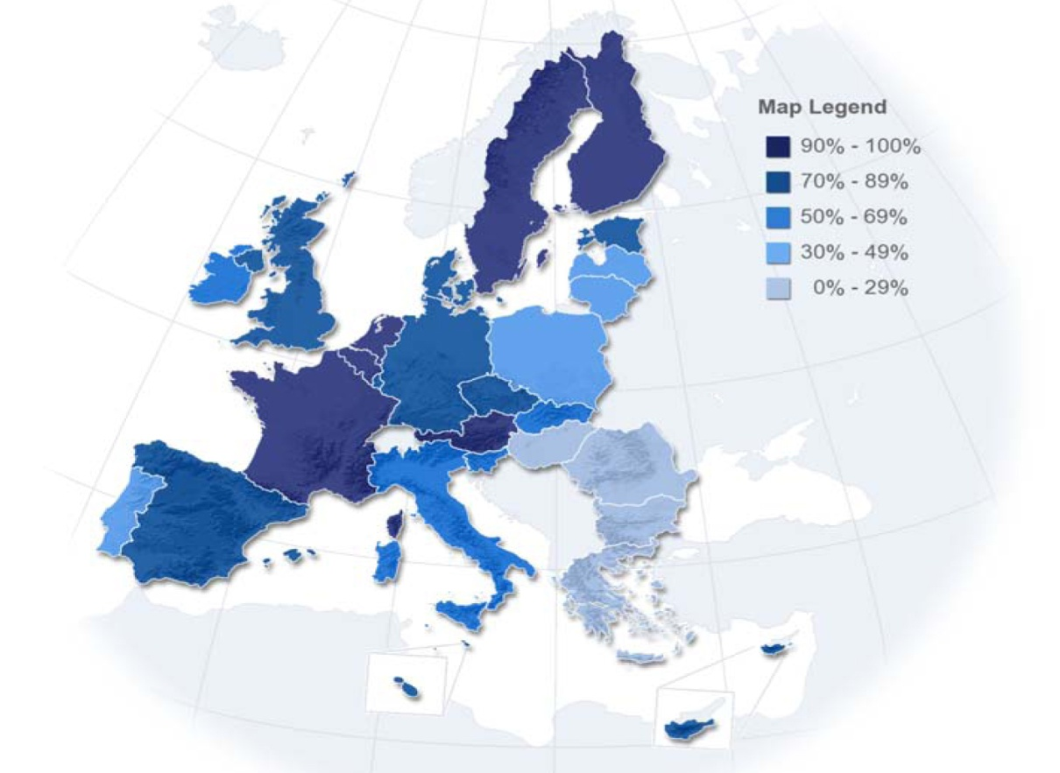
May 17th, 2011
The citizens perspective!
PATIENT SAFETY and QUALITY of HEALTHCARE – April 2010
HEALTH AT A GLANCE 2013: OECD INDICATORS
Percentage of adults reporting to be in good health, 2011

Slide 8
May 17th, 2011
What about the citizen perspective ?
HEALTH AT A GLANCE 2013: OECD INDICATORS
 | Year 2009 | Year 2010 | Year 2011
Total expenditure on health % GDP | 10,8% | 10,8% | 10,2%
Annual growth rate of total expenditure on health, real terms | 2,7% | 1,8% | - 6,7%
Annual growth rate of public expenditure on health, in real terms | 4,7% | 0,9% | - 8%
Out-of-pocket payments (households), % total expenditure on health | 25,9% | 25,8% | 27,3%
Total expenditure on pharmaceuticals and other medical non-durables, % total expenditure on health | 19,4% | 18,5% | 17,9%

Slide 9
EFSF Board of Directors approves final disbursement to Portugal – 24 April 2014
Klaus Regling, CEO of the EFSF said:
“As we approve the final EFSF disbursement to Portugal, I am very pleased to see the country’s achievements under the financial assistance programme. Three years ago Portugal had lost market access. After a painful but necessary economic adjustment the country is now starting to see benefits as imbalances are being corrected and credibility has been regained.”
“The upcoming end of the programme is not the end of the reform process.”

Slide 10
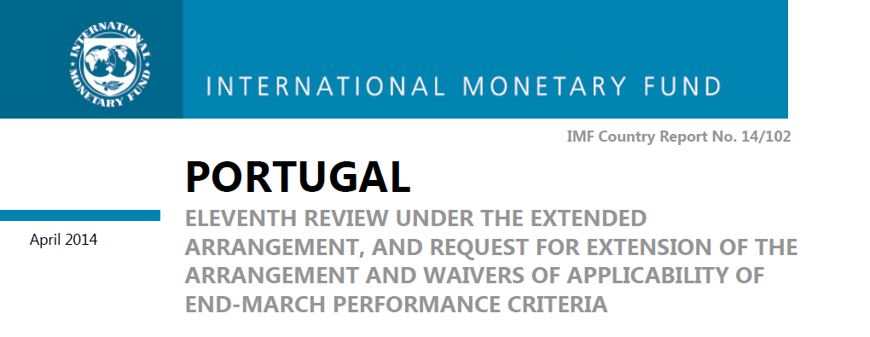
The health sector has already undergone a number of reforms since 2011, resulting in significant savings.
By increasing efficiency and reducing waste, in 2013, expenditure in the National Health Sector is likely to be about 15 percent lower than in 2010 (€1.5 billion in savings). Most cost categories were reduced, while preserving the quality of healthcare with the consolidated deficit of the sector (CG plus SOEs) declining from €833 million in 2010 to an estimated €126 million in 2013.
Despite the commitment control law (CCL) and the progression of the arrears clearance, new arrears continue to accumulate.
Success with the negotiations with pharmaceutical industry, which limited the State’s expenditure to 1% of GDP in 2013. This goal was extended to 2014.
Lastly, in the health sector, operational improvements geared at cost control and efficiency continues to be implemented, as exemplified by the recent publication of the clinical and prescription guidelines.

Slide 11
TROIKA RECOMMENDATIONS FINANCING
UNDERTAKEN ACTIONS
Reviews and increases on 2001 and 2012 years
However non payer patients - 5.729.986
(30.01.2014,Ministry of Health, ACSS)
Increased contribution rates to 3,5%
(starting May 2014) (11th MoU)
National Health Plan 2012-2016
pending approval
To review and increase NHS
moderating taxes
To achieve a self sustainable model
for health-benefits schemes for
civil servants
To produce a health sector strategic
plan consistent with the medium-term
budget framework

Slide 12
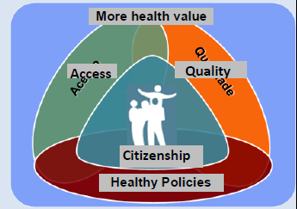
Vision of the National Health Plan
Maximise health gains through the alignment around common goals, the integration of sustained efforts of all sectors of society, and the use of strategies based on citizenship, equity and access, quality and health policies.

Slide 13
Focus on
Increasing the rationality of the Health System … as a crucial response to the economic crisis and guarantee factor for social support and economic development.
On inequalities as a basis for defining potential gains .... reduction of inequities, response to global and specific needs, including socially vulnerable groups.
Establishing itself as a tool to project and disseminate results and innovation.
Promoting Citizenship in Health, Equity and Access to Healthcare, Quality of Care and Healthy Policies.

Slide 14
TROIKA RECOMMENDATIONS Pharmaceuticals
UNDERTAKEN ACTIONS
To revise maximum prices of generics
To revise reference-pricing system to lower
levels (refer to the 3 EU countries with lowest
prices or comparable GDP)
To implement electronic prescription
To implement an assessment system volume
and value/doctor
To induce prescription best price, guidelines
for prescription of drugs and exams and
reinforce barriers to generics
Change profit margins of pharmacies
End of 2012 :
Generics reach ¼ of total expenditure and 35%
of NHS co-participations
Total savings of 190€ million / - 11,7% ( 2011-2012)
Action taken on 2013 :
Addendum to the 2012 Government
Pharmaceutical Industry agreement ( - 122€
million)
Revision of reference prices
Reinforcement the use of generics
Prescription by ICD
End of 2013 :
Reduction expenditure of 4,2% hospital sector

Slide 15
TROIKA RECOMMENDATIONS
UNDERTAKEN ACTIONS
CROSS SERVICES
To conclude the patient medical records system
To reduce costs for patient transportations by one third
CROSS SERVICES
On development across the NHS
New rules by national Law | deep media and social impact
PRIMARY CARE SERVICES
To proceed with the reinforcement of primary care services increasing the number od USF, that is, units contracting with regional authorities on a mixed scheme
To extend the presence of family doctors in needed areas
PRIMARY CARE SERVICES
Increased the number of USF units with new management principles and extend performance assessment to other primary care units
Planned (Feb. 2014. MoU, 10th Update)

Slide 16
TROIKA RECOMMENDATIONS
Hospital Services
UNDERTAKEN ACTIONS
To set up a timetable to clear all arrears (debts past due to 90 days)
New Commitment Control Law and deep scrutiny of compliance by Ministry of Health and Ministry of Finance
To define detailed measures to achieve reductions in the operational costs
Limitations on compensation of hours, reduction of price of working hours, suspension of performance rewards, reduction of salaries, veto to new staff contracts, waste reduction policies ...
To set up a hospital benchmarking indicators system
On development by ACSS with objectives: to understand variation in access, quality and development; to identify improvement areas; to identify “best practices”
Continue the reorganisation of the hospital network - concentration of emergency services, jopint mamnagement and joint operation of hospitals
Mergers of hospitals (specialised and smaller units) and creation of centres and hospital groups (Oncology area)
New hospital organization by Law (April 2014)

Slide 17
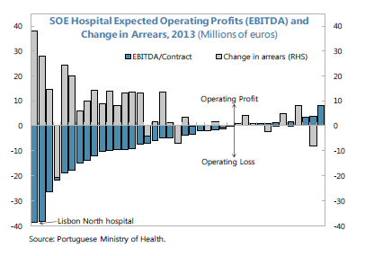
Hospitals exceed production contracted with the NHS
Price paid is lower than the cost of services
Relevance of other operational costs
Identification of 12 hospitals on severe control program

Slide 18
TROIKA RECOMMENDATIONS
Hospital Services
UNDERTAKEN ACTIONS
General Directorate of Health within Protocol with Medical Colleges - more than 100 clinical guidelines on clinical pathways, clinical conditions evaluation, prescription of exams and medication, quality of care, patient safety …
CReSAP creted by Law end 2011 with the Mission of recruit ment and selection of candidates to top Public Administration positions
On development
To define clinical guidelines and set in place na auditing system
To improve selection of hospital board members, based on criteria and more transparent
To ensure full interoperability of hospital IT systems, in order Ministry of Health may have acess to real time date

Slide 19
CRISIS CHALLENGES TO THE HEALTH REGULATOR
External pressure into health system and units
Adverse selection of patients
Capacity of NHS and units
Capability and competency of
human resources
Waiting lists
Quality levels and variations of
care : processes and results
Iniquities among patients
Patient safety and safety events
Access to medication
Access to innovation
Lack of transparency
(governance and social
accountability)
Leadership inconsistency
Lack of programs alignment
Weak sustainability of cost-
reduction actions
Guarantee patient rights
Promote equity and accessibility
Guarantee competition
Identify market failures
Evaluate system effectiveness
Evaluate access cross-border care
Guarantee public accountability
Guarantee providers transparency
Promote patients empowerment
Evaluate system responsiveness
Budgetary constraints
Staff shortages
Lack of materials
Lack of medicines
Quality failures
Safety events
Shortage of medicines
community pharmacies
Innovation limitations
Non-free disclosure of
information to patients
Reduction of units
governance autonomy
Deep Finance & Health
control
Top-Down cost-reduction
directives and programs

Slide 20
CRISIS CHALLENGES TO THE HEALTH REGULATOR
External pressure into patients and families
Efficiency of the health system
Patient safety
Access
Equity
Adhesion to public health programs
Continuity of care across networks
Timeless of care
(timely and coordination of care)
Patients satisfaction
Patients involvement
Difficult access to comparative data
Guarantee patient rights
Guarantee equity and accessibility
Identify market failures
Evaluate access cross-border care
Guarantee public accountability
Guarantee providers transparency
Promote patients empowerment
Evaluate system responsiveness
Economic difficulties from patients: access to care, transport to health units and medication
Social and economic problems with impact on public health: long term impact
Lack of patient involvement

Slide 21
CRISIS CHALLENGES TO THE HEALTH REGULATOR
But , the River Moved ...
from “The Bridge to Nowhere”
“ ... But we need new bridges ...
Political discourse does not yet know what we in the improvement world
hold and share as central: customer focus, joy in work; that all improvement
is change, though not all change is improvement; how to learn by testing
changes.
Far too few political leaders really understand that better quality is the best
road to lower cost.”
Donald M. Berwick, “Promising Care. How We Can Rescue Health Care bt Improving It”, Jossey – Bass, 2014

Slide 22
Thank you for your best attention!
Margarida França
Portuguese Society for Quality in Health Care
spqs.mail@gmail.com

