Slide 1
Organization of Norwegian Board of Health Supervision
Einar Hovlid

Slide 2
The Norwegian Board of Health Supervision is a national public institution organized under four different ministries.
It is mandated by the Norwegian Parliament to ensure that services regarding health care, social care and child welfare are provided in accordance with legal requirements.

Slide 3
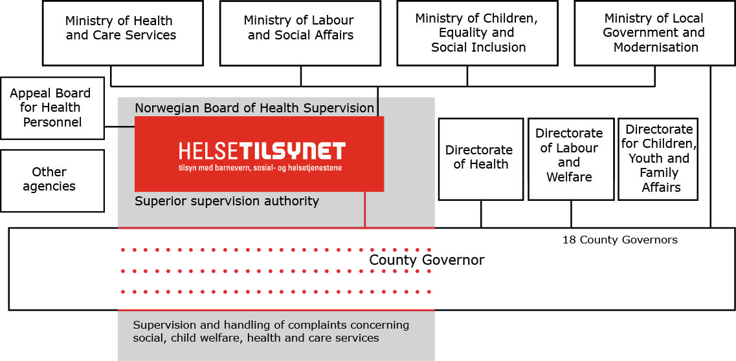
Notes:
Ta inn endring i 2002 reindyrking av tilsynsfunksjon
Direktorate policy execution.

Slide 4
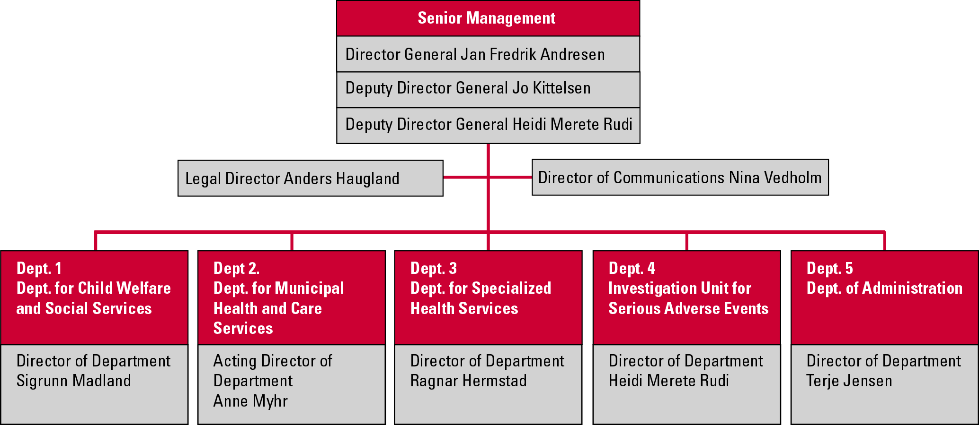
Norwegian Board of Health Supervision
Statens helsetilsyn
Organisation, October 2015

Slide 5
Main tasks
the superior supervision authority shall lay down requirements for:
  the supervision carried out by the Offices of the County Governors to monitor whether services meet the statutory requirements
  how complaints regarding the right to receive services are dealt with
deal with individual cases concerning serious deficiencies in services, in which administrative reactions against the services or against health personnel may be appropriate
monitor provision of services, in relation to the population’s needs and the community’s requirements for services
inform the government administration, the services and the public about the results of supervision

Slide 6
Recent changes - 2013
Change in department structure
  From: Planned inspections and incident investigation
  To: Municipality and specialized care
Advantage
  More holistic approach to the services

Slide 7
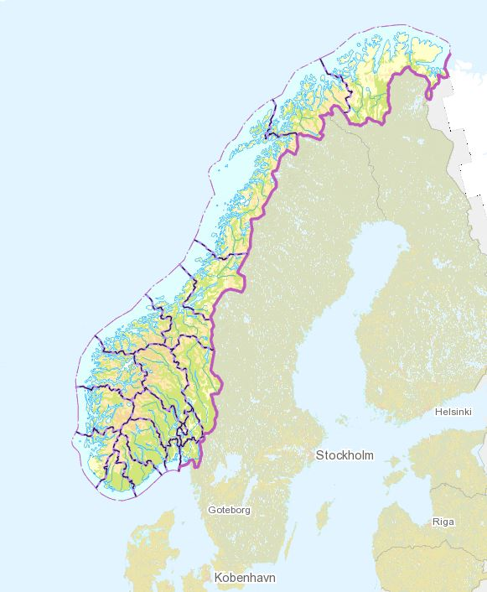
18 county governors
Source: Kartverket
Notes:
Få fram at Norge er eit langstrakt land med lange reiseavstandar. Mange sjukehus og kommunar.

Slide 8
County governors – main tasks
Supervision
Policy execution on regional level
Guidance to the services

Slide 9
County governors - challanges
  Proximity and context knowledge about the services
  versus
  Standardized practice in how supervision activities are performed
  Adequate competance
  Combining different roles

Slide 10
Individual cases
Complaints from patients the main source for individual cases handled by the supervision authority
Number of cases has doubled over the recent years
Patient have been granted rights as a party in these cases
Increasing expectation to the thoroughness of investigation in each case
No more resources

