Slide 1
Scrutiny and Assurance: safe and sound?
Jan Warner

Slide 2
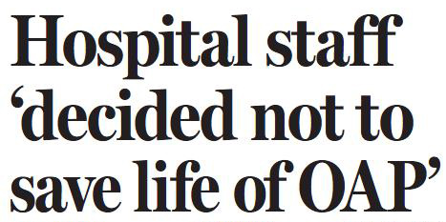
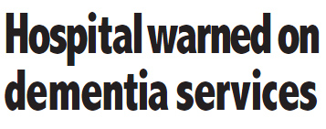
NHS Lothian report reveals 'bullying culture' and 'atmosphere of fear'
Sirens sound for ambulance service
Investigation into NHS Lothian after claims they ‘manipulated’ waiting times

Slide 3
MEDIA

Slide 5
Quotes….
‘The systems for inspection and regulation we have in Scotland can broadly be judged as acting reasonably in the interests of those using public services’ ‘
‘Take the case of the health service watchdog, Healthcare Improvement Scotland. This is a body that looks dispassionately and thoroughly at our hospitals to check they meet the standards patients and their relatives are right to demand’

Slide 6
Quotes….
‘Most NHS staff who care about the standards in our hospitals welcome the rigour which regular inspections bring...’
‘When we see the improvements in standards that ensue from inspection, the benefits of watchdogs – with teeth which can bite – cannot reasonably be questioned’

Slide 7
Dimensions….
48 staff in scrutiny and assurance
Spend around £1.9m on scrutiny and assurance as a function (11.7% of core allocation)
Over 100 announced/unannounced HAI inspections since 2009
9 announced/unannounced older people inspections so far
32 + independent healthcare providers

Slide 8
SCRUTINY AND ASSURANCE OPERATING FRAMEWORK….
Duty to explain
why we are undertaking scrutiny and assurance in priority areas
What behaviours and values underpin our scrutiny activity
How we will demonstrate added value and give assurance re the quality of services

Slide 9
Existing and emergent priorities….
Care of older people in acute hospitals
Healthcare associated infection (HEI work)
Prisoner healthcare
Independent healthcare services (regulation)
Independent healthcare services (inspection)
Improving learning from adverse events
Maternal health
Joint inspection of children’s services in local authorities
Joint inspection of adult services in local authorities
Medical revalidation
Suicide reporting system
Human tissue bank accreditation
Ionising radiation (medical exposure) inspection
Death certification
Improving the quality of diagnostic and imaging services
Supporting good governance
Scottish screening programmes

Slide 10
Our goals
There will be increasing confidence and reliance on our reports – patients and staff
We will have a shared understanding of the links between scrutiny and improvement but also in a way that doesn’t diminish our voice to appropriately challenge
By virtue of our delivery, we will be asked to do more – an even ‘greater licence to operate’ – capability and capacity

Slide 11
DISCUSSION…..
What does a highly reliable scrutiny and assurance function look like?
How do we further build on collaborative partnership working without compromising on our ‘regulatory’/scrutiny requirements?
With media interest, how do we ensure scrutiny does not ‘crowd out’ our improvement activities?

